Slide 1
Opportunities for Invasive Species Management in Calvert County
Mara Cunningham
Government Relations Manager, NAISMA

Slide 2
Terminology
Native
a species that originated and developed in its current habitat
Non-Native/Exotic
a species that originated somewhere other than its current habitat (can be invasive or benign)
Invasive
a non-native species of plant or animal that outcompetes native species in its current habitat
Endangered/Vulnerable/Threatened – not what we’re talking about
Not all non-native species are invasive! But all invasive species are non-native

Slide 3
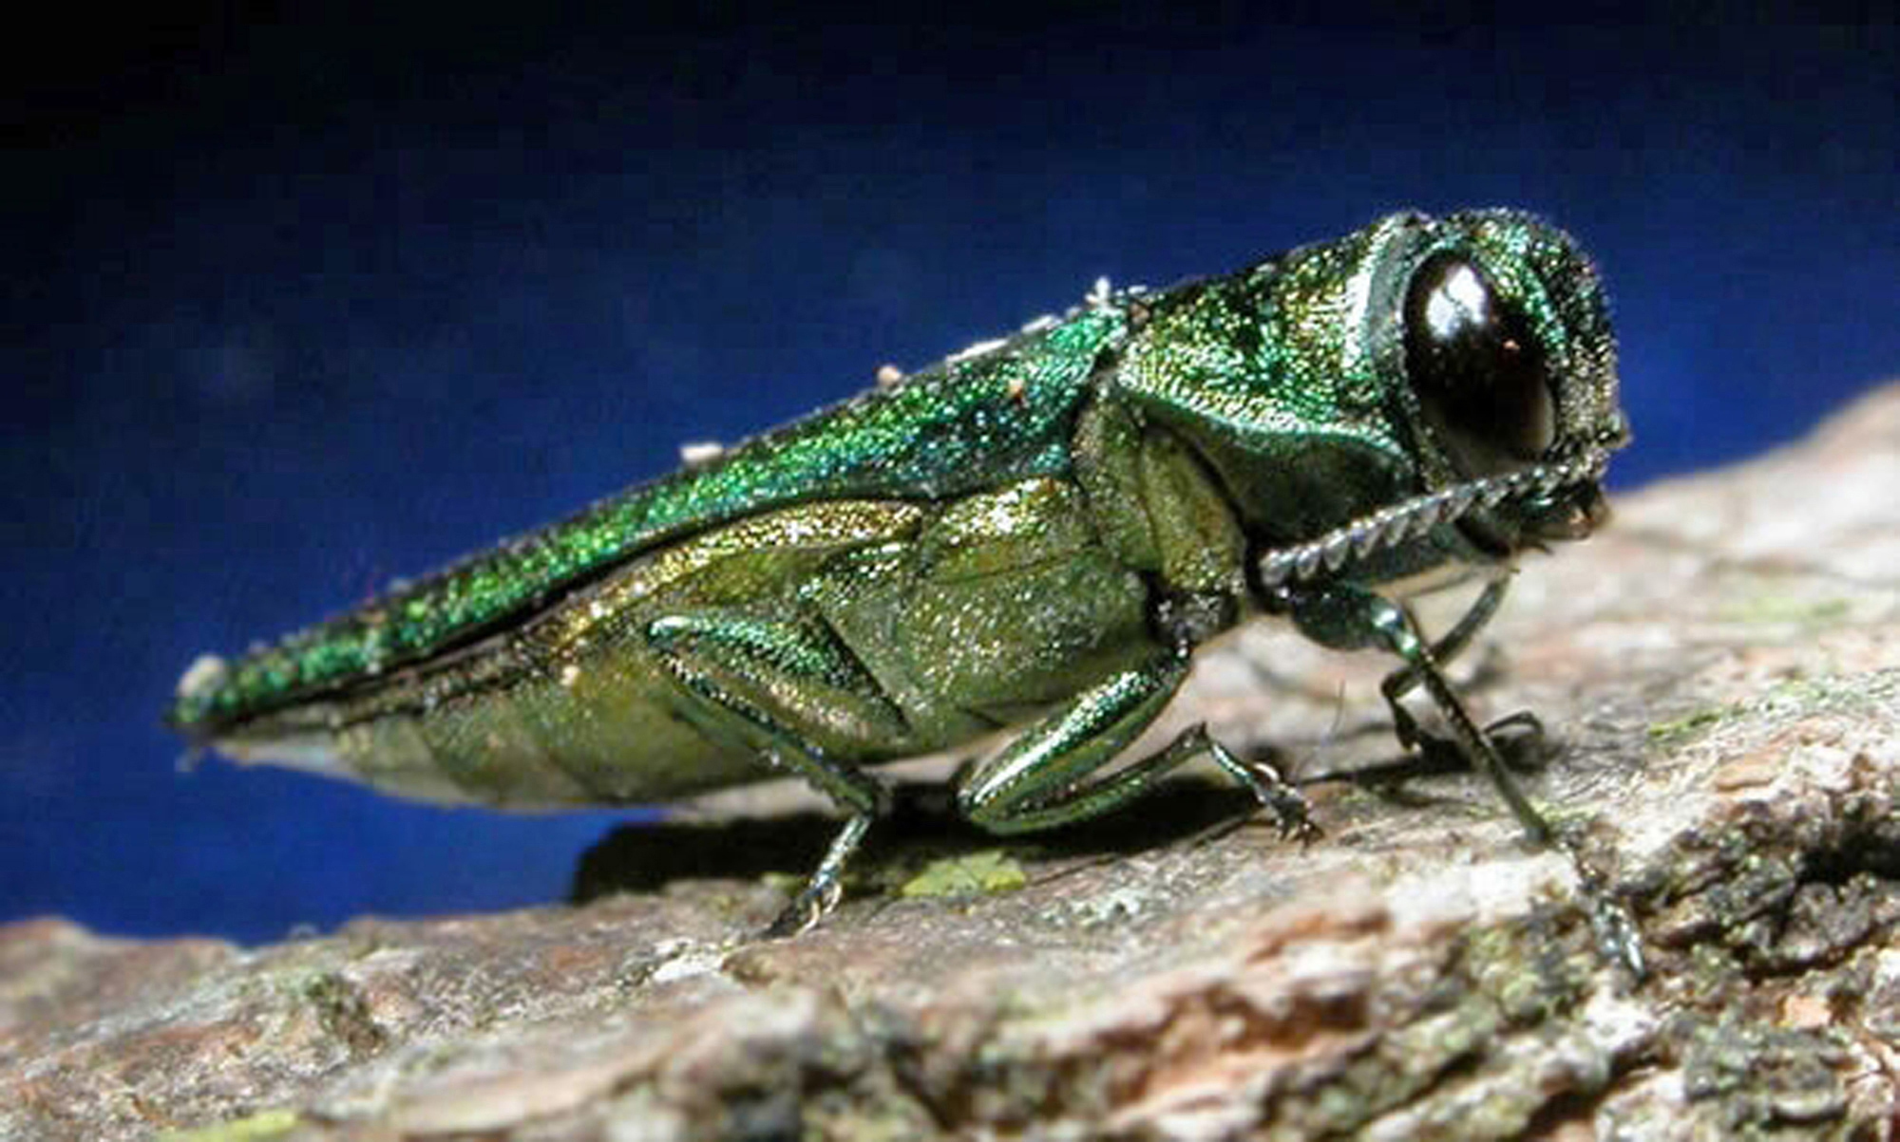
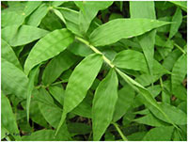
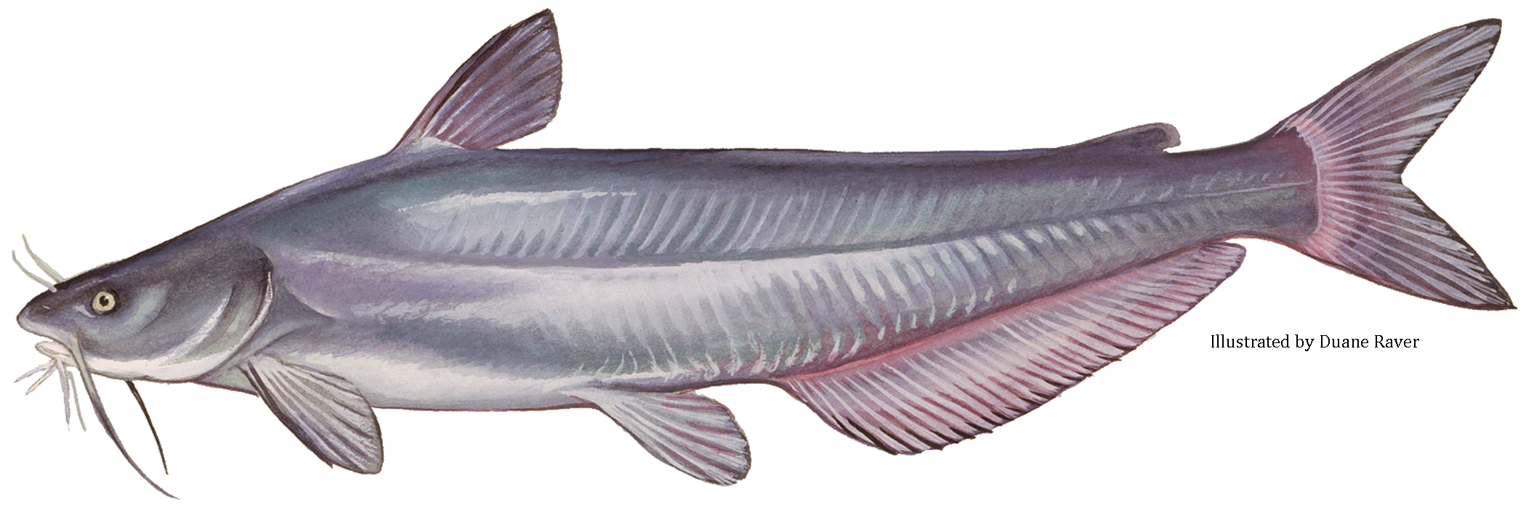
Common Invasives in Calvert County
Phragmites (common reed)
Kudzu
Oriental Bittersweet
Wavyleaf Basket Grass
Spotted Lanternfly
Emerald Ash Borer
Northern Snakehead
Blue Catfish

Slide 4
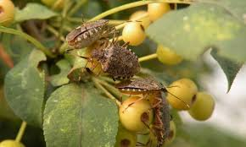
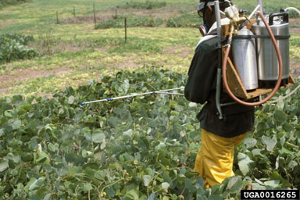
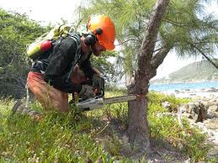
Control Methods
Chemical
Uses herbicides, insecticides, fungicides, and rodenticides to kill or inhibit growth of invasives
Biological
Uses natural enemies like predators, parasites, and pathogens to control invasives
Mechanical
Uses physical removal of invasive plants and animals, i.e. hunting, fishing, hand-pulling, mowing, etc.
Early Detection Rapid Response
(EDRR)

Slide 5

About NAISMA
North American Invasive Species Management Association
Empower invasive species management in North America
Board of Directors made up of academics
and nonprofit professionals in field of
invasives to consult on programs and
legislation
Weed Free Products Program &
Play Clean Go Campaign

Slide 6
Opportunities for Initiatives
ACLT/Southern Maryland Conservation Alliance (SMCA)
  Play Clean Go, weed-pulling groups
Weed Free Products
Home plant standards
Updating Calvert County Invasives FAQs
MD DNR Forestry Initiative (Amalia)

Slide 7
Questions? Ideas?

