Slide 1
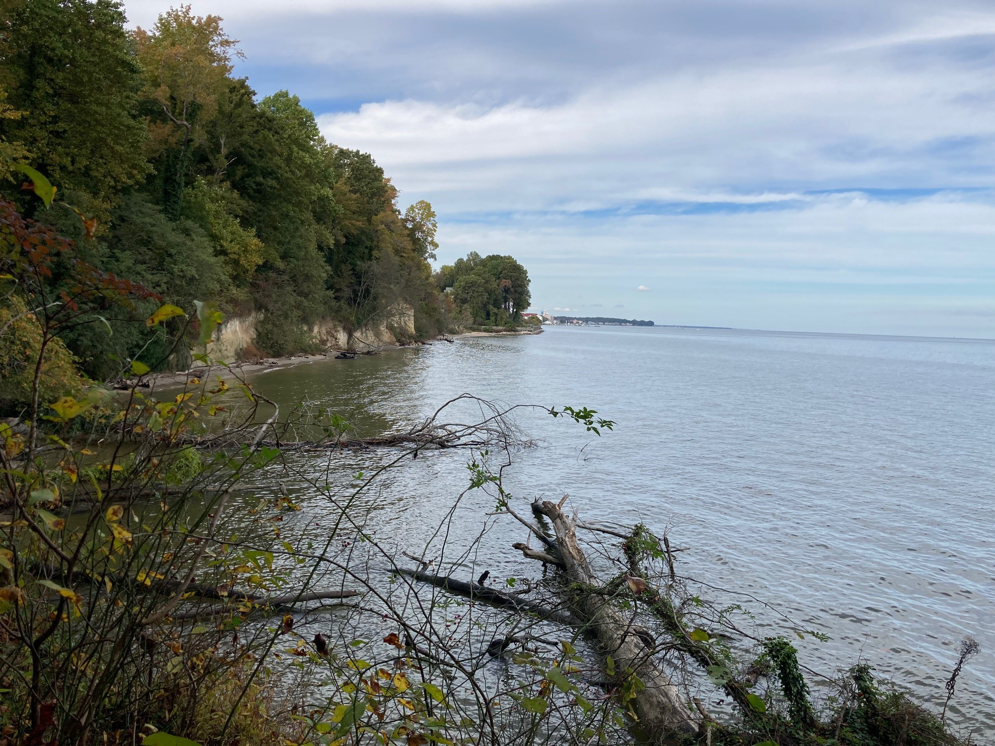
Southern Maryland National Heritage Area
Opportunities for Environmental Conservation
Christopher Sperling
Historic Preservation Planner
Calvert Environmental Commission
May 20, 2024

Slide 2
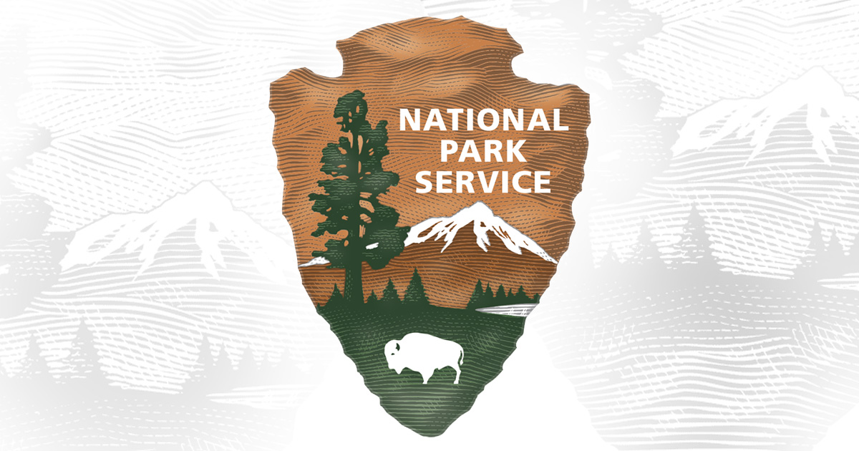
What is a National Heritage Area?
National Heritage Areas preserve and protect historic and cultural resources by engaging the public through a variety of educational programs. NHAs work to reach new and diverse audiences, share meaningful stories, and connect residents, teachers, and students to history in their own backyards. Since National Heritage Areas need to match federal funding, they work with their partners to connect students and educators with natural and cultural resources as well as fostering civic engagement to strengthen the public understanding and relevance of heritage sites.

Slide 3

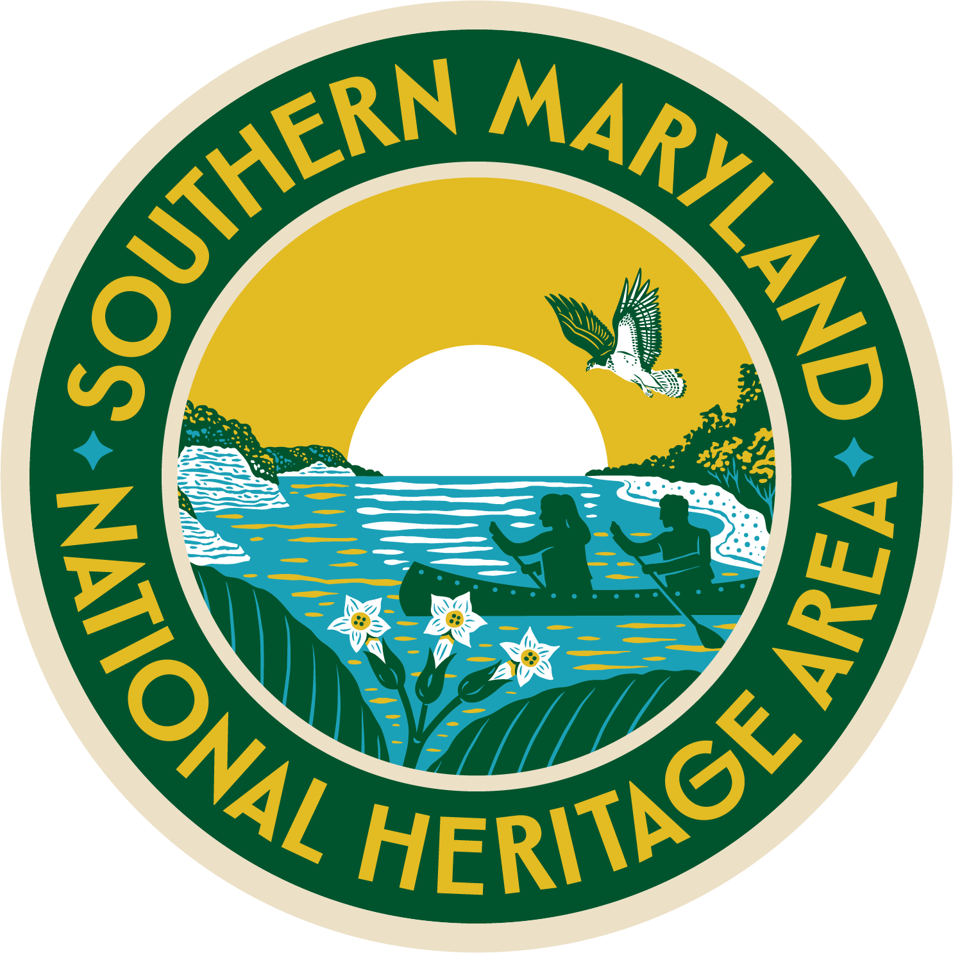
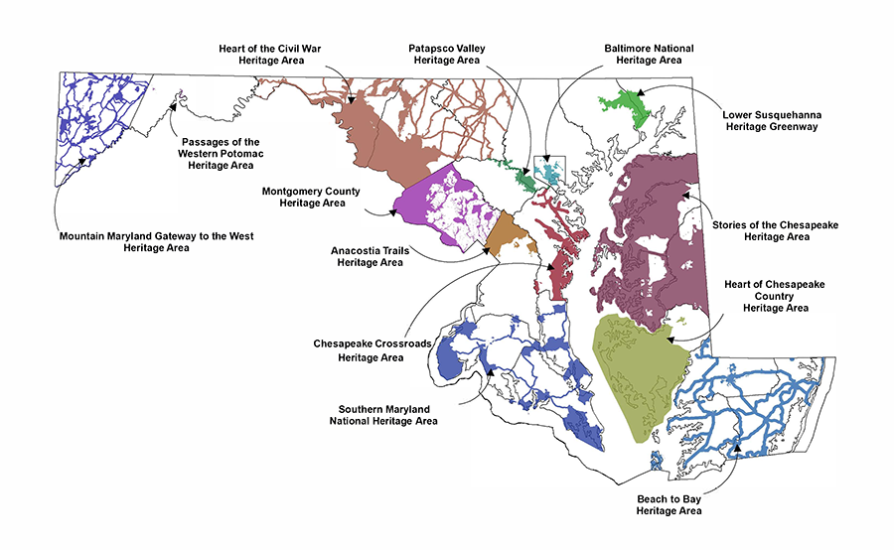
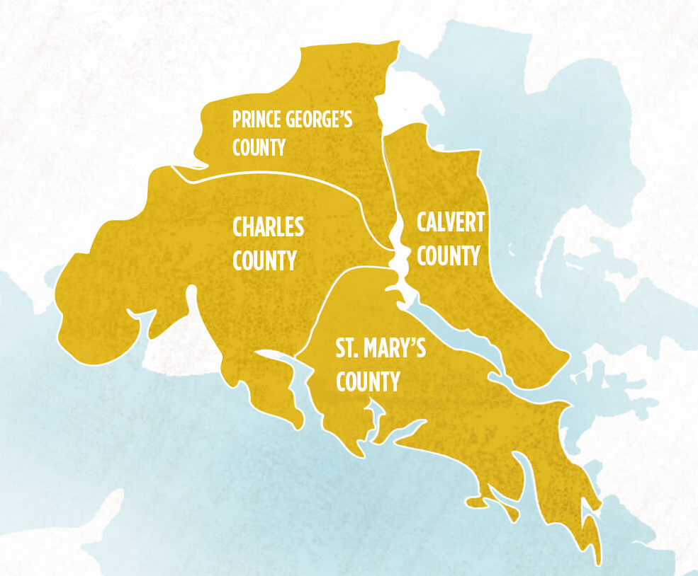
Maryland Heritage Areas
Southern Maryland
National Heritage Area

Slide 4
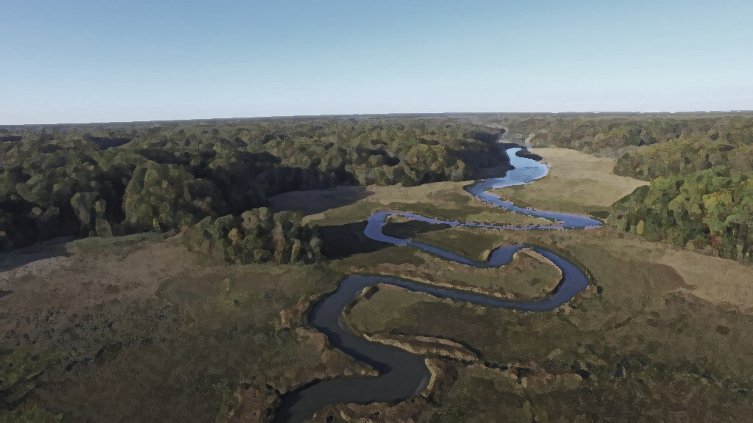
Southern Maryland National Heritage Area
MISSION STATEMENT
Our mission is to enhance Southern Maryland through innovative heritage tourism experiences, comprehensive cultural and natural resource conservation, and excellence in educational opportunities. SMNHA is also an economic engine, providing product development and increased economic activity throughout the region through grants, partnership building, and sustaining regional identity.
– Lucille Walker, Executive Director
Preservation of Cultural and Natural Resources
Promotion of Heritage Tourism and Economic Development
Education and Interpretation
Community Engagement and Collaboration
Conservation and Environmental Stewardship
Cultural Diversity and Inclusivity
Heritage Planning and Management
Promotion of Volunteerism and Civic Engagement

Slide 5
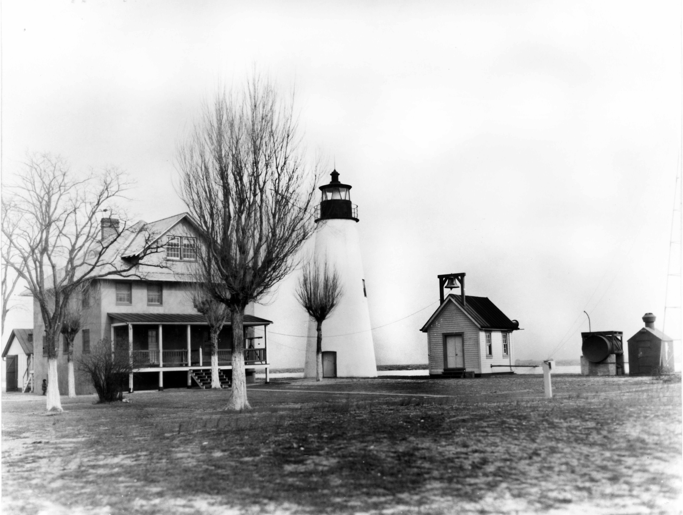
Southern Maryland National Heritage Area
Contained within Calvert, Charles, St. Mary’s, and southern Prince George’s counties, the Southern Maryland National Heritage Area brings federal, state, and private resources to promote heritage tourism, conserve natural landscapes, and enhance the local economy.

Slide 6
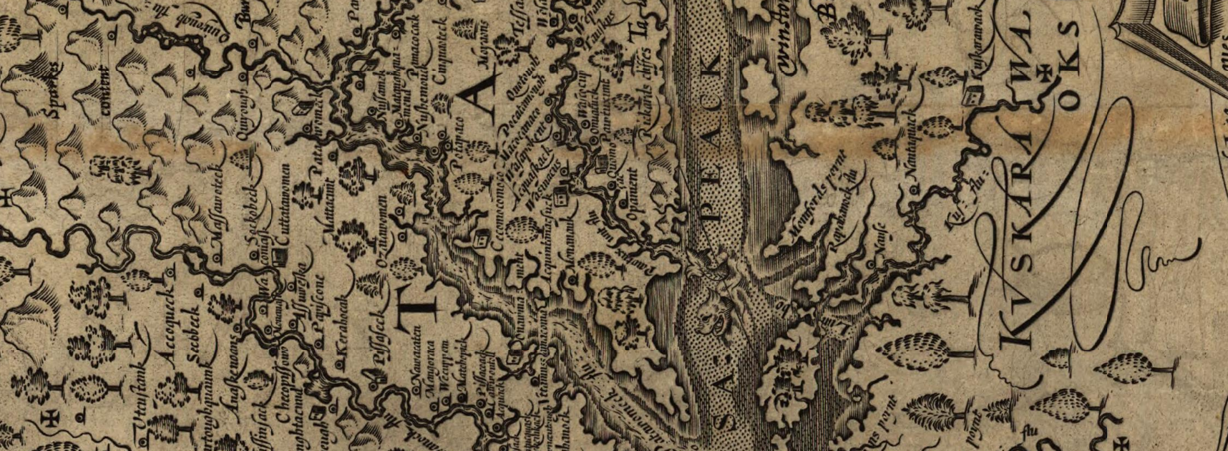
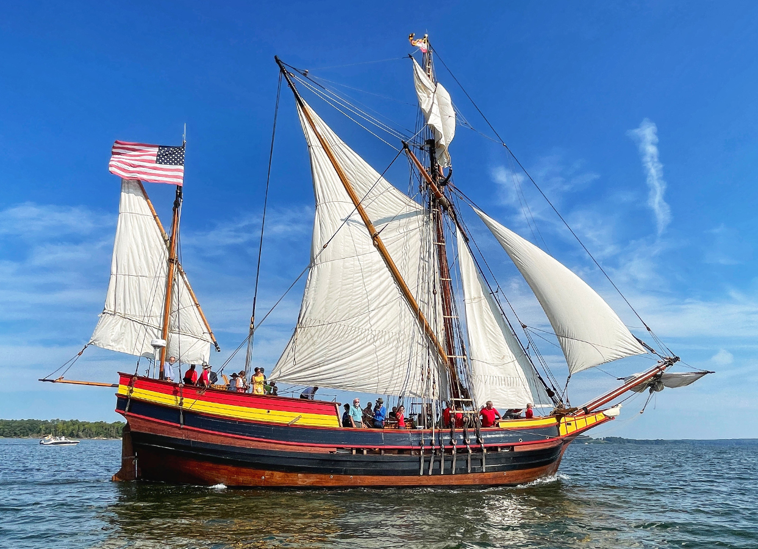
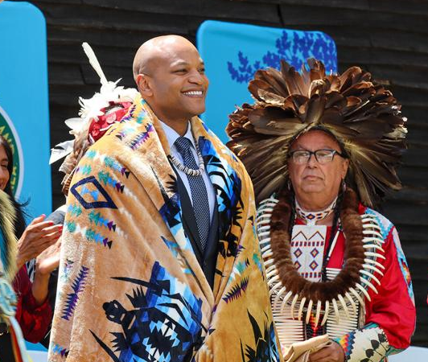
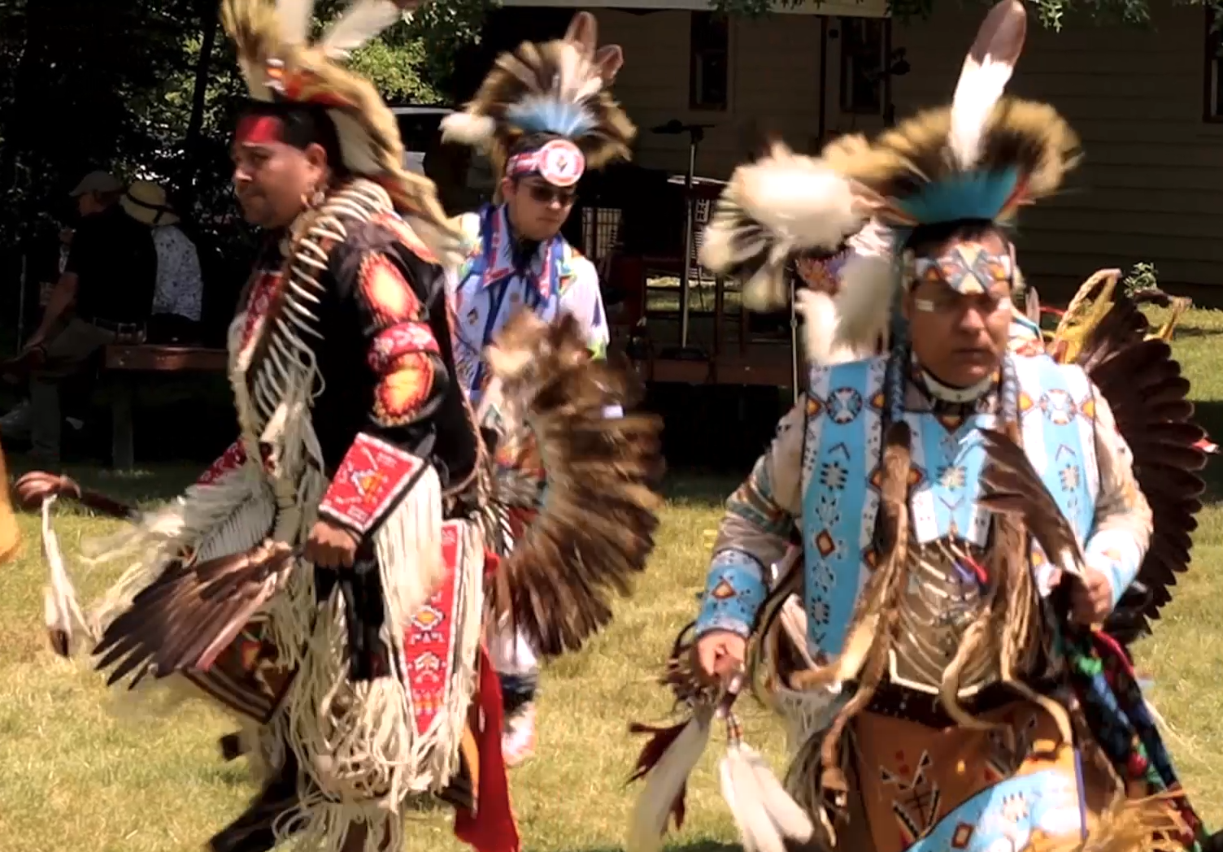
Southern Maryland National Heritage Area

Slide 7
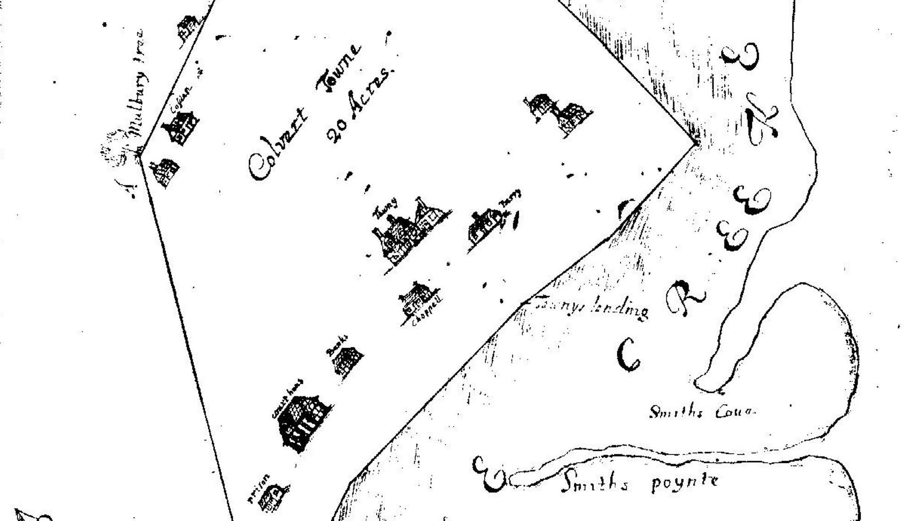
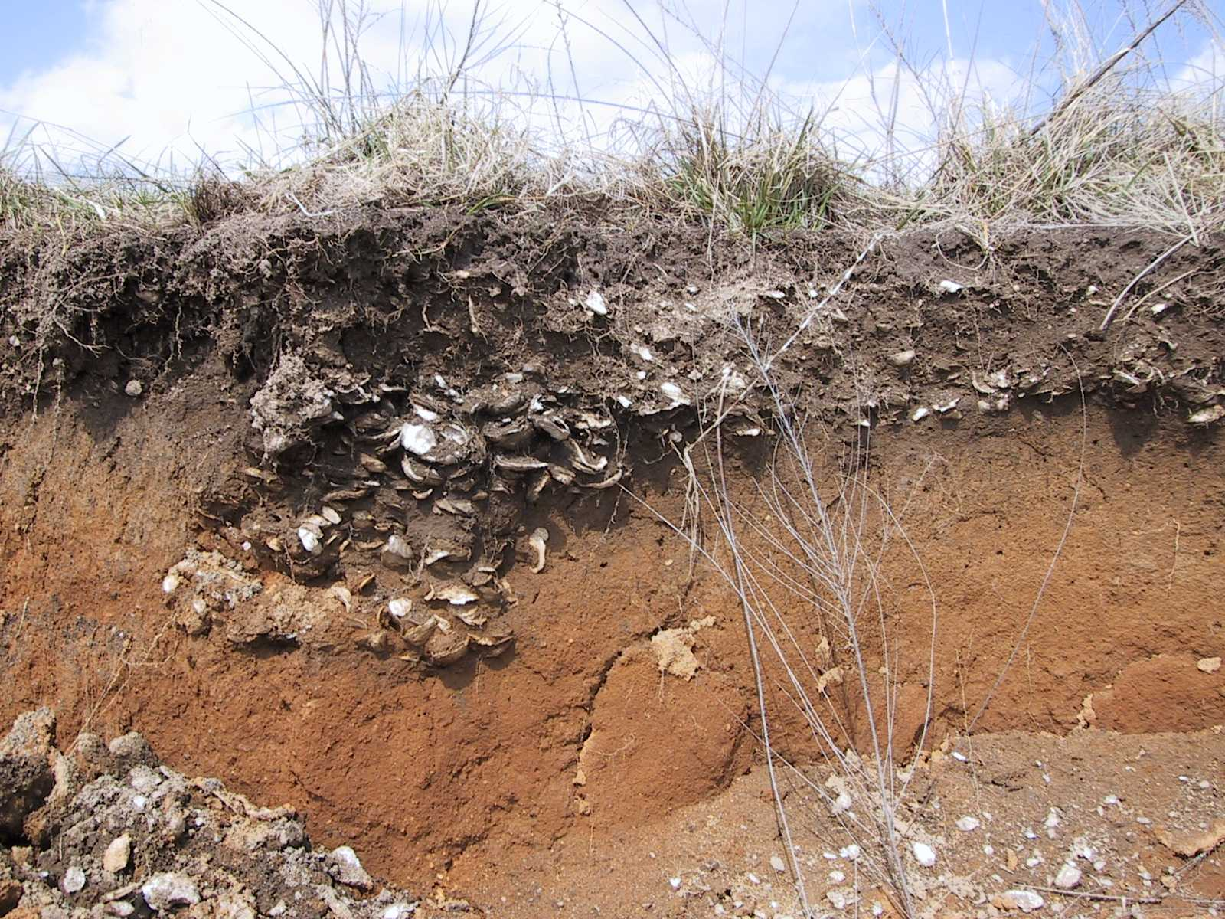
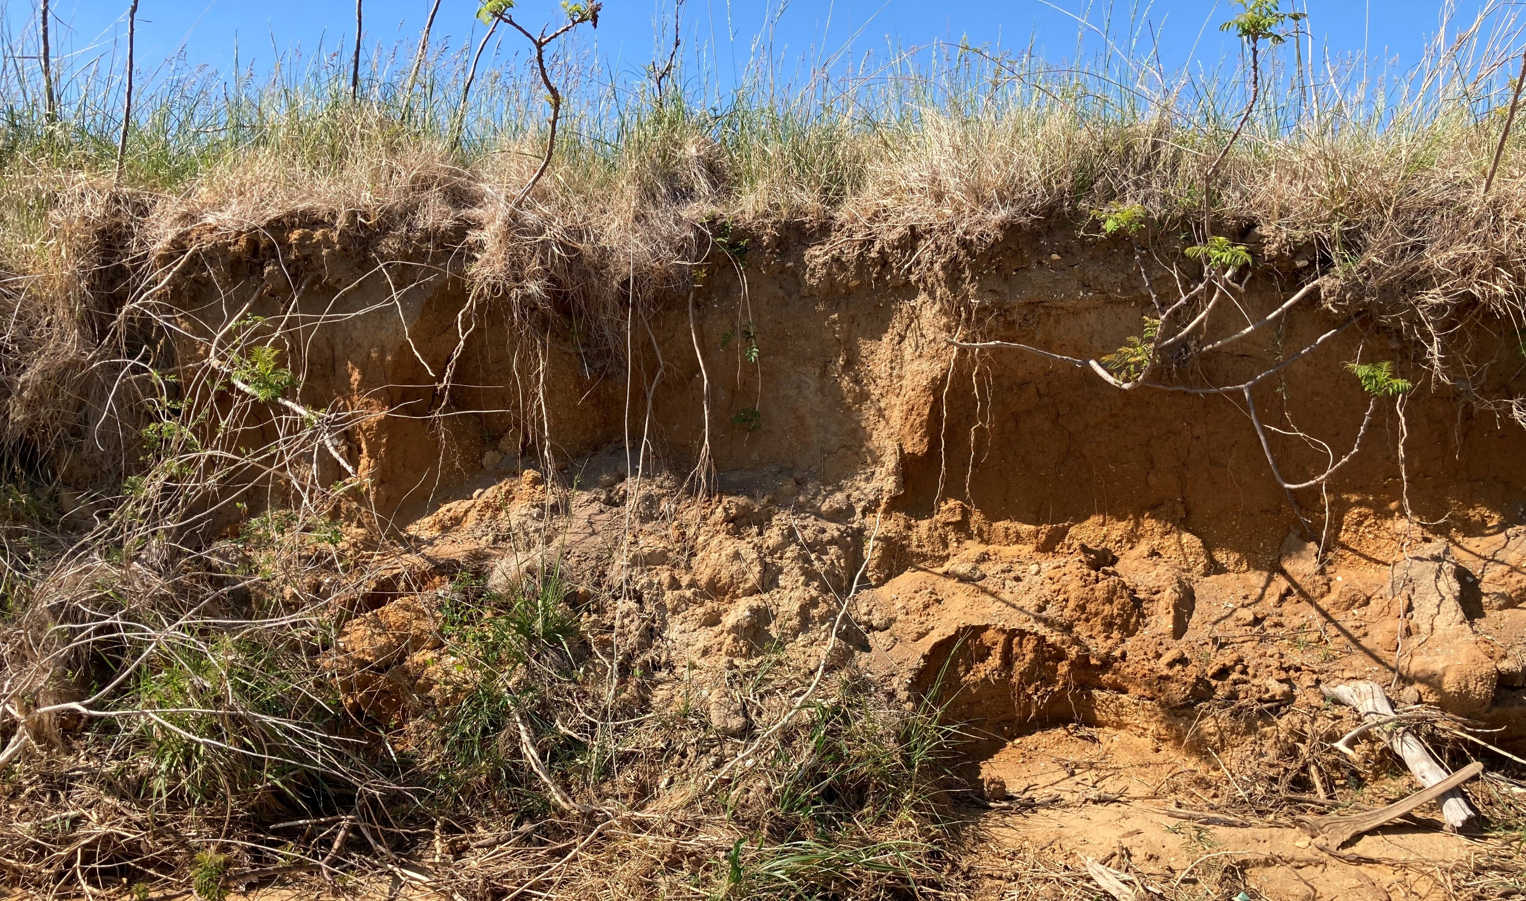
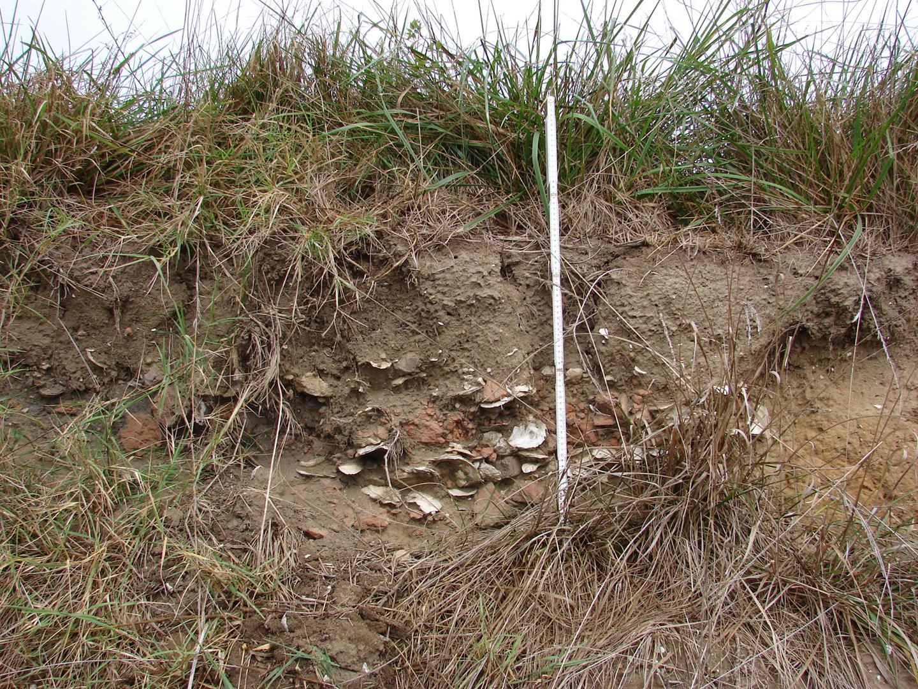
Southern Maryland National Heritage Area

Slide 8
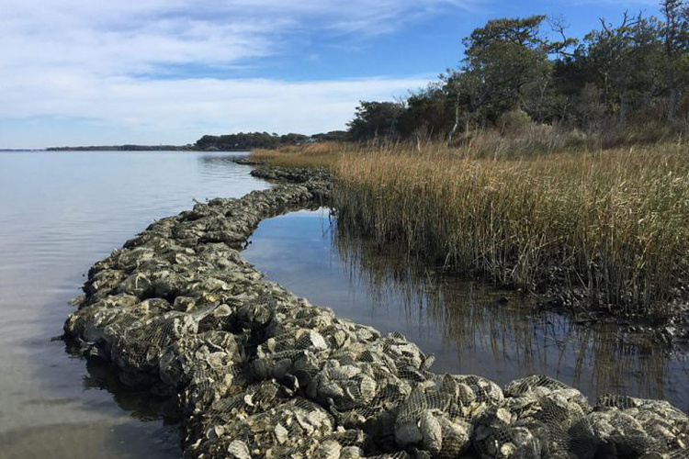
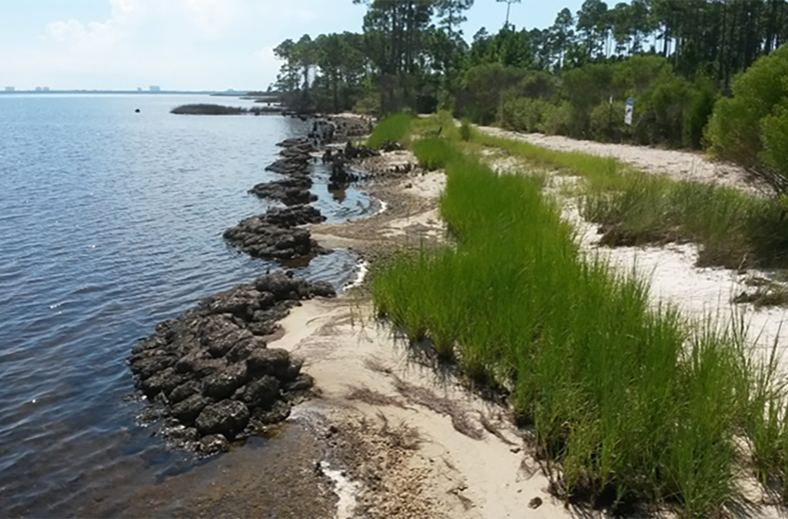
Southern Maryland National Heritage Area
Notes:
Calvert is a location defined by water, the Chesapeake Bay to the east, the Patuxent River to the west, and tributaries of each in between. Because of this, we are particularly vulnerable to the effects of climate change. Some of the most threatened resources reflect the lives of historically marginalized and under-represented communities.

Slide 9
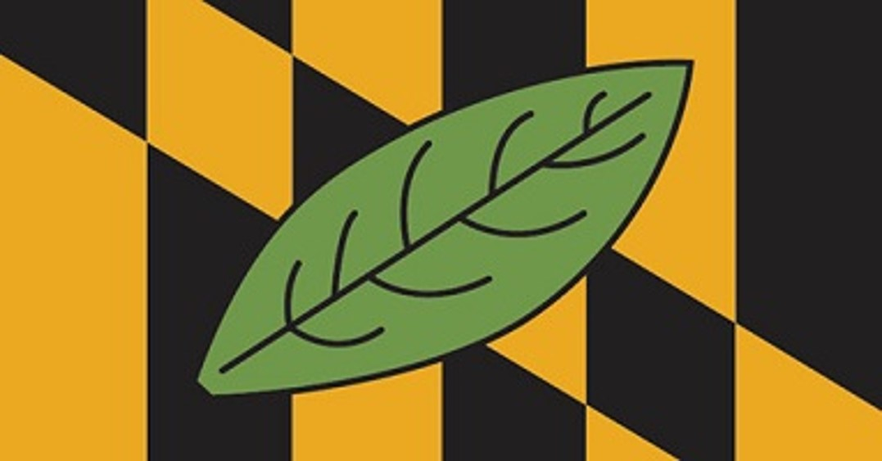
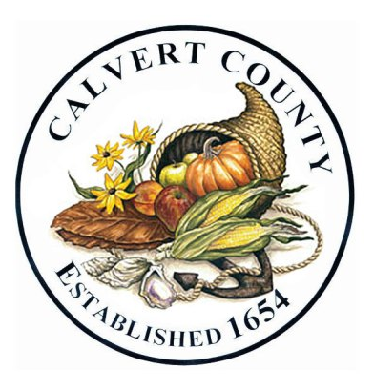
Thank You!!!
Christopher Sperling
Historic Preservation Planner
Calvert County, Maryland
Christopher.Sperling@CalvertCountyMD.gov
410-535-1600 (x2504)
Notes:
Calvert is a location defined by water, the Chesapeake Bay to the east, the Patuxent River to the west, and tributaries of each in between. Because of this, we are particularly vulnerable to the effects of climate change. Some of the most threatened resources reflect the lives of historically marginalized and under-represented communities.

