Slide 1

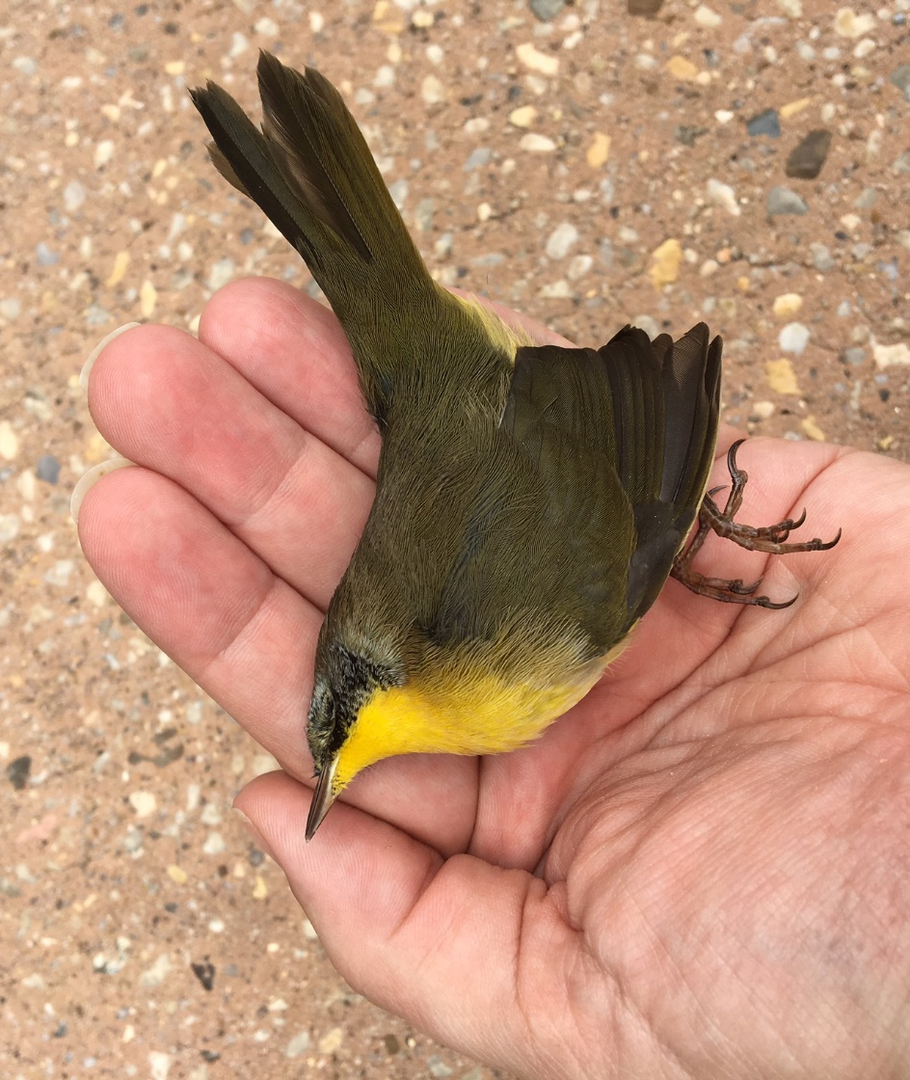
1 Billion Birds Are Lost Annually In Collisions with Building Glass
AERIAL HABITAT NEEDS CONSERVATION TOO

Slide 2
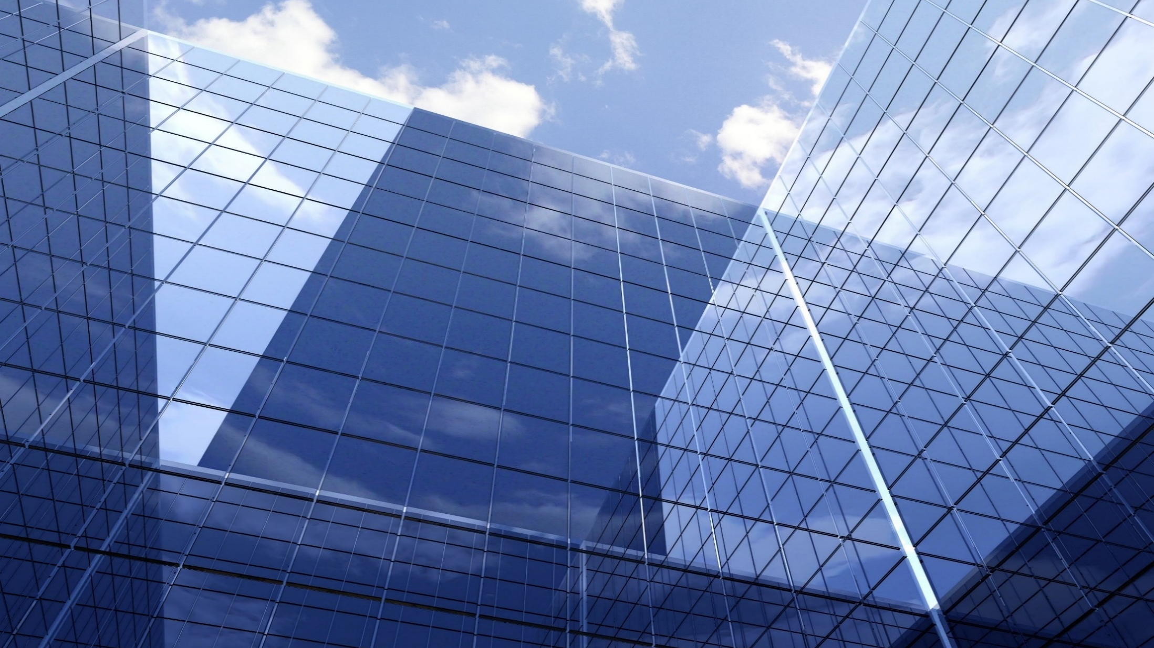
Because we have this:

Slide 3
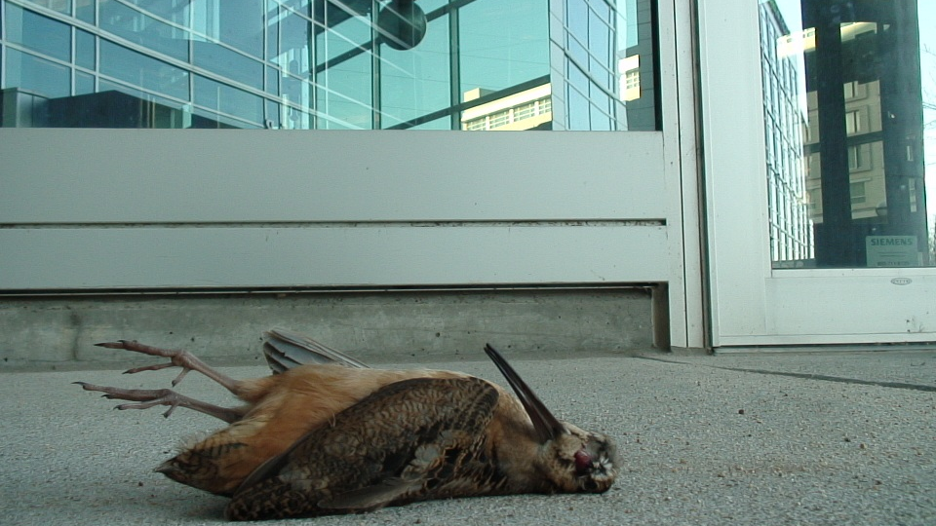
We have this:

Slide 4
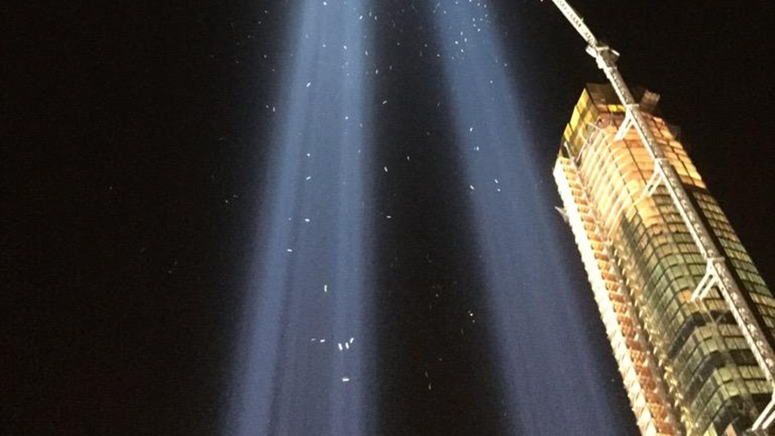
Artificial Nighttime Lighting Attracts Migrants
Plus this:

Slide 5
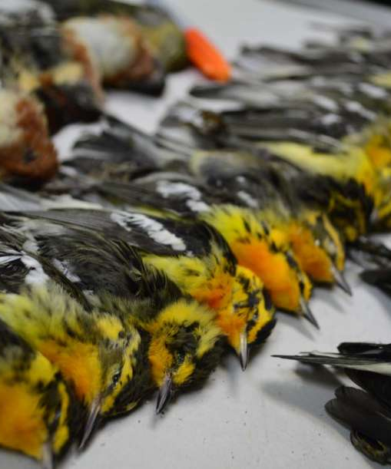
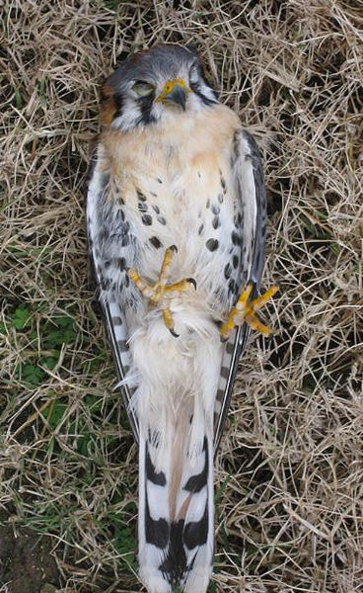
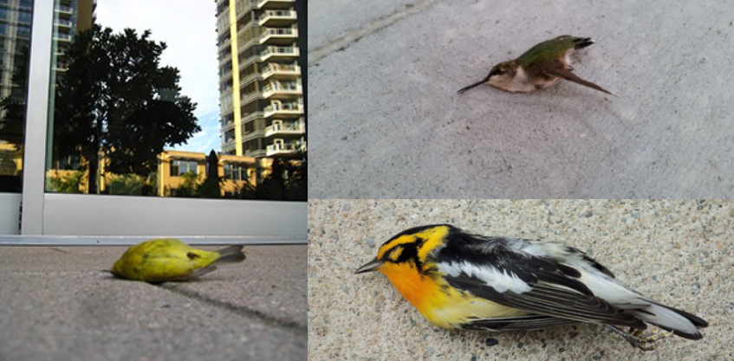
Even the Strongest Die
Migratory birds – long range neotropical migrants are hardest hit
No birds are safe – all species from hummingbirds to raptors die
Healthy birds – even most fit in body weight score and breeding condition
No chance to reproduce – Lost prior to completing spring migration
Fledgling birds – highest deaths during fall migration
Iconic birds of Maryland – Baltimore oriole is among steepest declines

Slide 6
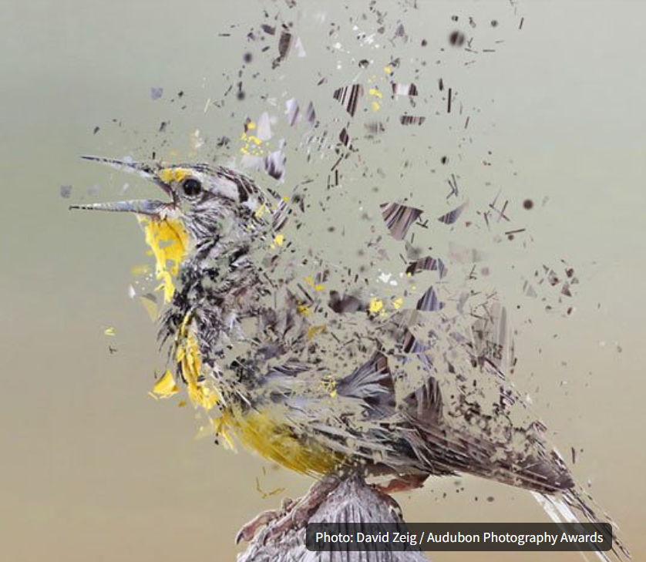
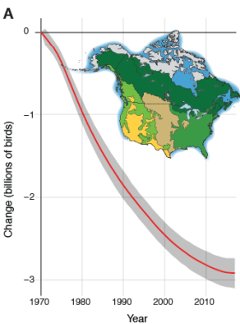
29% Fewer Birds in United States than in 1970
Rosenberg et al. 2019 Science

Slide 7
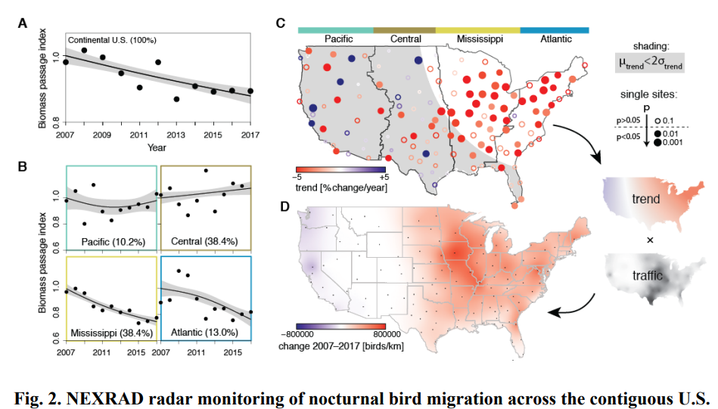
Decline of the North American Avifauna
Authors: Kenneth V. Rosenberg1,2*, Adriaan M. Dokter1 , Peter J. Blancher3 , John R. Sauer4 , Adam C. Smith5 , Paul A. Smith3 , Jessica C. Stanton6 , Arvind Panjabi7 , Laura Helft1 , Michael Parr2 , Peter P. Marra8,9

Slide 8
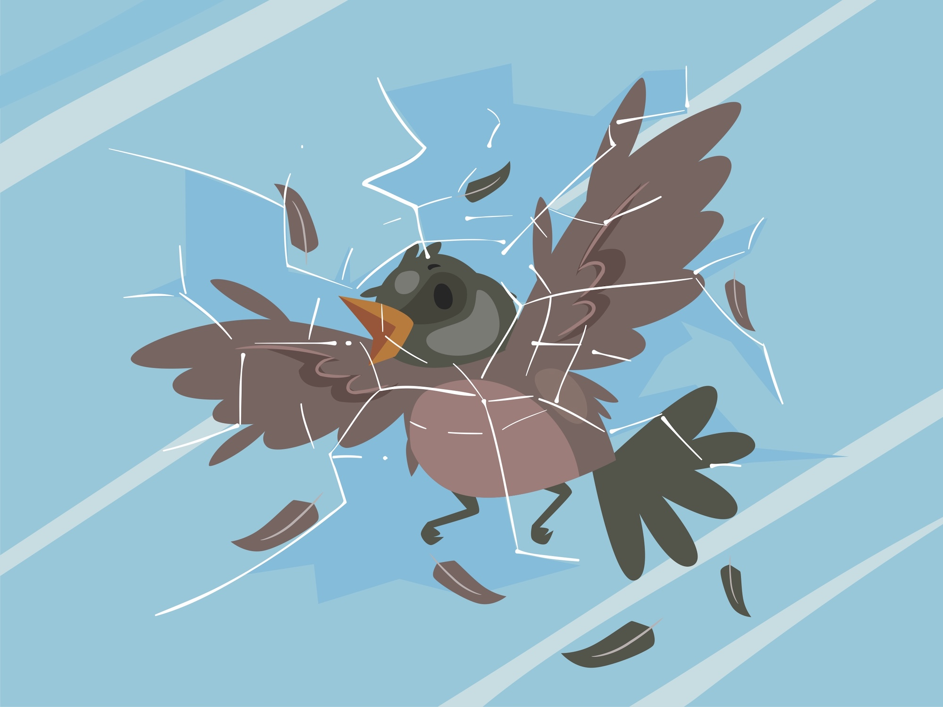
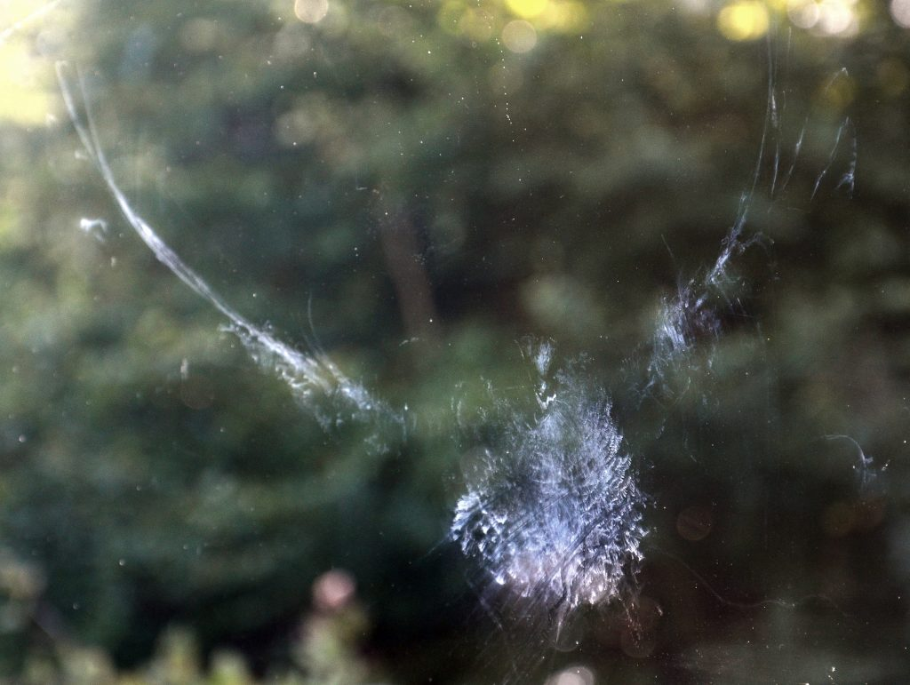
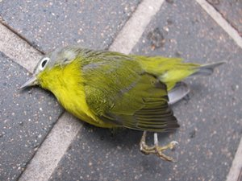
Birds Can’t See Glass
They see blue sky reflected in the glass
They see habitat reflected in the glass
They see through the glass to habitat inside the building
When two windows line up, they see through to blue sky or habitat and try to fly through
Notes:
Every species of bird is susceptible to collisions with windows – resident and migratory
Annual photos of collected birds from small routes help people to visualize the cumulative effect

Slide 9
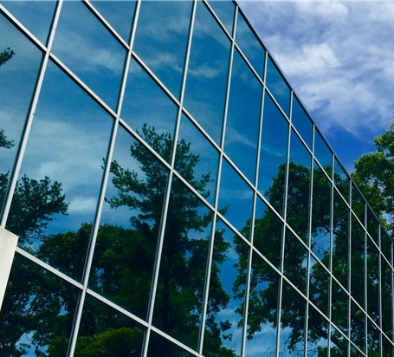
Reflected Habitat

Slide 10
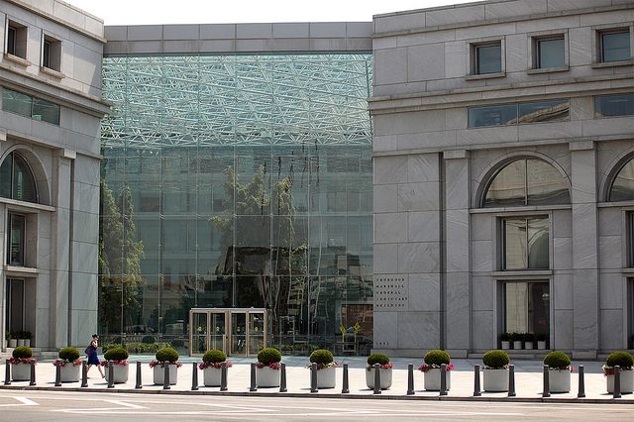
Habitat Behind Glass
Thurgood Marshall Federal Judiciary Building in DC
Photo: Paul Provencher

Slide 11
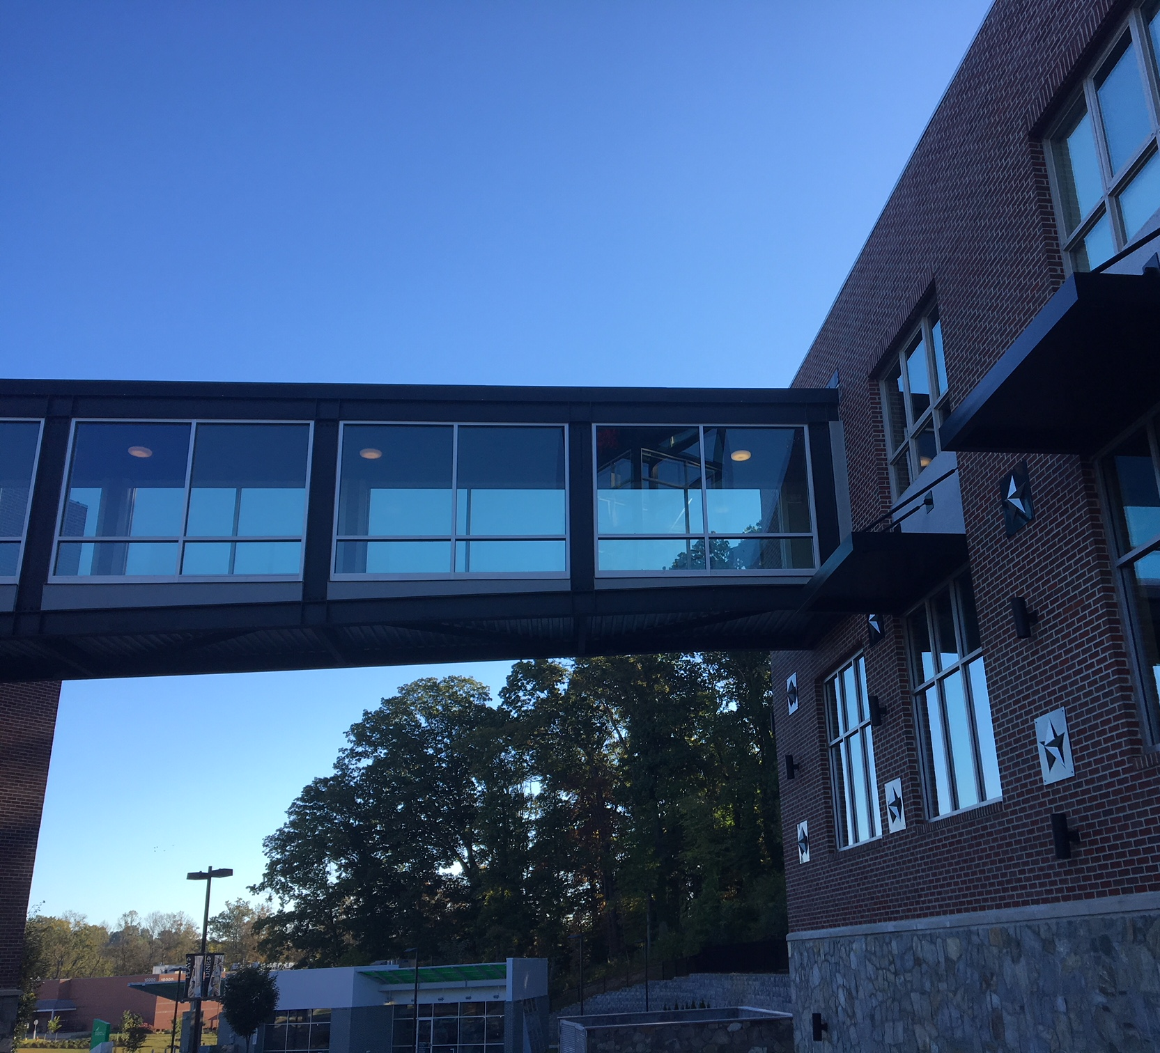
Fly Through

Slide 12
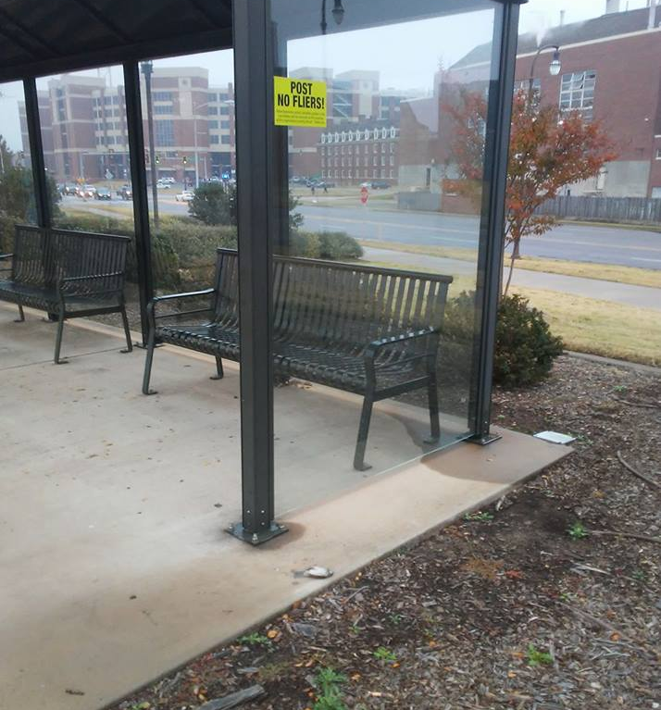
Bus
Shelters

Slide 13
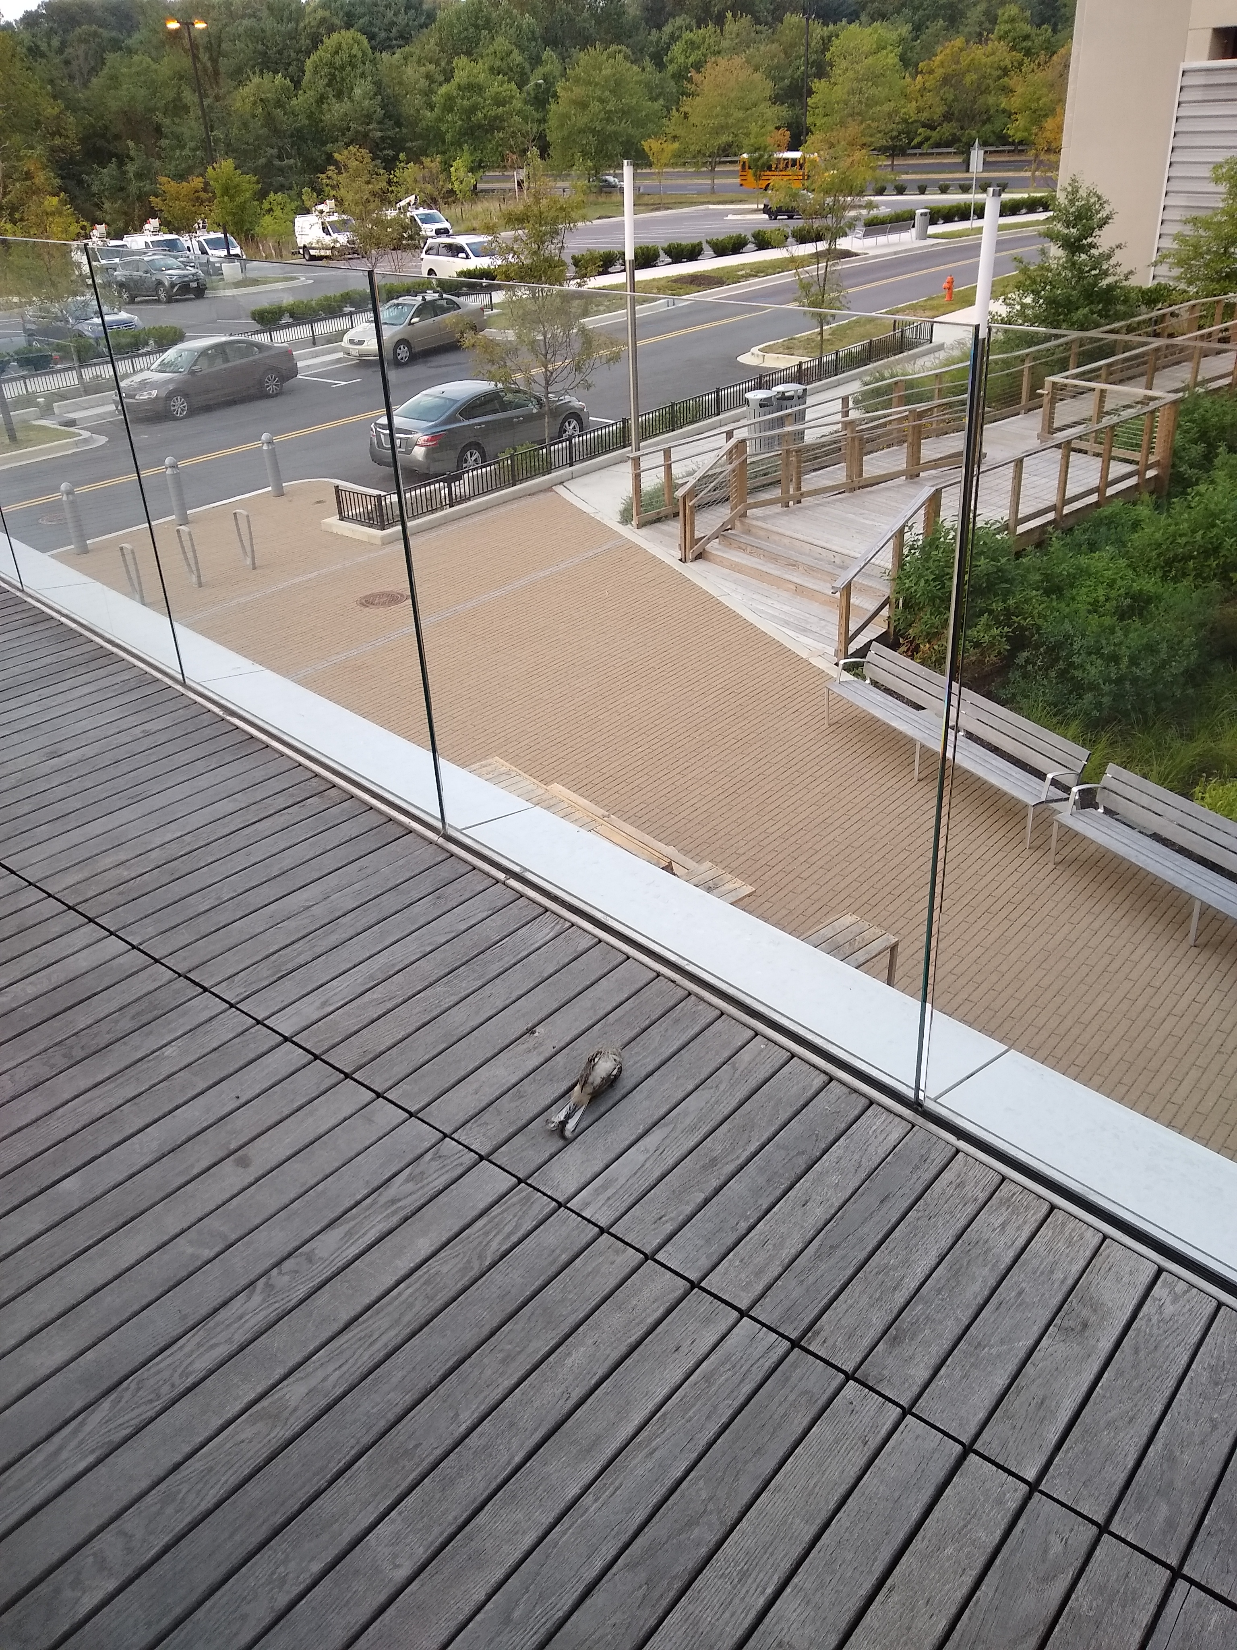
Glass
Barriers

Slide 14
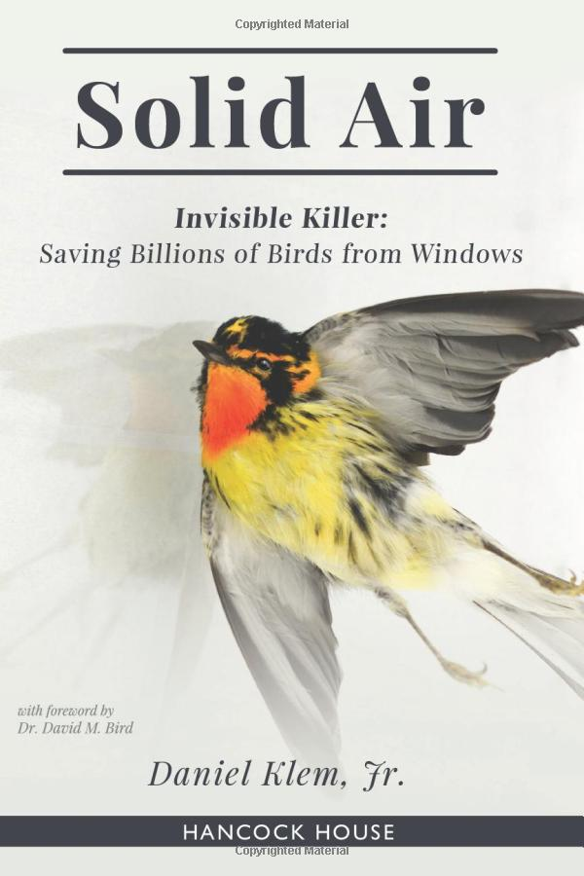
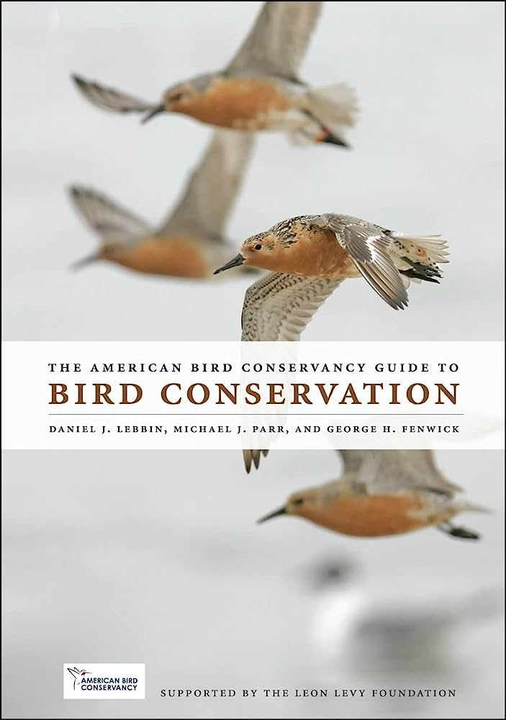
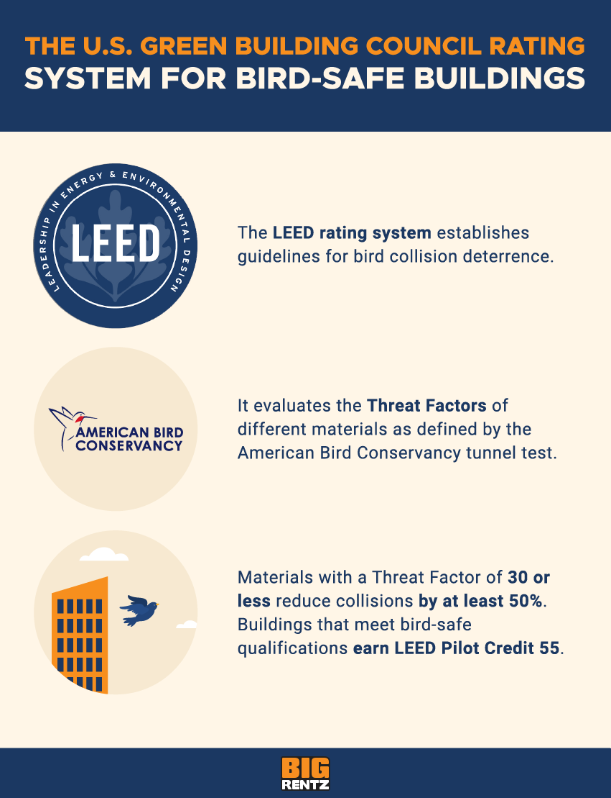
Solution – Science Meets Green Building

Slide 15
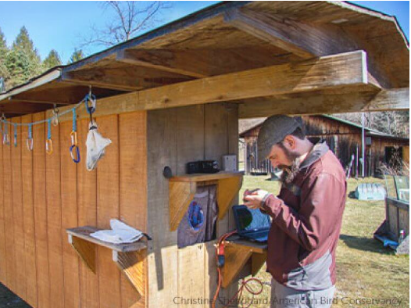
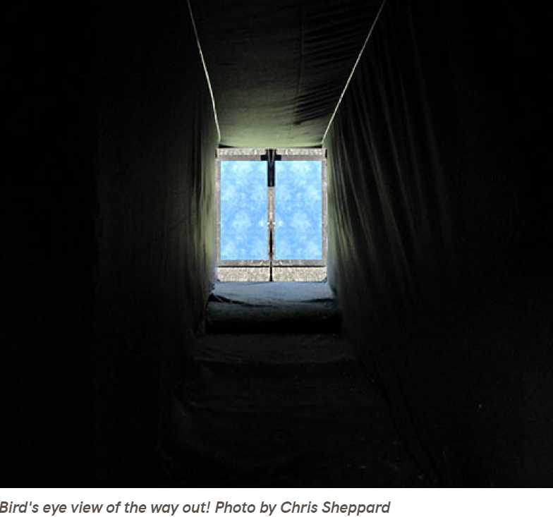
Flight Tunnels Test Window Treatments

Slide 16
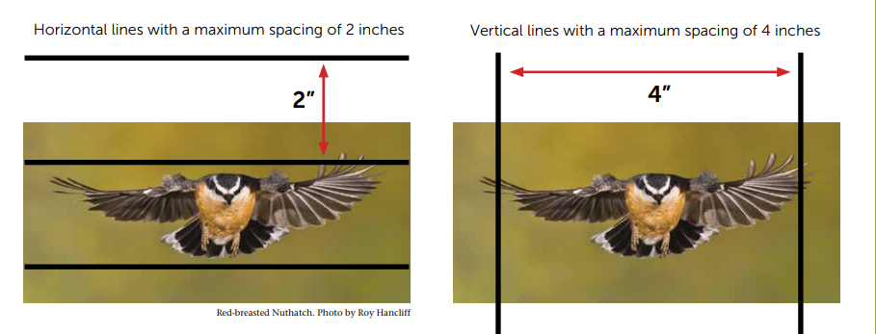
Solution = Visual Barriers Birds Can See

Slide 17
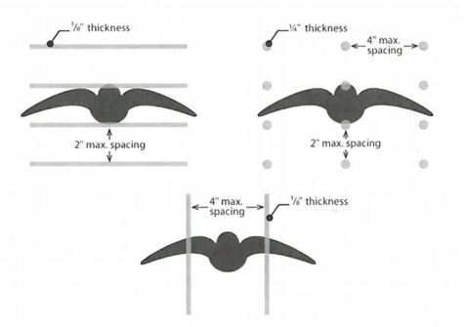
Birds only need small visual cues to avoid glass
The 2 x 4 rule protects most birds
The 2 x 2 rule is best for protecting the smallest birds like hummingbirds

Slide 18
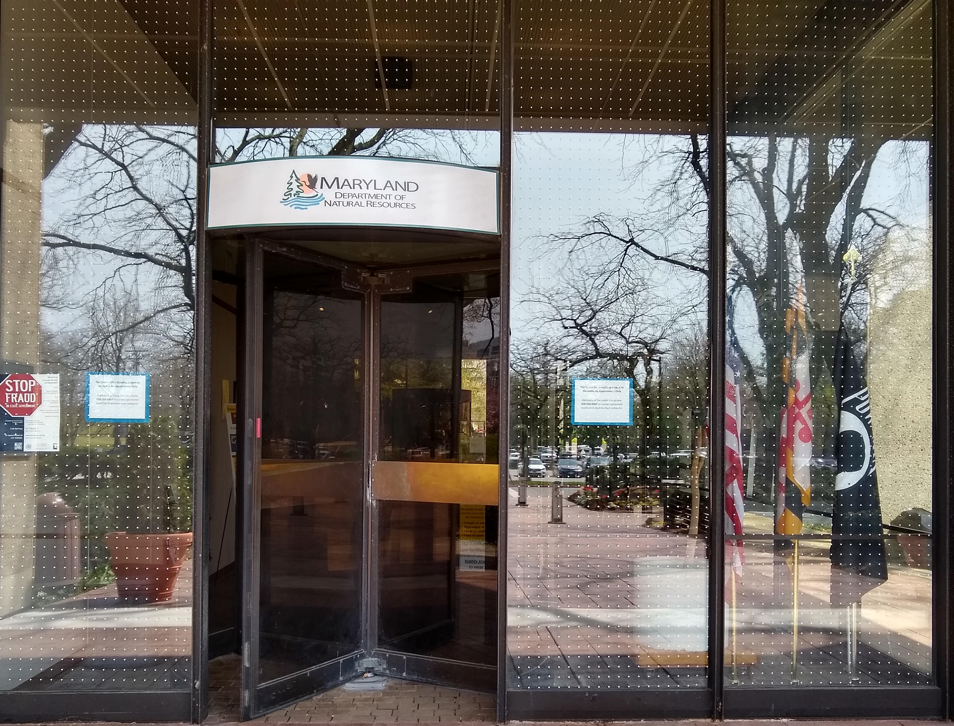
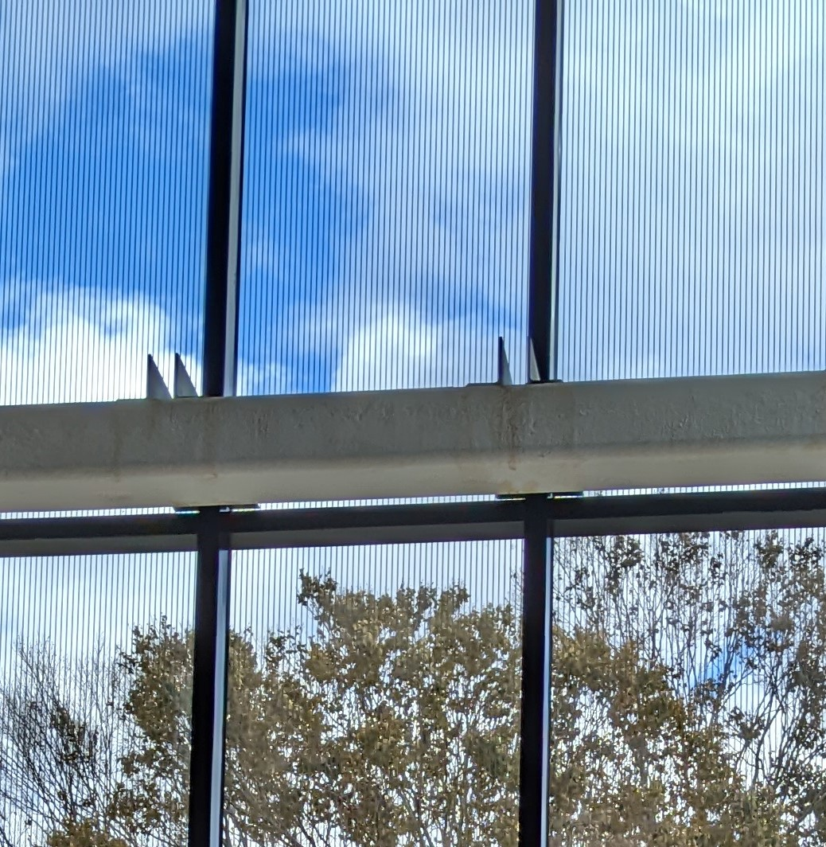
Local Examples
Maryland DNR HQ Tawes Building retrofit by SSM
MAC building at Howard Community College designed to meet 2020 Howard County law

Slide 19
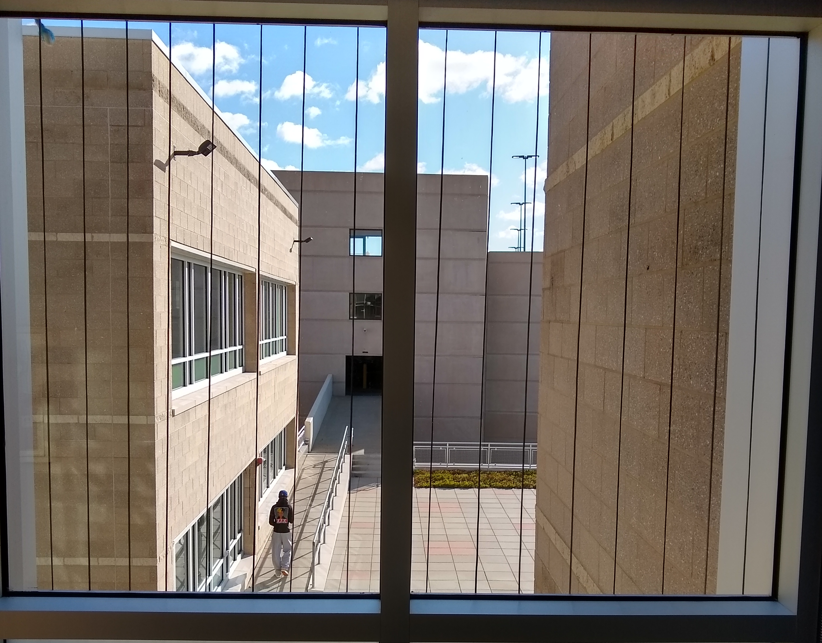
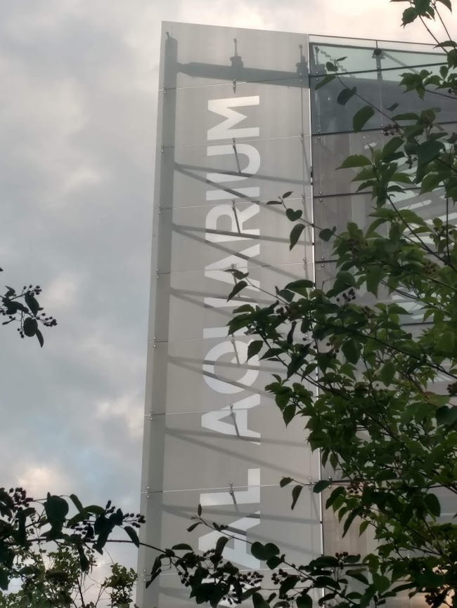
Local Examples
Washington DC Convention Center skyway
National Aquarium in Baltimore

Slide 20
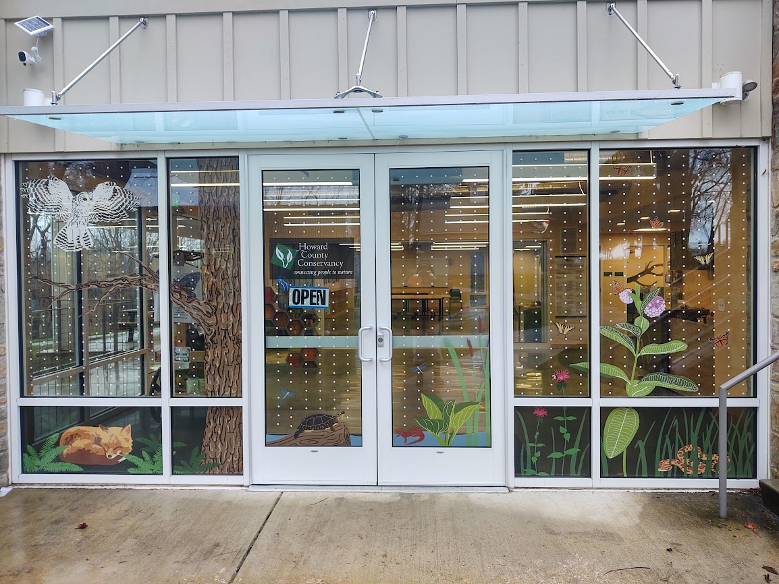
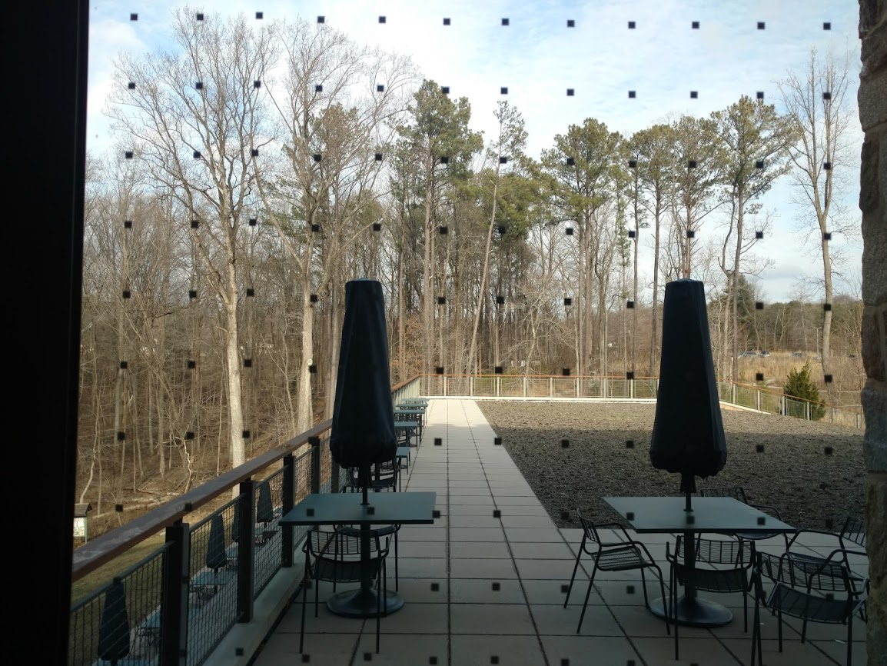
Local Examples
Howard County Conservancy, Woodstock MD
Robinson Nature Center, Columbia MD

Slide 21
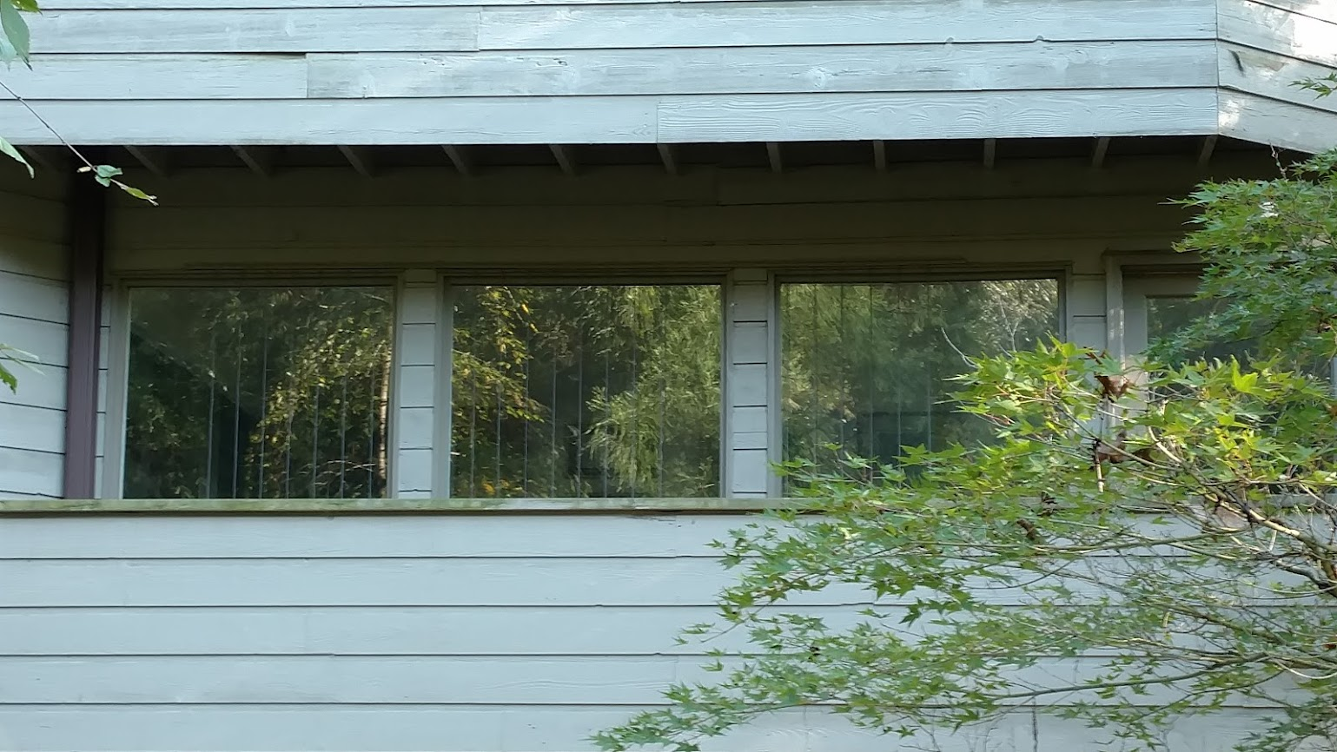
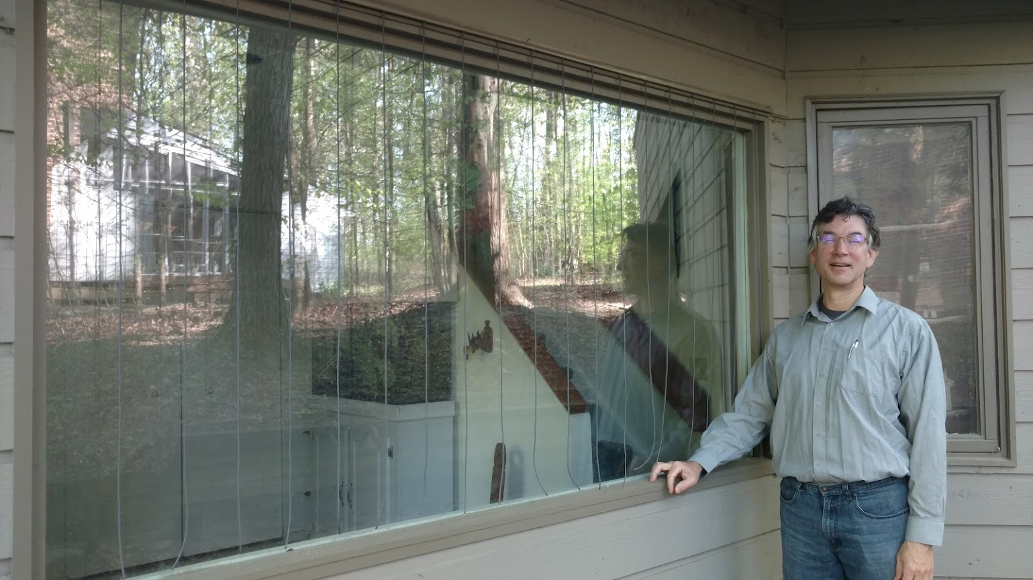
My Example
DIY Acopian BirdSavers, Private Home, Columbia MD

Slide 22
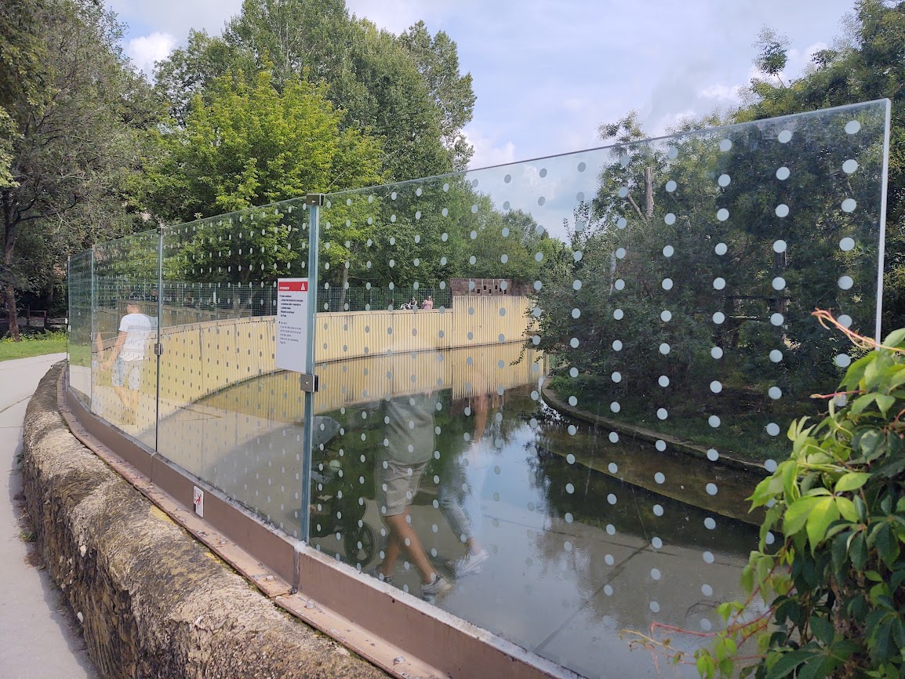
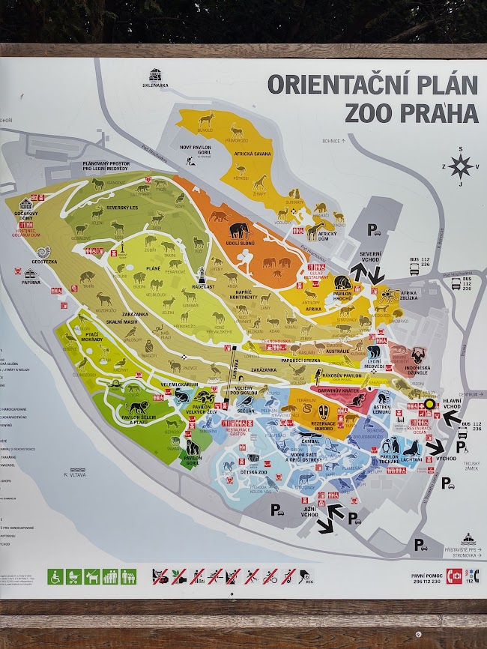
Example from Prague Zoo

Slide 23
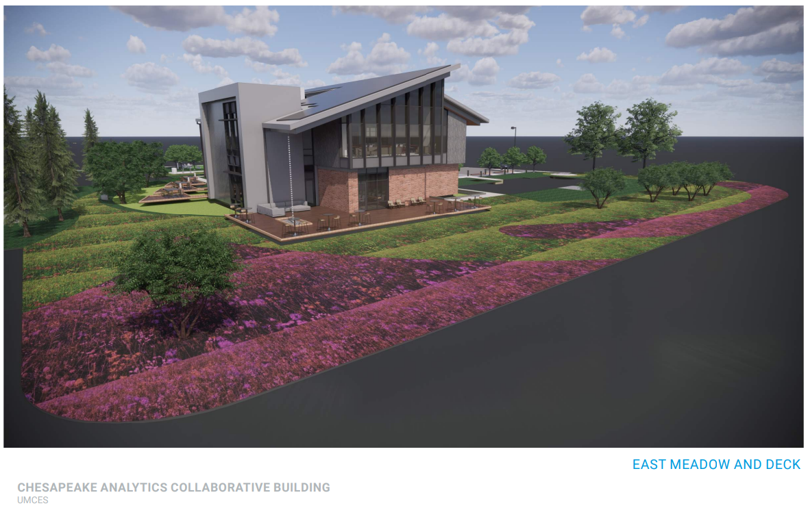
UMCES – Chesapeake Biological Laboratory

Slide 24
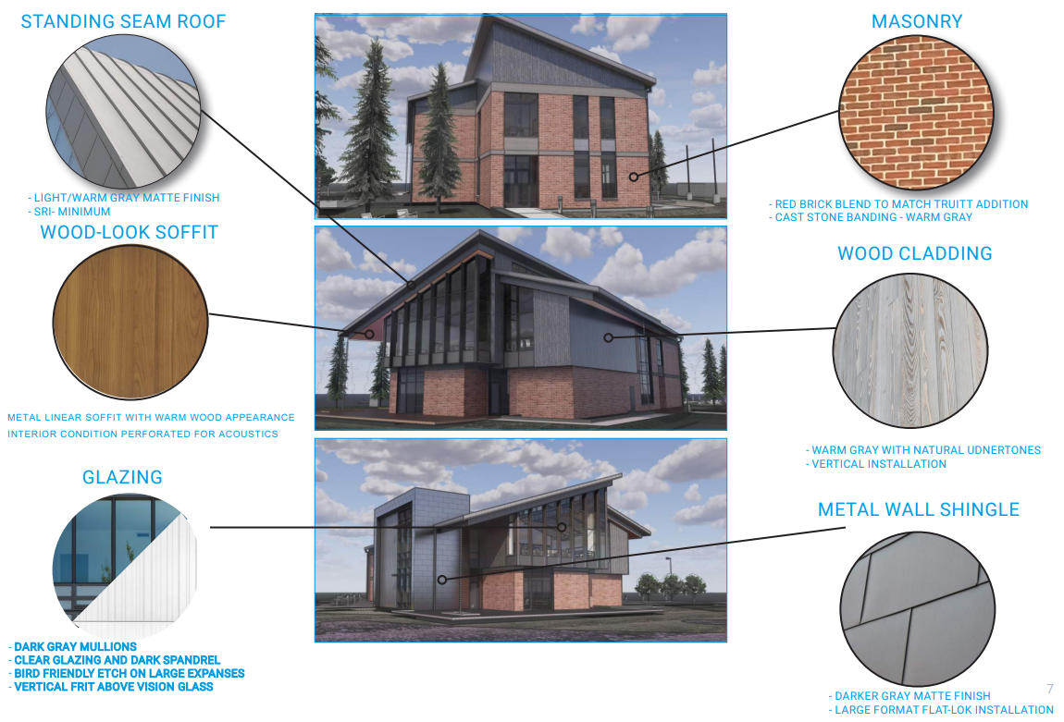
UMCES – Chesapeake Biological Laboratory

Slide 25
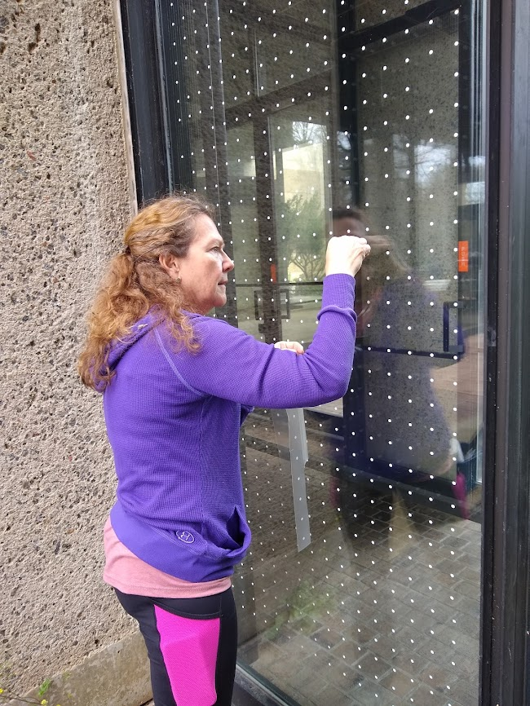
Number of Glass Buildings is Growing Exponentially
Glass buildings lose energy and contribute to climate change
LEED innovation credit for bird collision deterrence is cost neutral in design phase and saves money over time through less air conditioning
Many buildings are retrofitting to become bird safe, including National Aquarium in Baltimore, DNR Tawes HQ in Annapolis, and Javits Conference Center in NYC

Slide 26
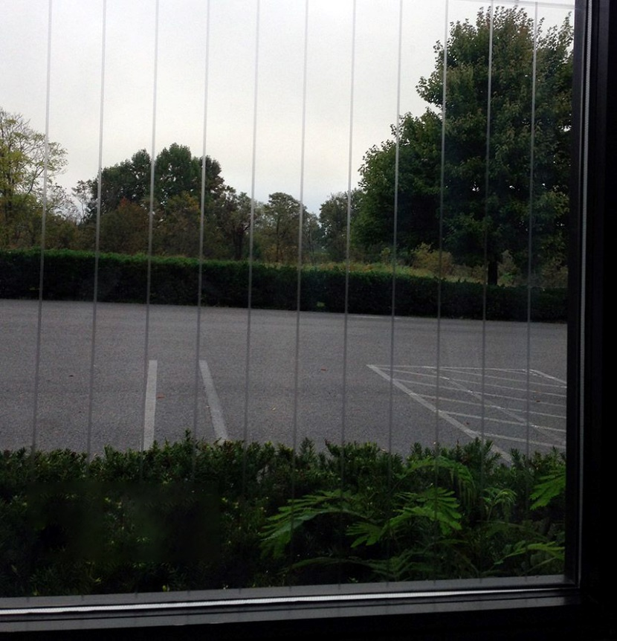
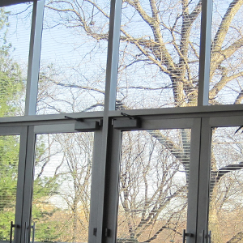
Bird Safe is Cost Neutral in Design
American Institute of Architects (AIA) agrees that bird safe standards can be met in new construction without additional cost
Post-design example estimated 0.125 percent cost increase for Maryland DGS courthouse
High-quality windows for energy conservation are comparable in cost to bird safe windows (which are also energy conserving)
Cost of bird safe windows may exceed standard windows by 10-25%
Retrofit costs depend on number of windows and ease of access for treatment
Nature center retrofits range from $1000 to $10,000

Slide 27
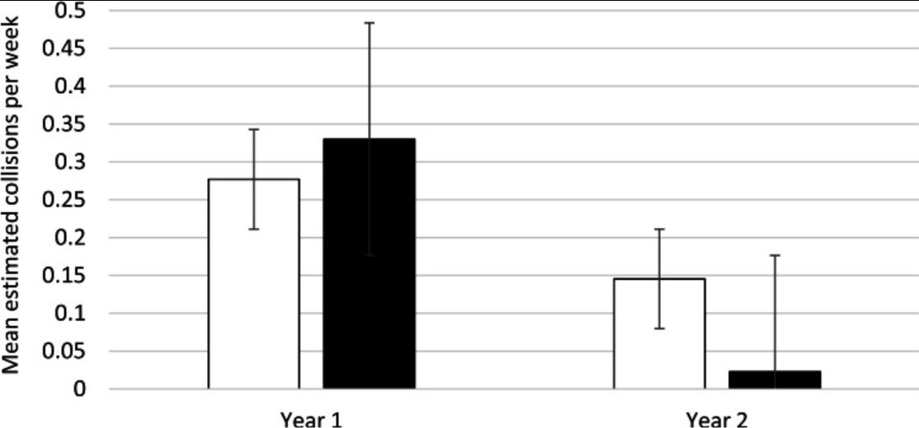
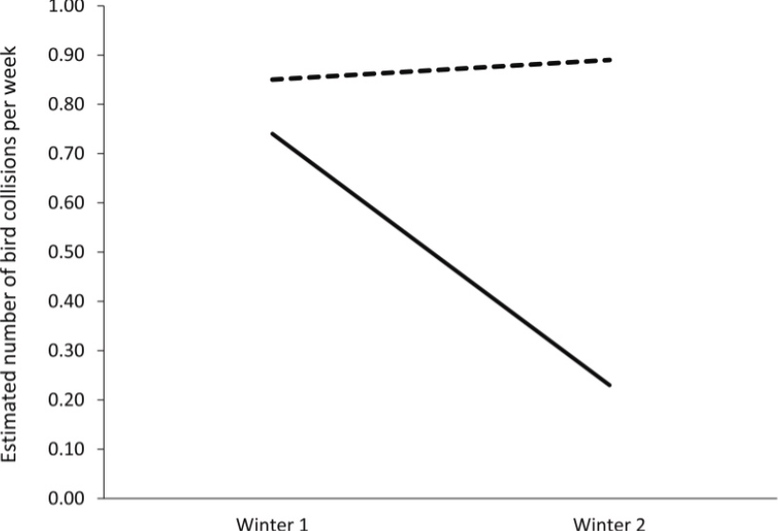
Bird Safe Treatments Reduce Collisions by 90+%
De Groot et al. 2022. We found that the Feather Friendly® markers reduced collision risk at the retrofitted building by 95%. Collision incidence was also lower at the two monitored façades of the building with ORNILUX® glass compared to the building with untreated glass.
Brown et al. 2021 Brown et al. 2019

Slide 28
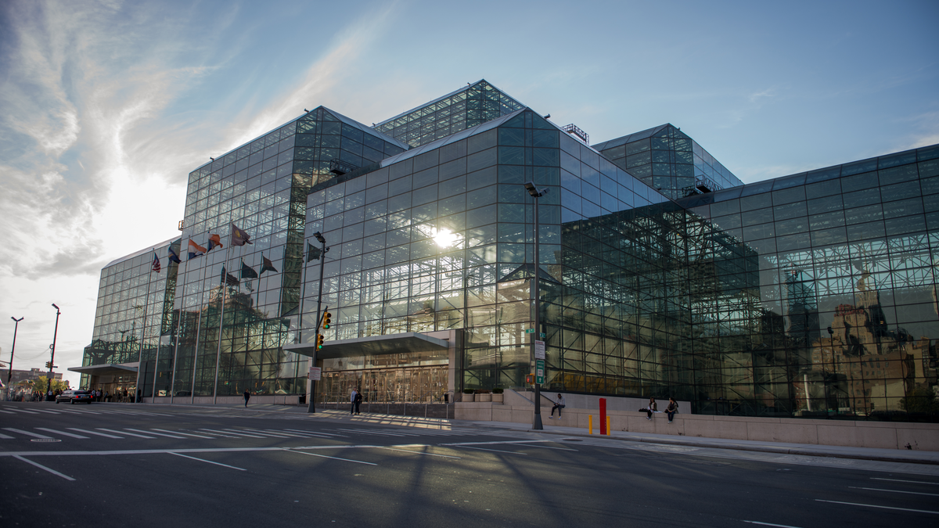
95% Less Bird Deaths at Javits
25% Less Energy Used
Notes:
Jacob Javits Center NYC

Slide 29
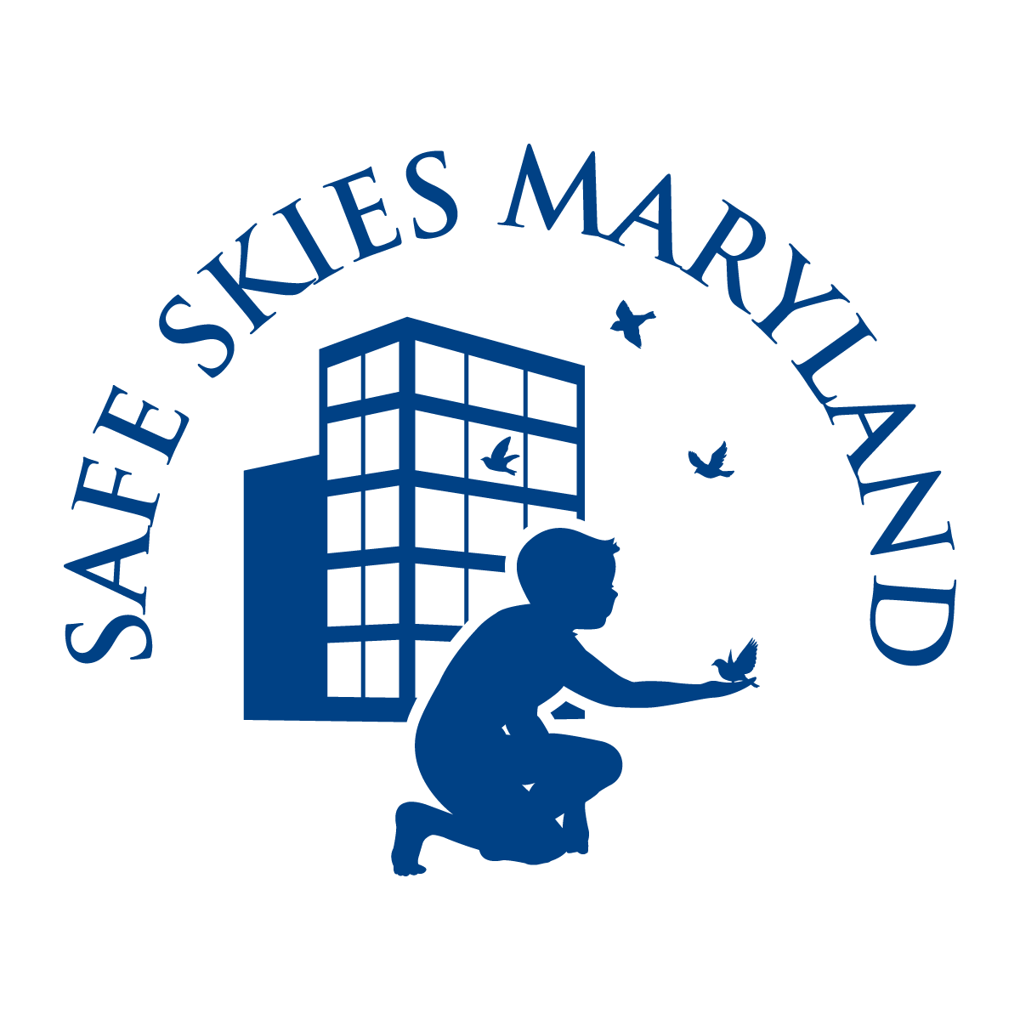
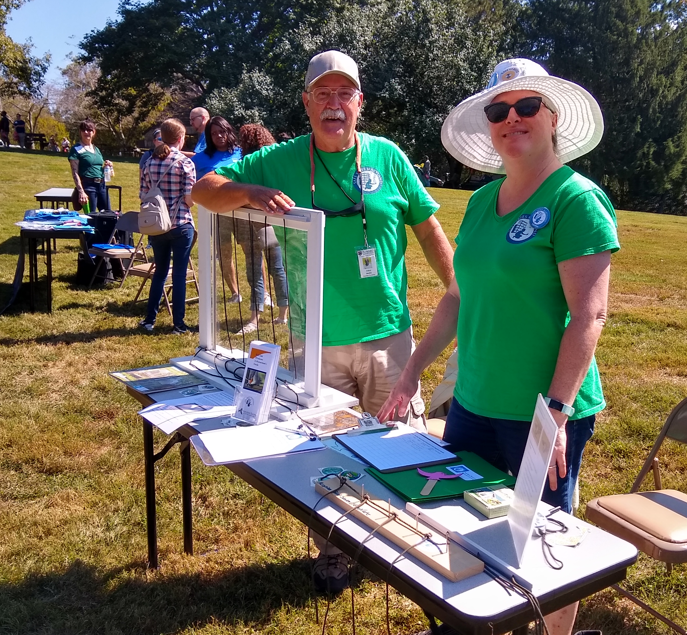
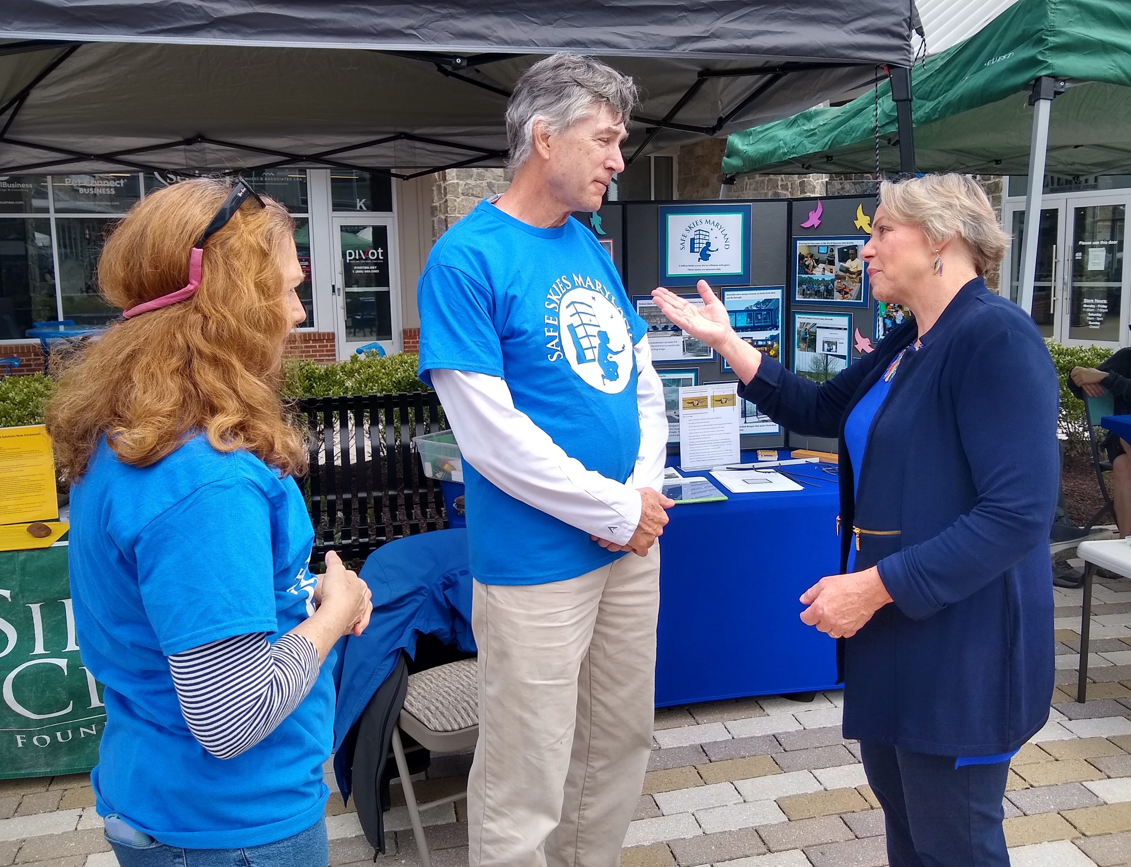
Brief History of Safe Skies Maryland
Early 2017 – Created a task force of the Howard County Environmental Sustainability Board to study bird window collisions
September 2017 – Maryland Ornithological Society (MOS) adopts Safe Skies Maryland as a conservation subcommittee
Mission – To raise awareness and reduce the threats posed by bird collisions with man-made structures
Areas of work – Outreach and education, retrofitting of buildings, advocacy of legislation to make more buildings bird safe
Legislation – Passed Howard County law in 2020 and passed State law in 2023

Slide 30
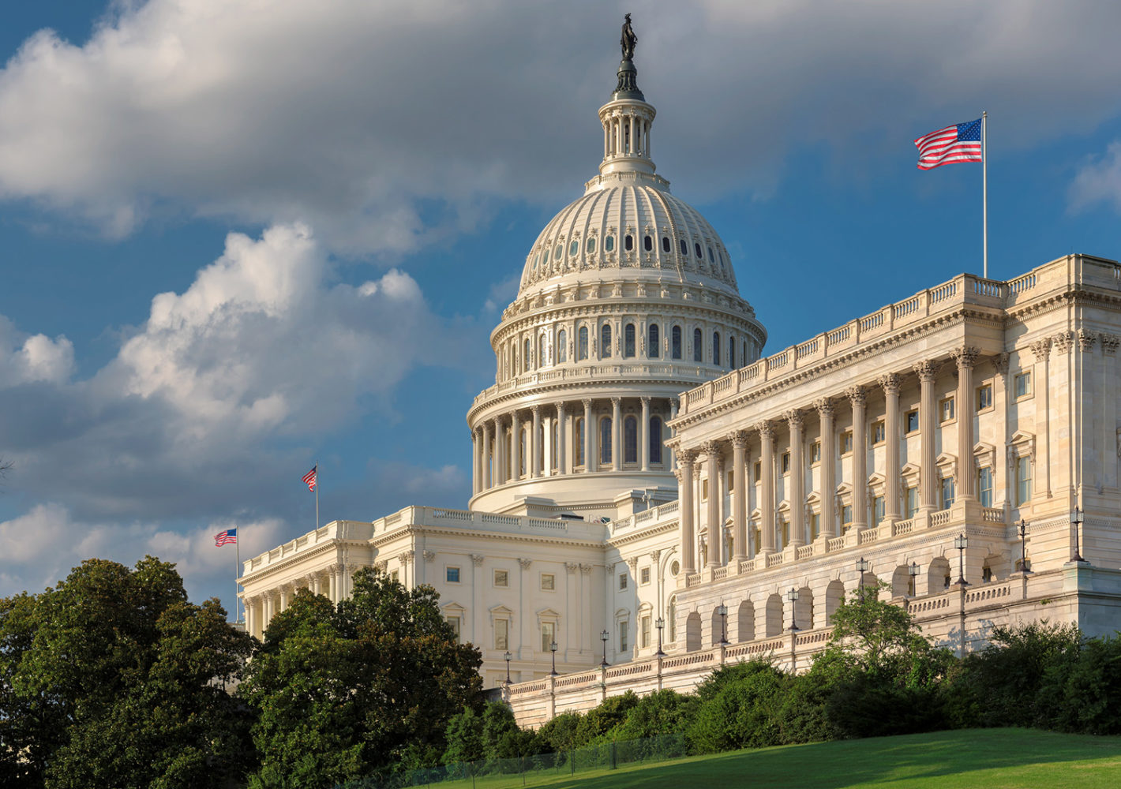
Federal Bill Bird-Safe Buildings Act Multiple introductions U.S. Rep. Mike Quigley (D-IL) U.S. Sen. Cory Booker (D-NJ)
Passed U.S. House twice in 2020 attached to larger bills
Never passed the Senate

Slide 31
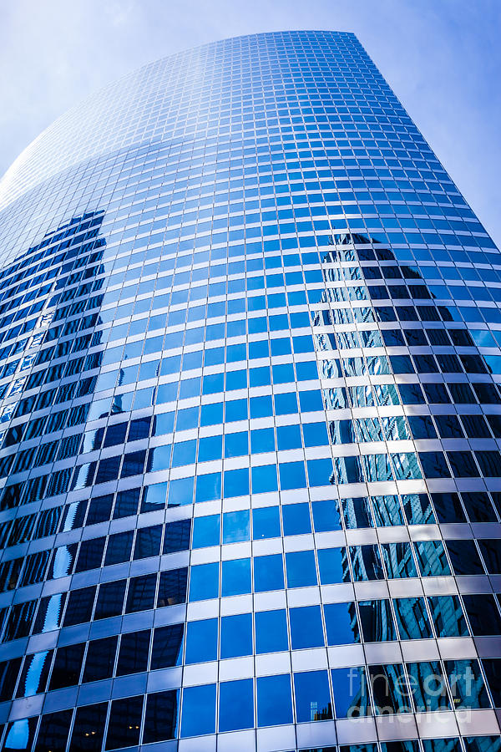
State and Local Bills Minnesota 2013 law (lighting) Illinois 2021 law (buildings and lighting) 21 local jurisdictions
More bills and laws every year

Slide 32
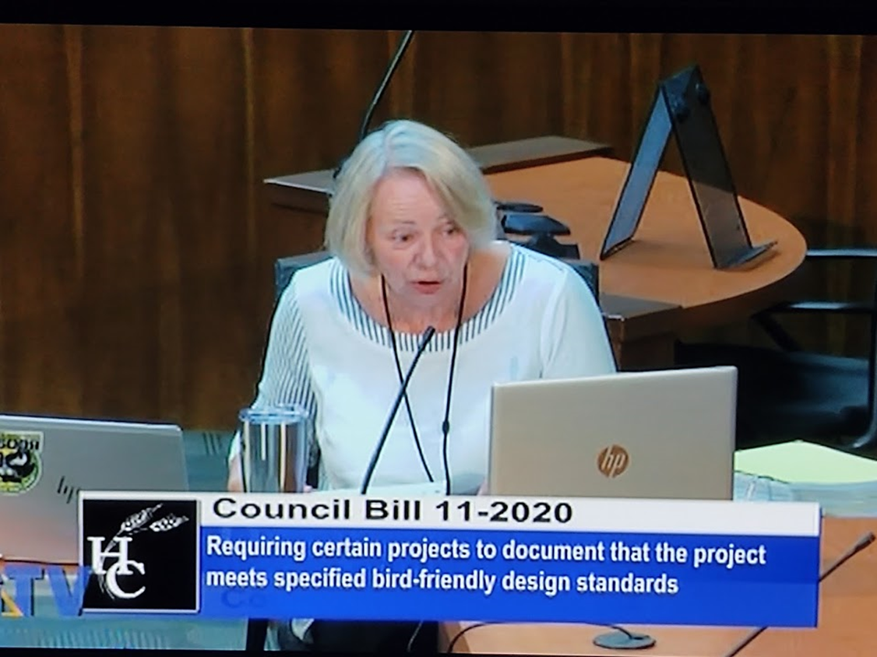
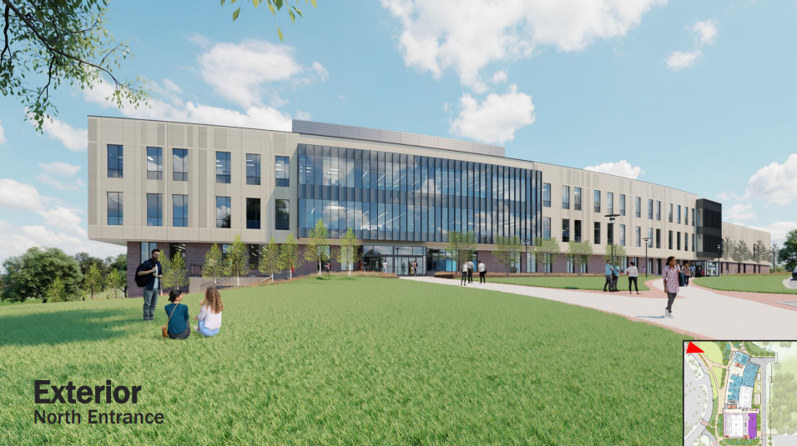
Howard County MD Passed 2020 law Deb Jung, HC Council sponsor Includes both public and private buildings (no schools) Safe Skies Maryland surveys and advocacy Started September 2020 First construction is MAC at Howard Community College

Slide 33

Washington DC Passed 2023 law Subsidies available to help offset any extra costs Mary Cheh, DC Council sponsor Lights Out DC surveys and advocacy since 2010 Starts October 2024

Slide 34


Maryland Sustainable Buildings
HB 6 Department of General Services – Energy Conserving Standards (Maryland Sustainable Buildings Act of 2023)
Provides for all new and substantially renovated buildings with 51% state funding to meet bird safe standards per LEED Innovation Credit for Bird Collision Deterrence and ABC guidelines (schools are excluded)

Slide 35
Bill Provisions
LEED Innovation Credit requires maximum of 30 Threat Factor (likelihood of bird collision) for new building exterior
Glass may be used anywhere if it include a pattern of dots or lines or UV (or screening) that birds can see (but rarely noticed by people)
Lighting is reduced from midnight to dawn, during spring and fall migration, on existing buildings
Buildings shall meet standards to the extent practicable and within budgetary constraints

Slide 36

Maryland Sustainable Buildings Act
Passed both houses on last day of session
Bill passed with 25 minutes to spare
Vote of 91 to 26

Slide 37

Maryland Sustainable Buildings Act of 2023 Passed
Signed by Governor Wes Moore on May 8, 2023
Will take effect October 1, 2023

Slide 38
Safe Skies Can Help
Survey for collision hotspots and evaluate buildings for retrofit
Connect you with bird safe architects and window vendors
Build broad constituency of support, from architects to youth to hunters
Work with bill sponsors and discuss with affected agencies

Slide 39
Contact Us
CONTACT
Mark Southerland PhD
Safe Skies Maryland
mark.t.southerland@gmail.com
OR
Carolyn Parsa
Safe Skies Maryland
Carolyn.parsa@gmail.com
VISIT
Safe Skies Maryland website
https://mdbirds.org/safeskiesmaryland/

