Slide 1
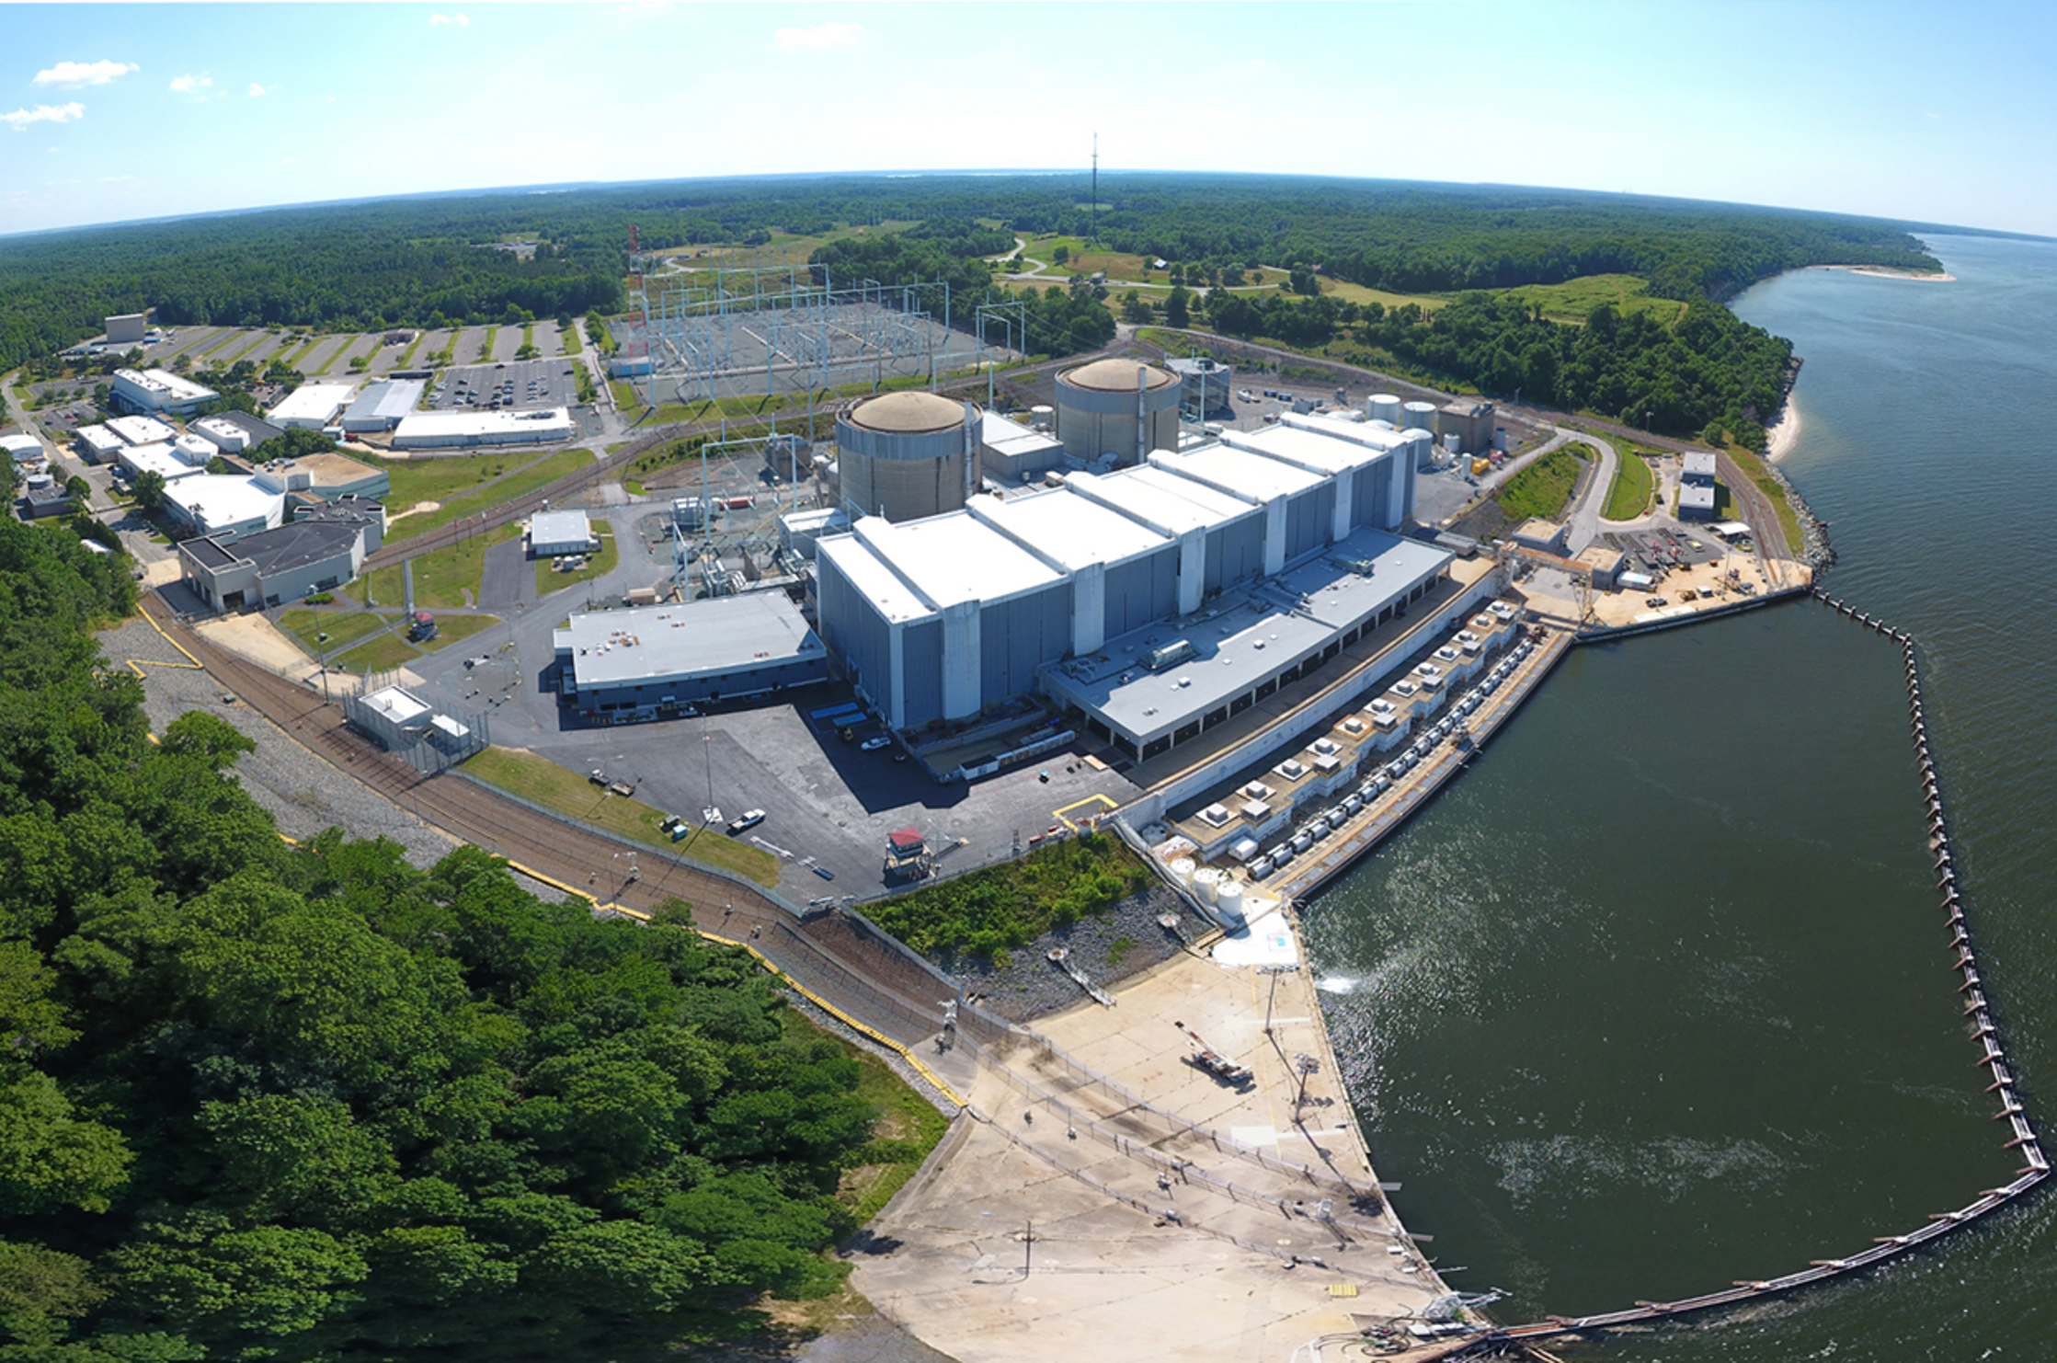
Calvert Cliffs Nuclear Power Plant
Environmental Update
Jason Prowinski – Sr. Environmental Specialist
May 2023

Slide 2
Permits
National Pollutant Discharge Elimination System
  Permit number 21-DP-0187 (MD0002399) issued 11/01/2022
  Effluent toxicity testing will be initiated the week of June 1 (first event)
  Clean Water Act §316(b)
    existing intake structure at the facility has been demonstrated to achieve an impingement mortality standard no greater than 24%
    monthly impingement monitoring is required to continue demonstration of the numerical standard
    must maintain compliance with the 24% impingement mortality standard on a basis of rolling 12-month periods
    sampling will be initiated from U-2 Fish Collection & Holding Facility on Wednesday, May 24, 2023

Slide 3
Permits
National Pollutant Discharge Elimination System (continued)
  Nutrient Reduction Goals
    an overall nutrient assessment which summarizes the annual usage of nitrogen and phosphorus at the facility and identifies any changes in nutrient levels in the discharge must be submitted as an addendum to the next renewal application
    Maryland Department of the Environment has established goals to reduce total nitrogen loading to 8,382 pounds per year and total phosphorus loading to 143.6 pounds per year by December 31, 2025
    implement this reduction goal via multiple means including but not limited to reduction in chemical usage, changes in chemical usage, additional wastewater treatment, water re-use, water recycling, or nutrient offsets
    develop and submit a Nutrient Reduction Report to the detailing its efforts towards meeting the nutrient reduction goals by November 1, 2025
    monthly grab sampling for ammonia added for Monitoring Point 102A (Plant Sumps & Stormwater)

Slide 4
Permits
National Pollutant Discharge Elimination System (continued)
  Thermal Evaluation
    temperature limit at Outfall 001 was established based on a demonstration that the limitation assures that facility discharges will always meet the thermal mixing criteria at COMAR 26.08.03.03D(2)
    submit a report which demonstrates that the limitation continues to be protective of Maryland thermal mixing criteria by November 1, 2024

Slide 5
Permits
Oil Operations
  COMAR 26.10.17 (Shop Fabricated Aboveground Storage Tanks) & 26.10.18 (Field Erected Aboveground Storage Tanks)
    tightness testing for the Lube Oil Storage Tank (LOST) underground piping is a new requirement
    previous underground tightness testing was only listed in the permit and only encompassed the Diesel Fuel Oil piping associated with 11 & 21 Fuel Oil Storage Tanks (FOST)
    LOST testing is scheduled on Wednesday, May 24, 2023
Notes:
LOST testing due date is June 13, 2023

Slide 6
Stewardship
Wildlife Habitat Council Gold Certification
Artificial Reef at Breezy Point
Bluebird Nesting Program – Cornell Lab of Ornithology NestWatch
Deer Management Program
Pollinator Program – milk weed garden, bee boxes, bee hotels
Breeding Bird Atlas Surveys
Tiger Beetle Surveys
Wood Duck Boxes
Maryland Big Tree Program Official Record, Calvert County – Chestnut Oak BT-3038, circumference 15’5”, height 100’, crown 97.5’
Annmarie Gardens Earth Arts Fest Presenting Sponsor
Huntingtown High School AP Science Class Site Tour

Slide 7
