Slide 1
Maryland Sea Level Rise and Cove Point Shoreline Erosion
University of Maryland Center for Environmental Science
Chesapeake Biological Laboratory
Dr. Lora Harris

Slide 2
Predicted Sea Level Rise for Maryland

Slide 3
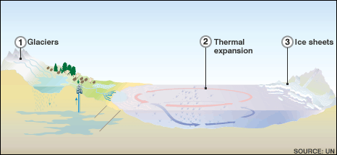
Cause of Sea Level Rise
Thermal expansion of Ocean water as temperatures rise due to climate change
Melting of glaciers and polar ice sheets due to climate change
Source: University of Maryland
Source: Global Energy Network Institute

Slide 4
Impacts of Sea Level Rise (SLR)
Erosion
SLR intrusion can accelerate current erosion; waves are able to reach a higher elevation
Storm Surge
As SLR, storm surges are becoming higher (causing more damage)
Stormwater Management
Higher SLR can prevent current stormwater management systems from functioning, causing increased flooding when there is precipitation
Rising Groundwater
Can cause increased flooding and septic system failure in low-lying coastal areas
Saltwater Intrusion
Saltwater moving onto land can cause intrusion of freshwater aquifers and also impacts sewage/septic, agriculture, forests, and water resources
Source: University of Maryland

Slide 5
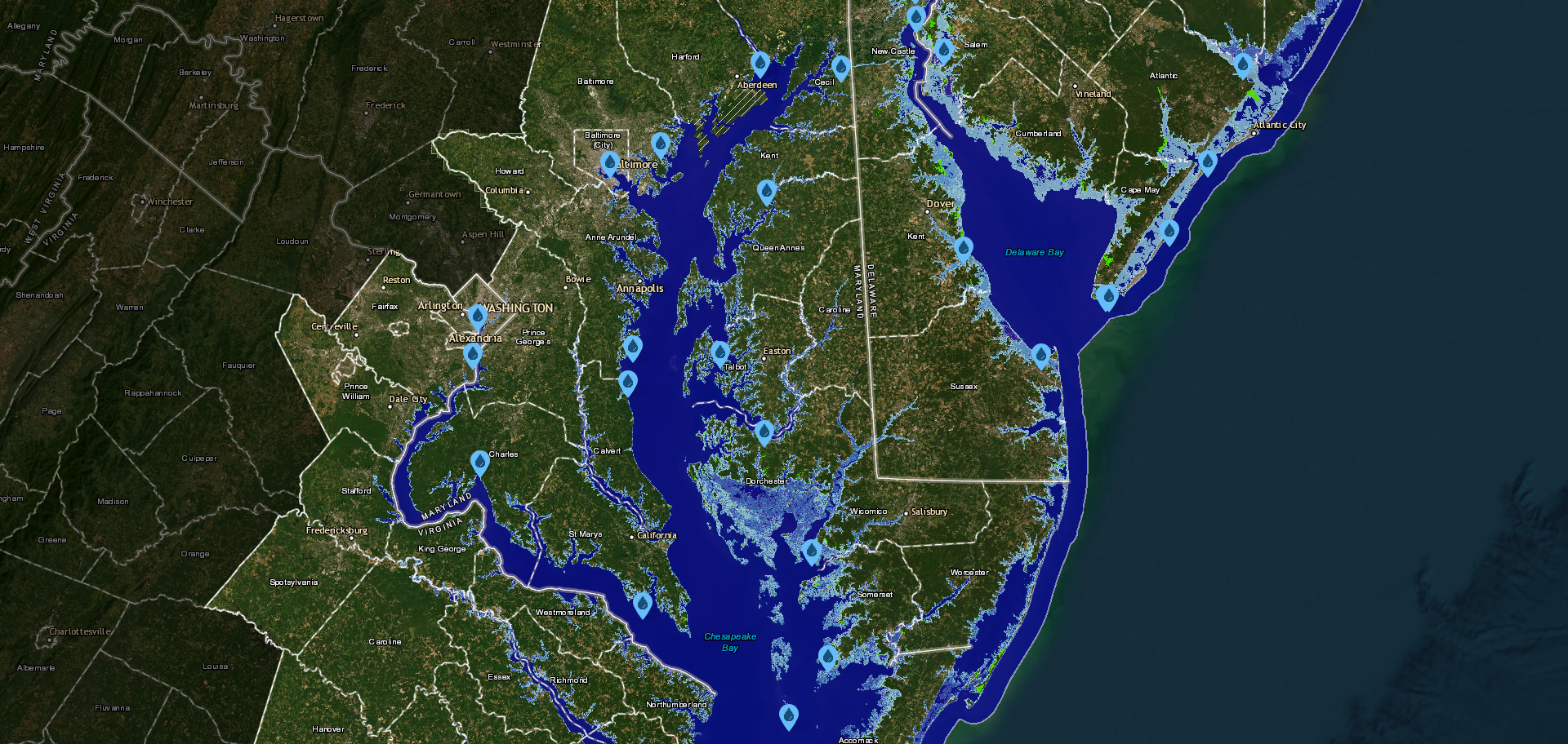
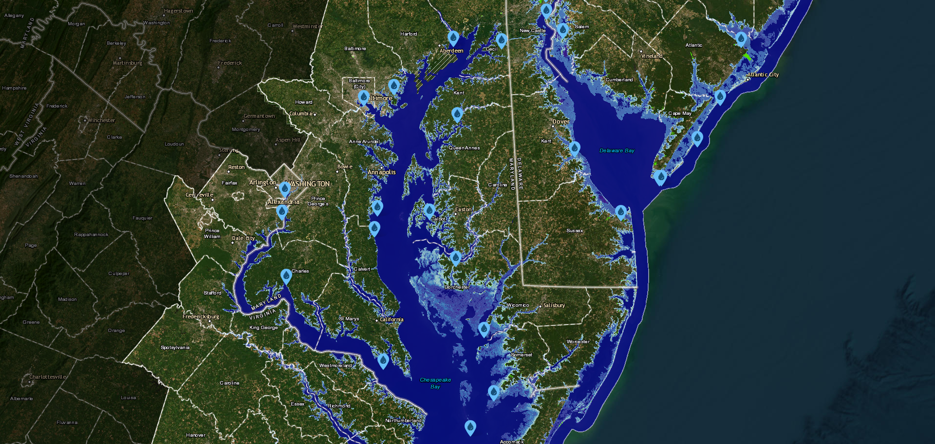
Maryland Predictions
Maryland sea level rates are expected to rise 1-2 feet by 2050 (compared to 2000).
By 2100, levels may exceed 4’.
Two Feet
Four Feet
Boesch et al. 2018
Notes:
Lighter Blue = Shallower depth
Darker Blue = Deeper Depth
The main difference between the two photos is the depth of the inundated areas of coast (see southern tip of the eastern shore and coastal regions such as OC and Assateague)

Slide 6
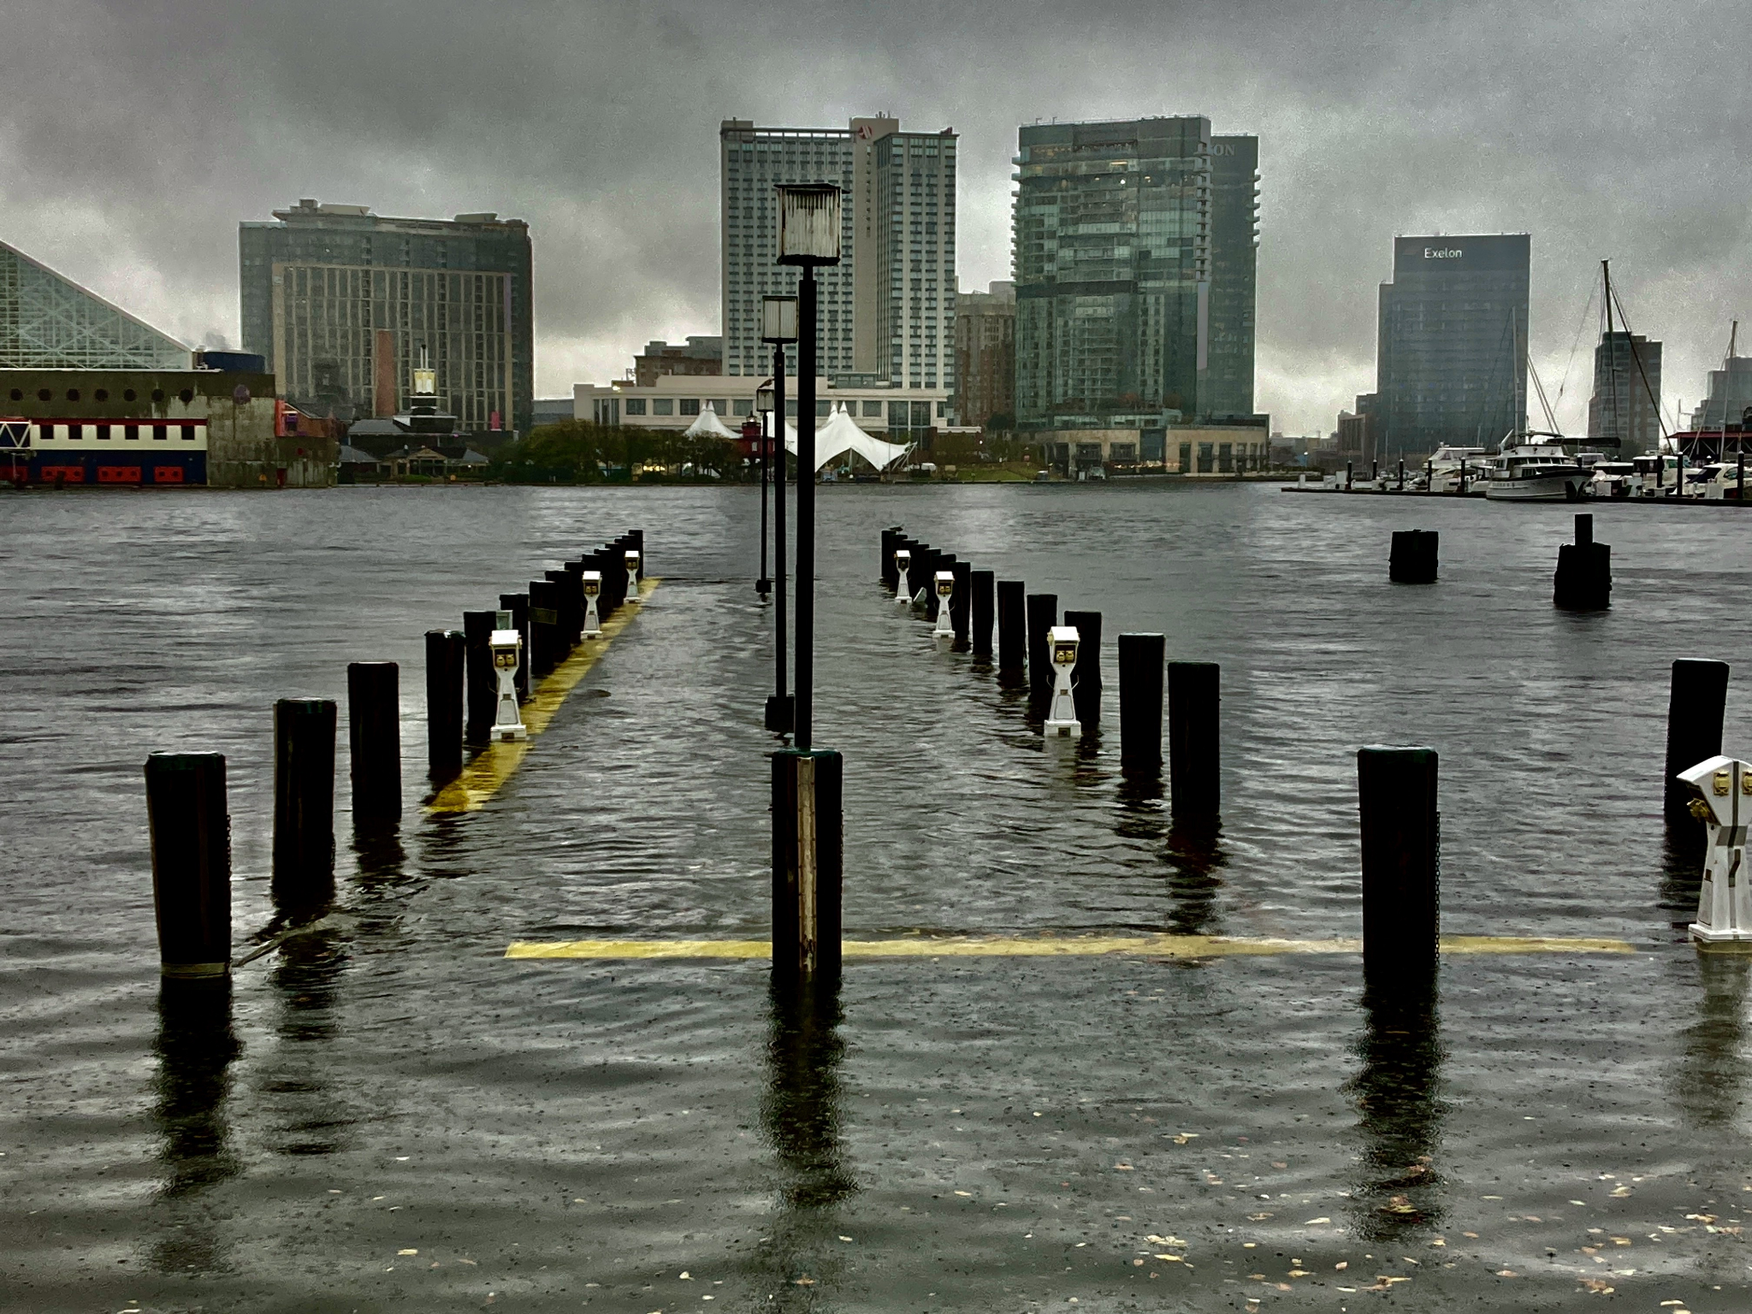
Maryland’s Vulnerability
Maryland is more vulnerable than other locations globally. The land in Maryland is sinking [subsiding] while sea level rise is inundating much of Maryland’s coasts. This causes the land along Maryland’s coast to become flooded faster than other locations on a global scale.
Nuisance flooding will eventually become normal “high tides”.
Baltimore Inner Harbor (The Baltimore Sun, 2022).
Notes:
Baltimore experienced 11 days of nuisance flooding in 2019. By 2050, the same area will experience 50-155 days of the same type of “nuisance flooding”
The Northern U.S. was covered in ice sheets during the most recent Ice Age. The weight of these ice sheets pressed down on the land, causing the crusts that were not covered with ice to rise. Now that the ice is melting, the crusts are settling back down, causing the subsidence that we’re seeing; this is accelerating erosion and SLR in MD.

Slide 7
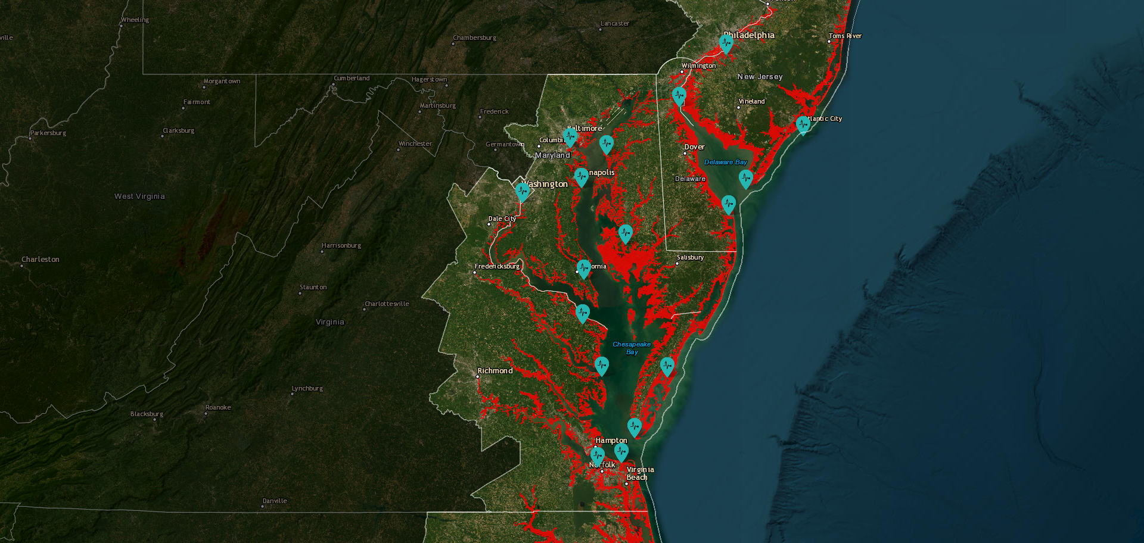
Red: Current High Tide Flooding
NOAA Sea Level Rise Tool

Slide 8
Predicted Sea Level Rise for Cove Point, MD

Slide 9
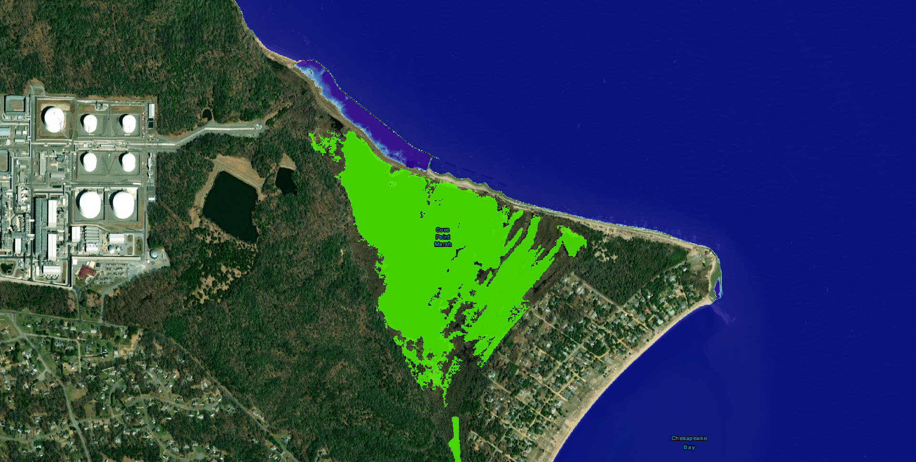
1 Foot
Green: Low-Lying Areas
NOAA Sea Level Rise Tool

Slide 10
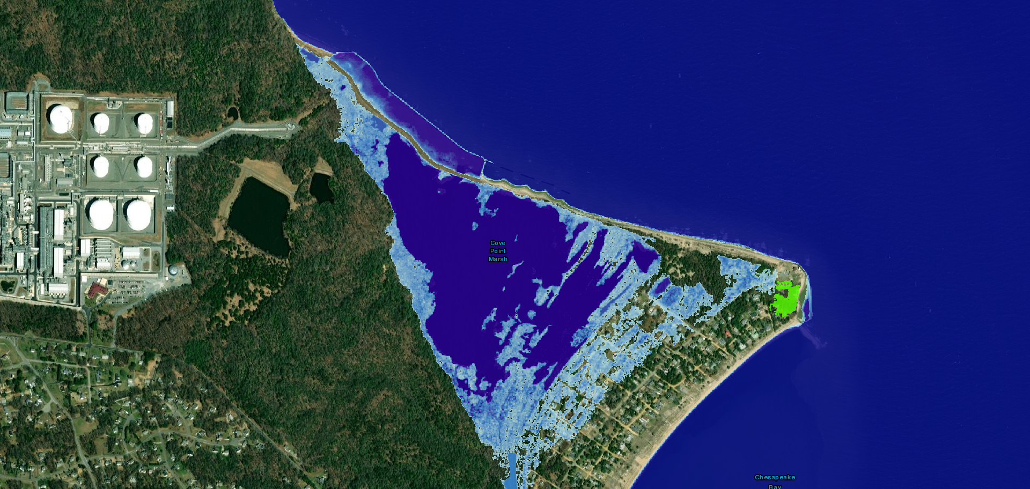
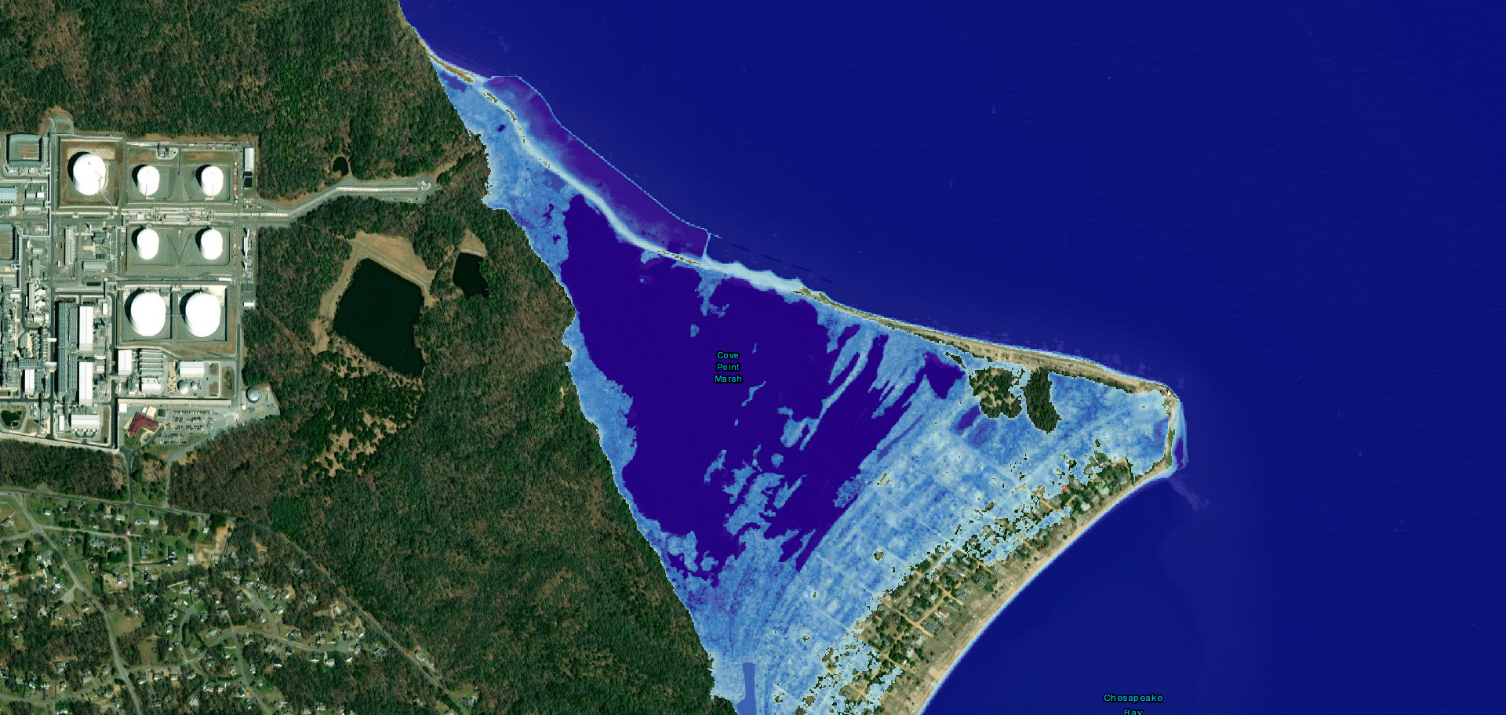
2 Feet
Green: Low-Lying Areas
NOAA Sea Level Rise Tool
Notes:
Predicted SLR outcome for Cove Point by 2050. Houses in the community will begin to see an impact

Slide 11
3 Feet
NOAA Sea Level Rise Tool

Slide 12
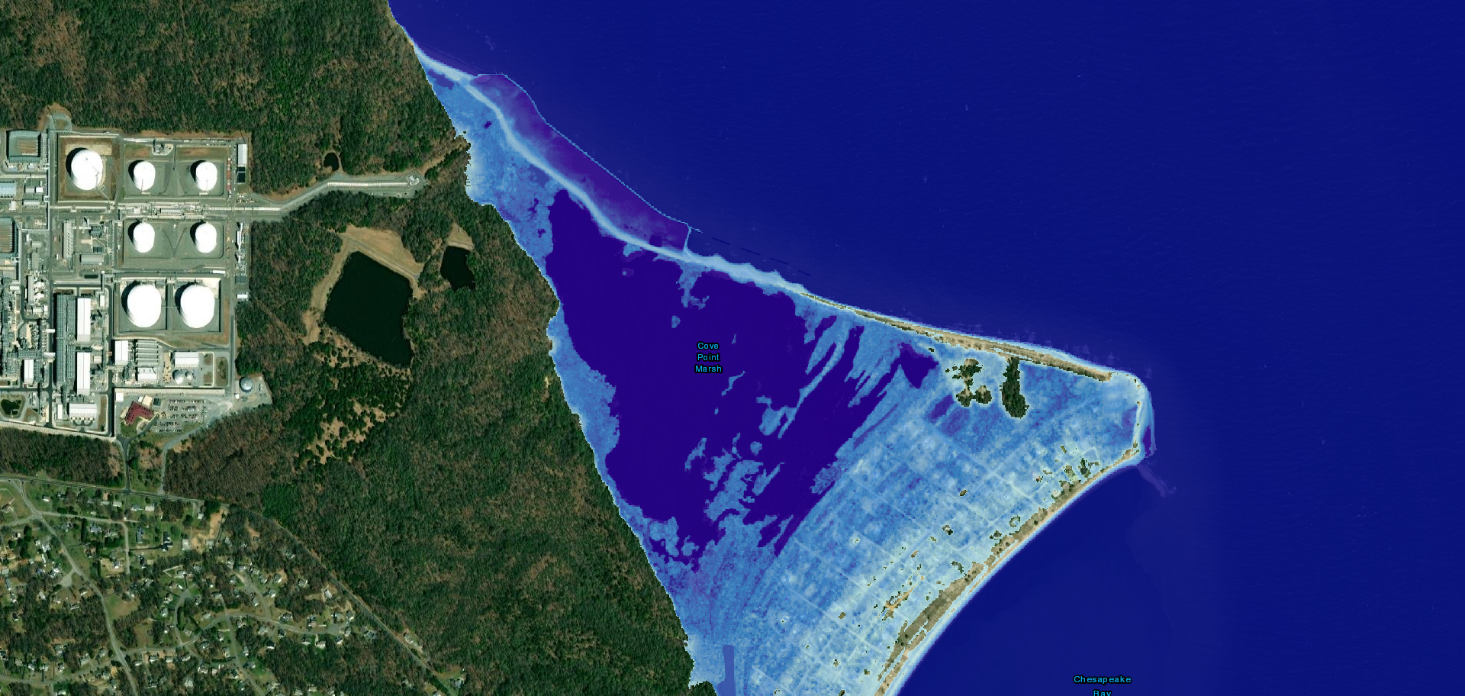
4 feet
NOAA Sea Level Rise Tool
Notes:
Predicted SLR outcome of Cove Point by 2100

Slide 13
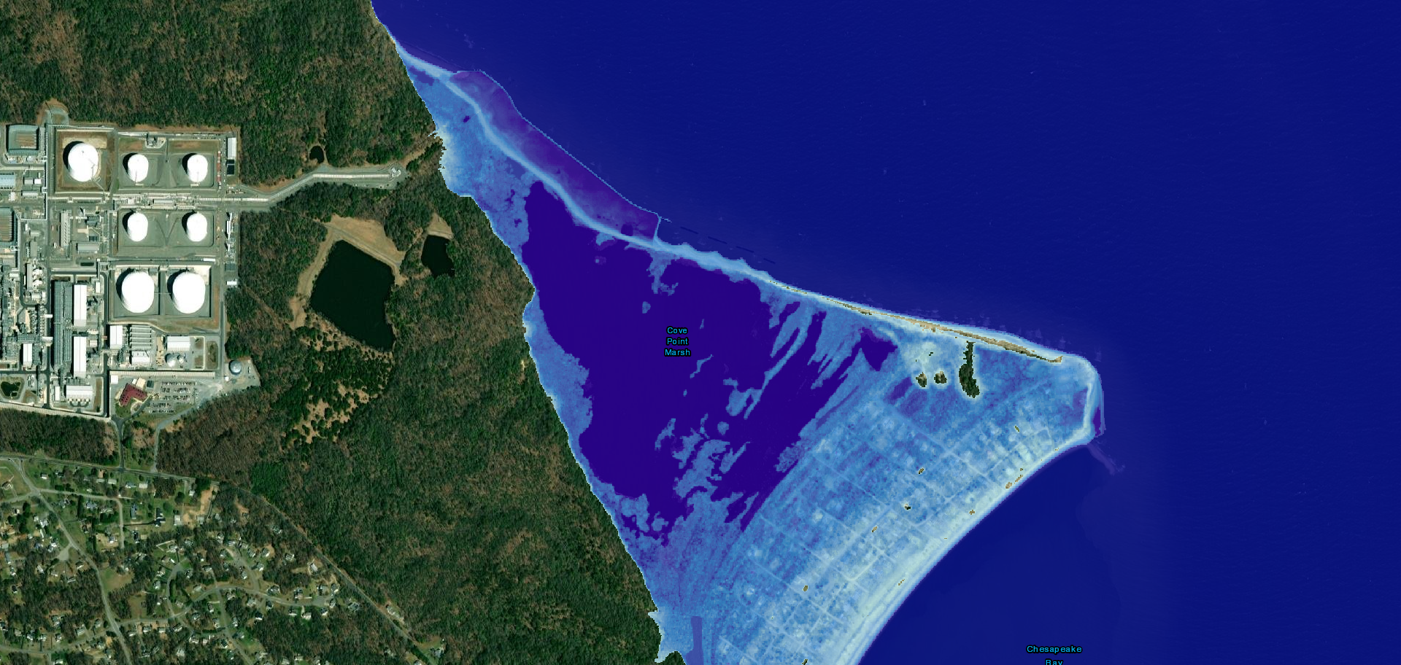
5 feet
NOAA Sea Level Rise Tool

Slide 14
Monitoring of the Cove Point Shoreline

Slide 15
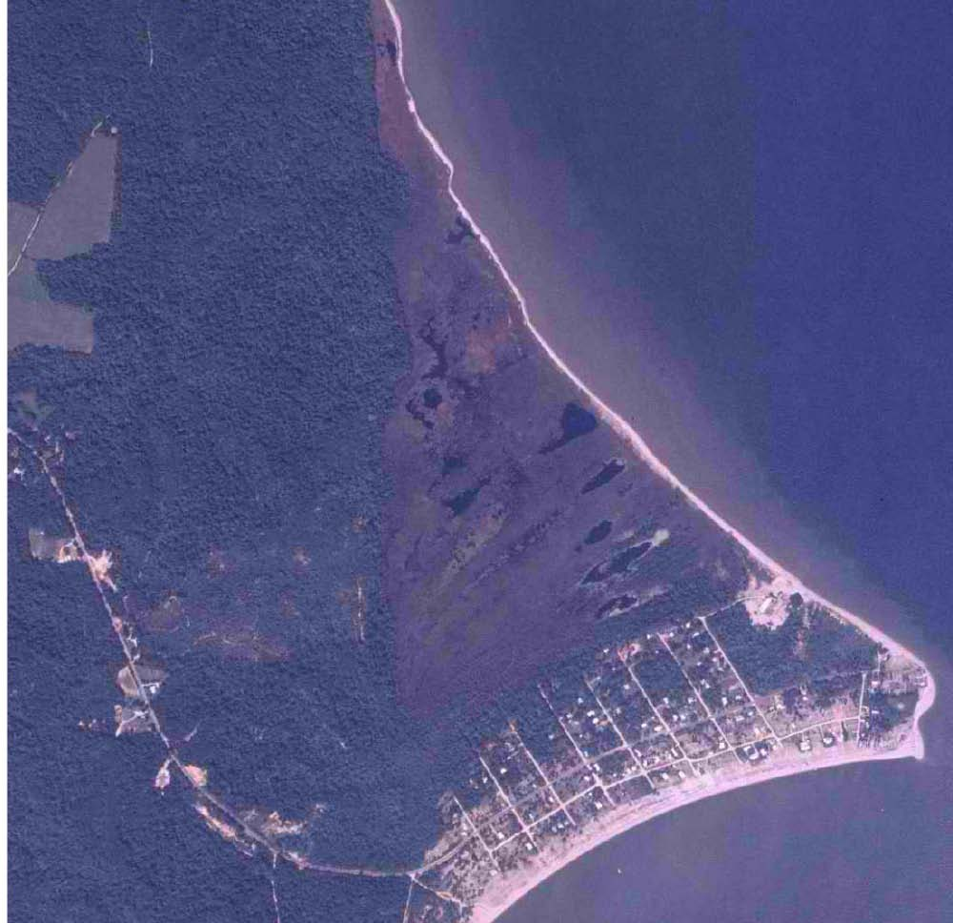
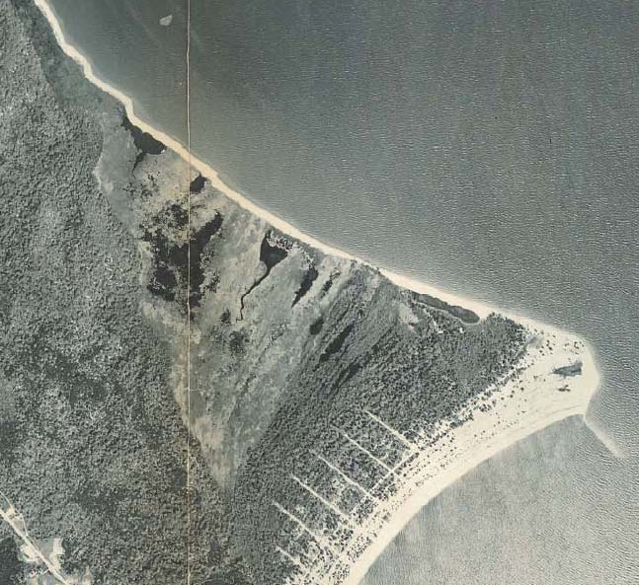
1969
1939

Slide 16
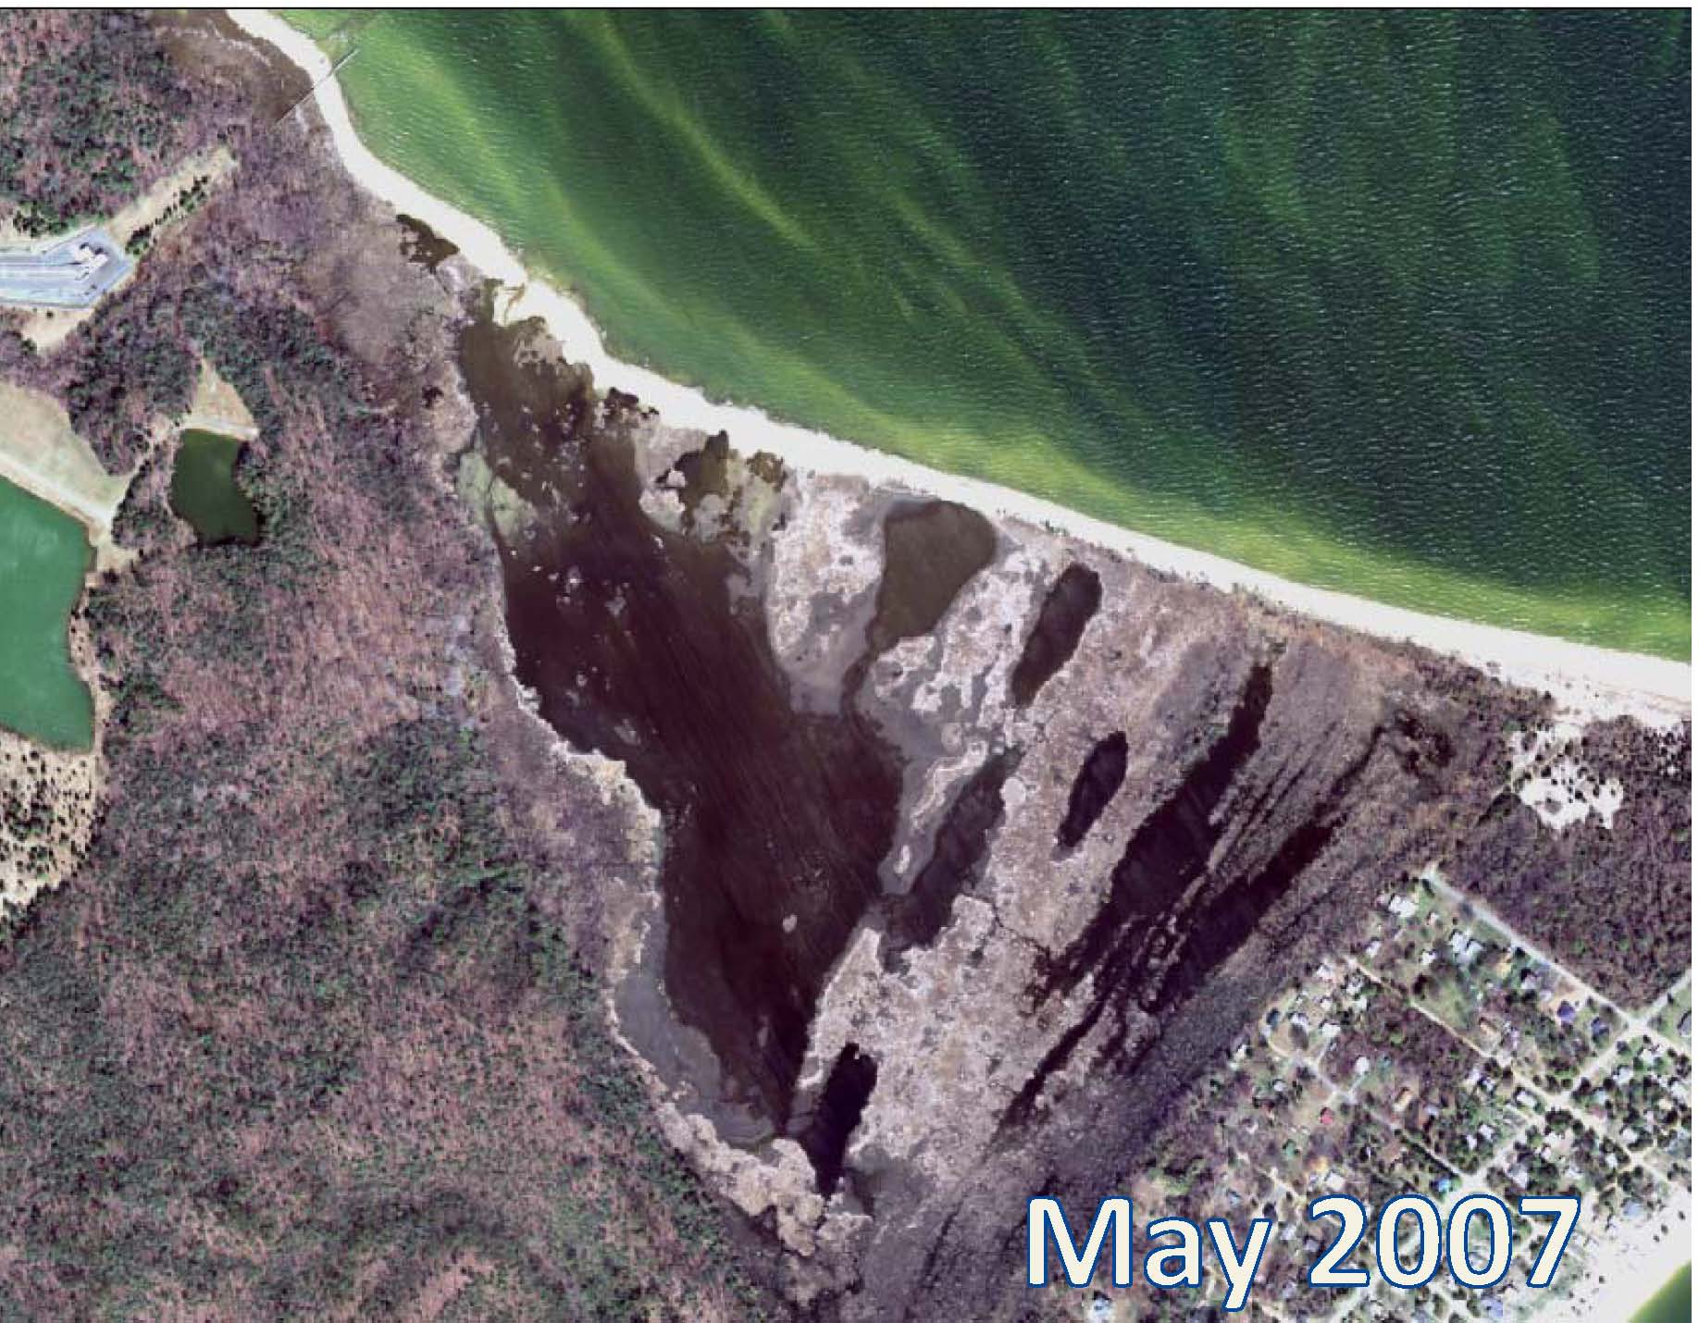

Slide 17
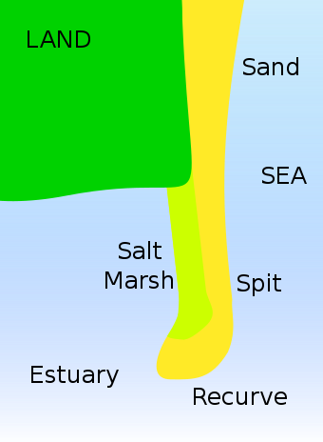
Cuspate Spit
Cuspate spits are projections of a beach into an enclosed or semi-enclosed lagoon.
“Cuspate spits form in elongate lagoons where the basin shape acts as a selective filler on the wave spectrum, so dominant wave approaches are at a high angle to the shoreline” (Rosen, 1975).

Slide 18
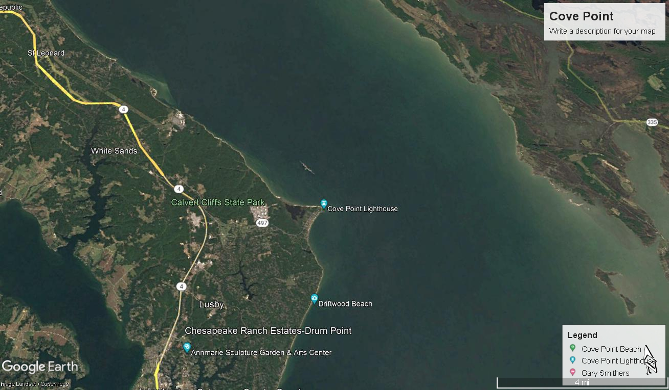
Tide flow/Wave action
Tide flow/Wave action
Cove Point, a cuspate spit, is vulnerable to major wave action. Sediments from shoreline erosion also get trapped

Slide 19
Sediment erodes off of Calvert Cliffs and flows towards Cove Point with the tide
Tide flow/Wave action

Slide 20
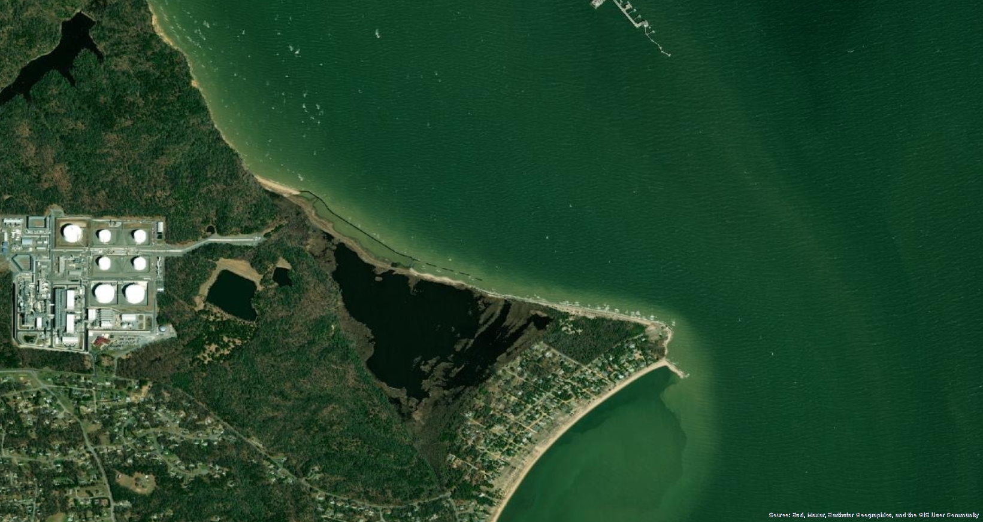
Sediment from the eroding cliffs gets trapped at the
beginning of the revetment, with less sediment available to be deposited by the time the flow of the tides reach the end of the revetment. High wave energy impacts the end of the revetment with less sediment to deposit
Tide Flow/Wave Energy

Slide 21
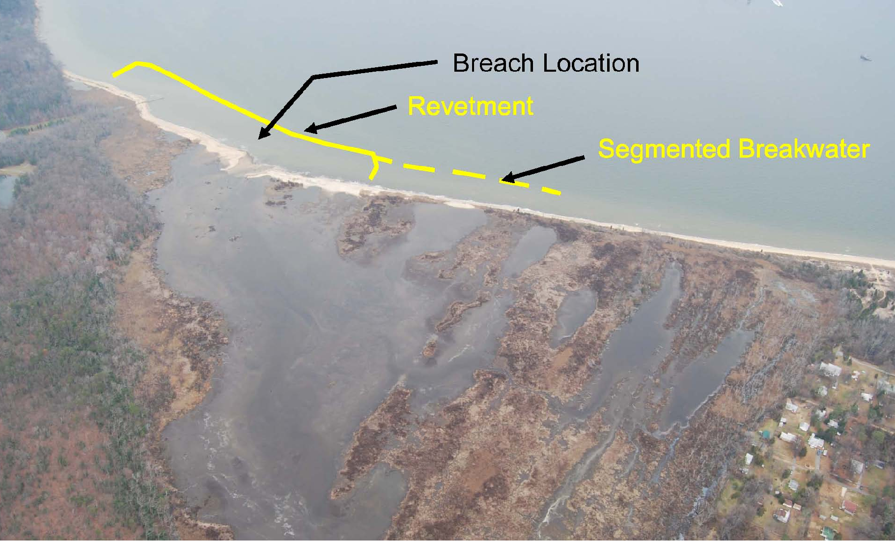

Slide 22
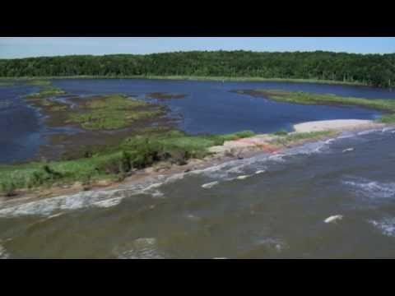

Slide 24
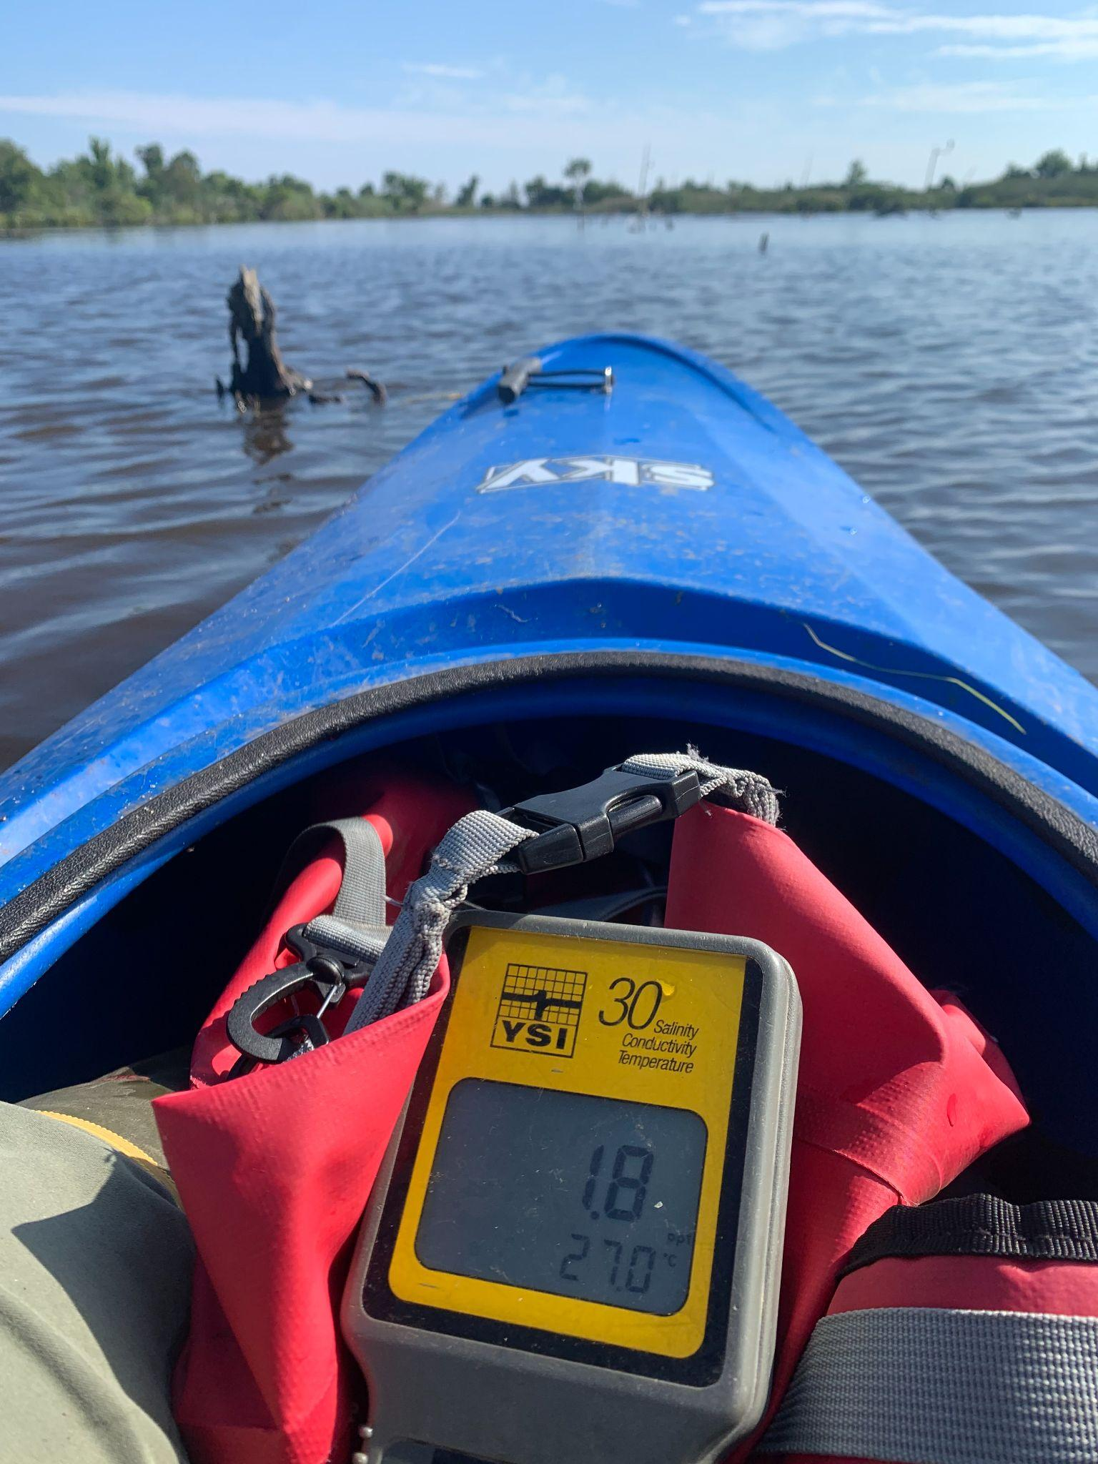
Data Collected Monthly
Salinity of freshwater marsh
This is not required per our award, however, lets us know of any overwash or breaches that are not detectable visually.
Shoreline Inspection
This is required per our award. This allows us to monitor erosion, and any breaches or overwash spots. It is not associated with an official permitted task or responsibility but was added to our award
Conductivity
Measured through the deployment of Hobo loggers placed near the revetment pipes. This would allow us to know if the pipe(s) fail at being one-way drainage, and also detects any breaches and the exact date of said breach.

Slide 25
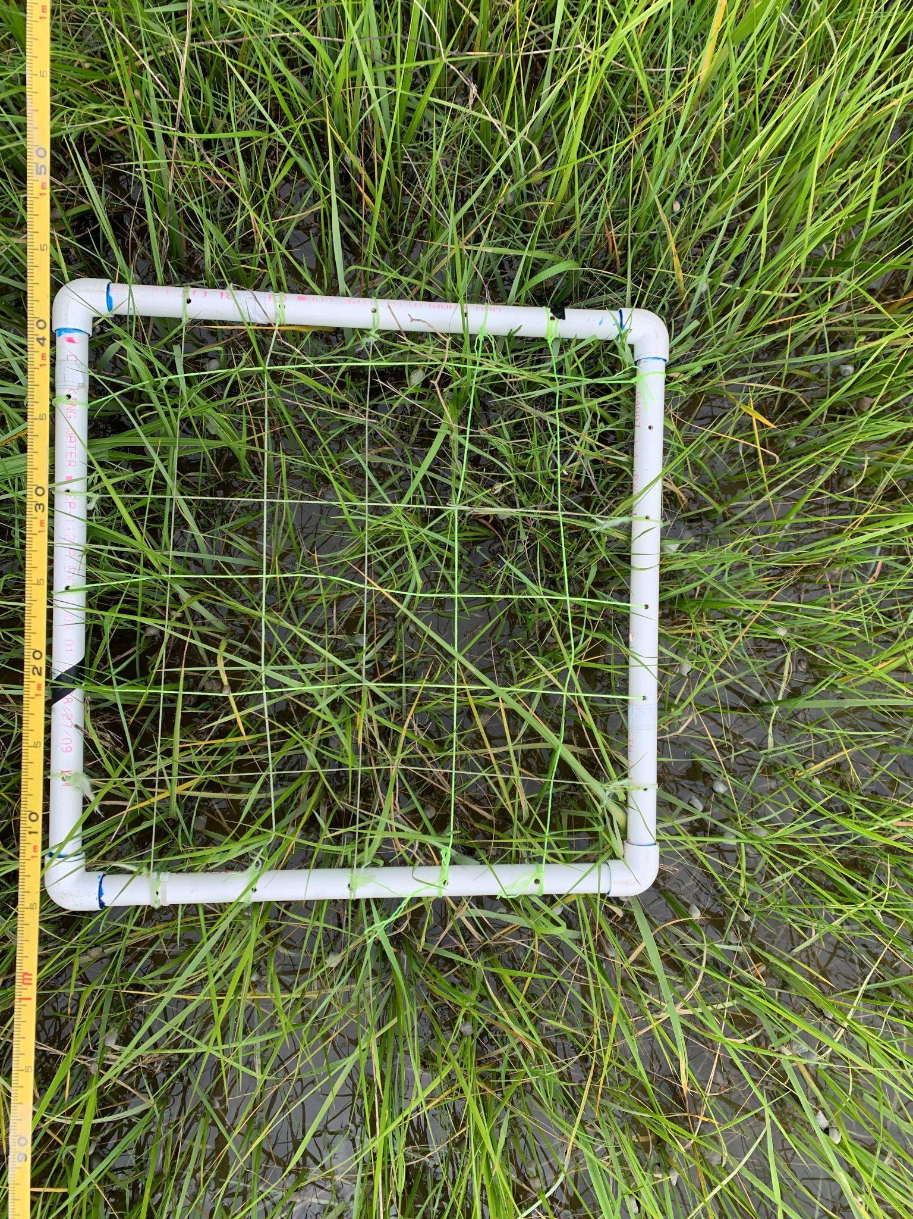
Data Collected Annually
Percent Cover (Invasive) 1.2.3.1, 1.2.4.1
Biomass 1.2.3.1, 1.2.4.1
Surface Elevation Tables (rSET) not required by permit
Rare Threatened Endangered (RTE) Survey not required by permit
Some of this is only required on every 5 year basis, but in order to meet invasive species work we must do it eah year (e.g. % cover)

Slide 26
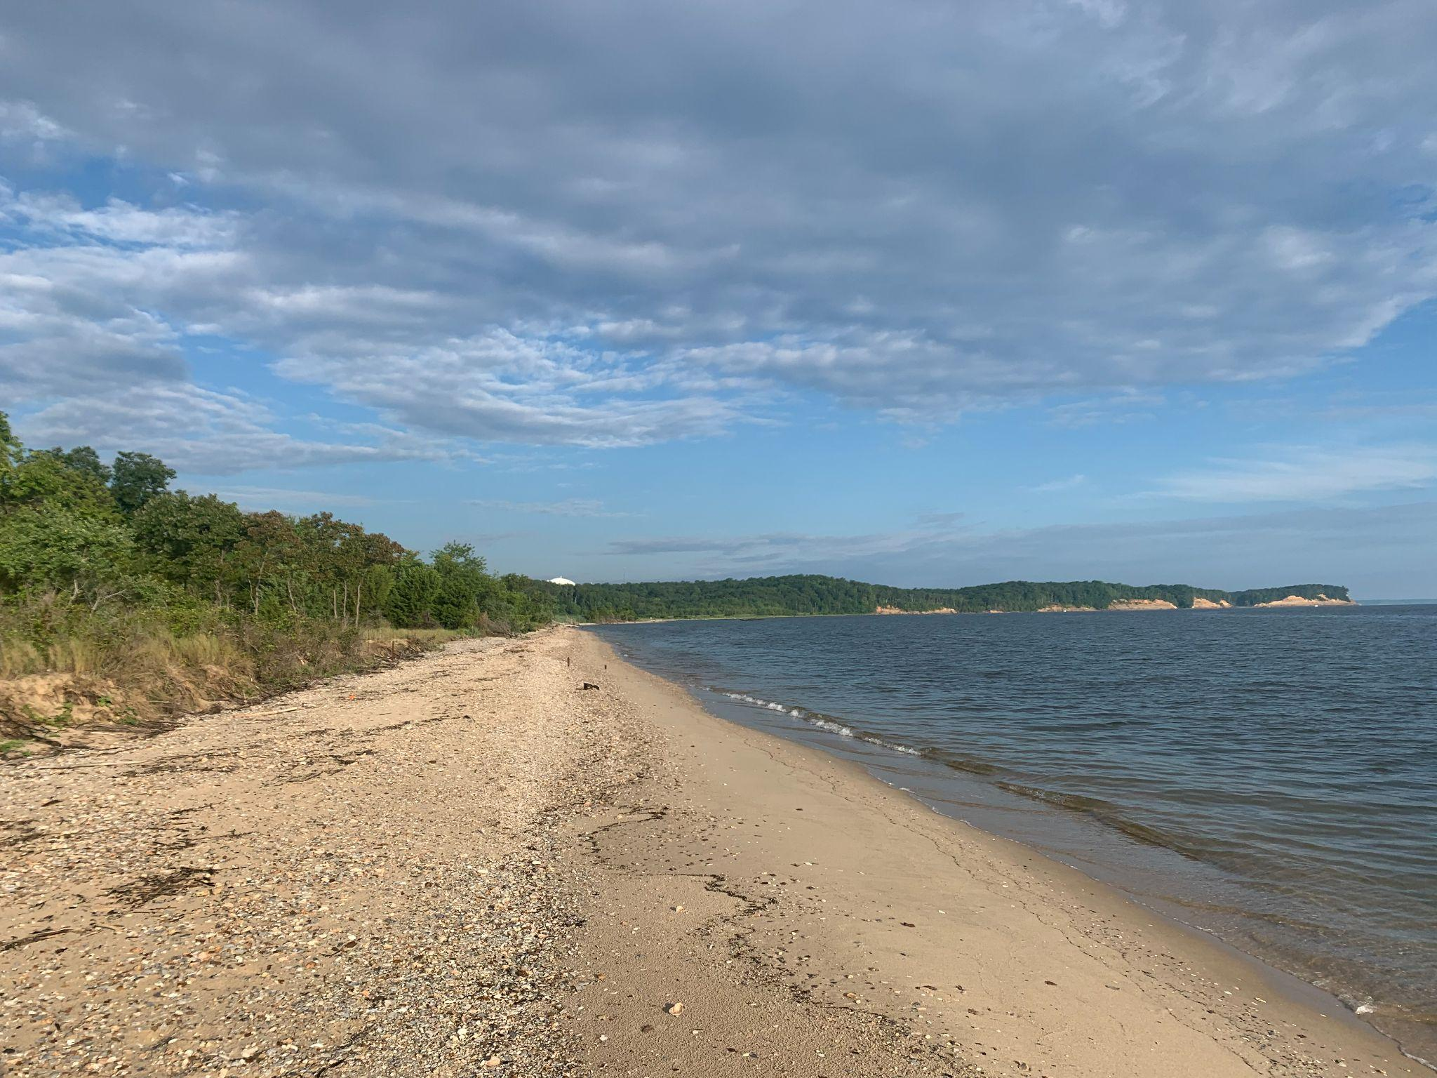
Data Collected Bi-Annually or Every Five Years
Drone Shoreline Imagery (even years) 2.2.3.1, 2.2.3.3
Beginning in 2022, this data will be collected by another lab in the UMCES community. The pilot is FAA certified and experienced commercially and recreationally.
Shoreline Profiles 2.1.3.3
RTK elevations
PEET Plots for biodiversity 2.2.4.1
Water Levels (even years) 2.2.3.1
Collected using a Hobo monitoring device.

Slide 28
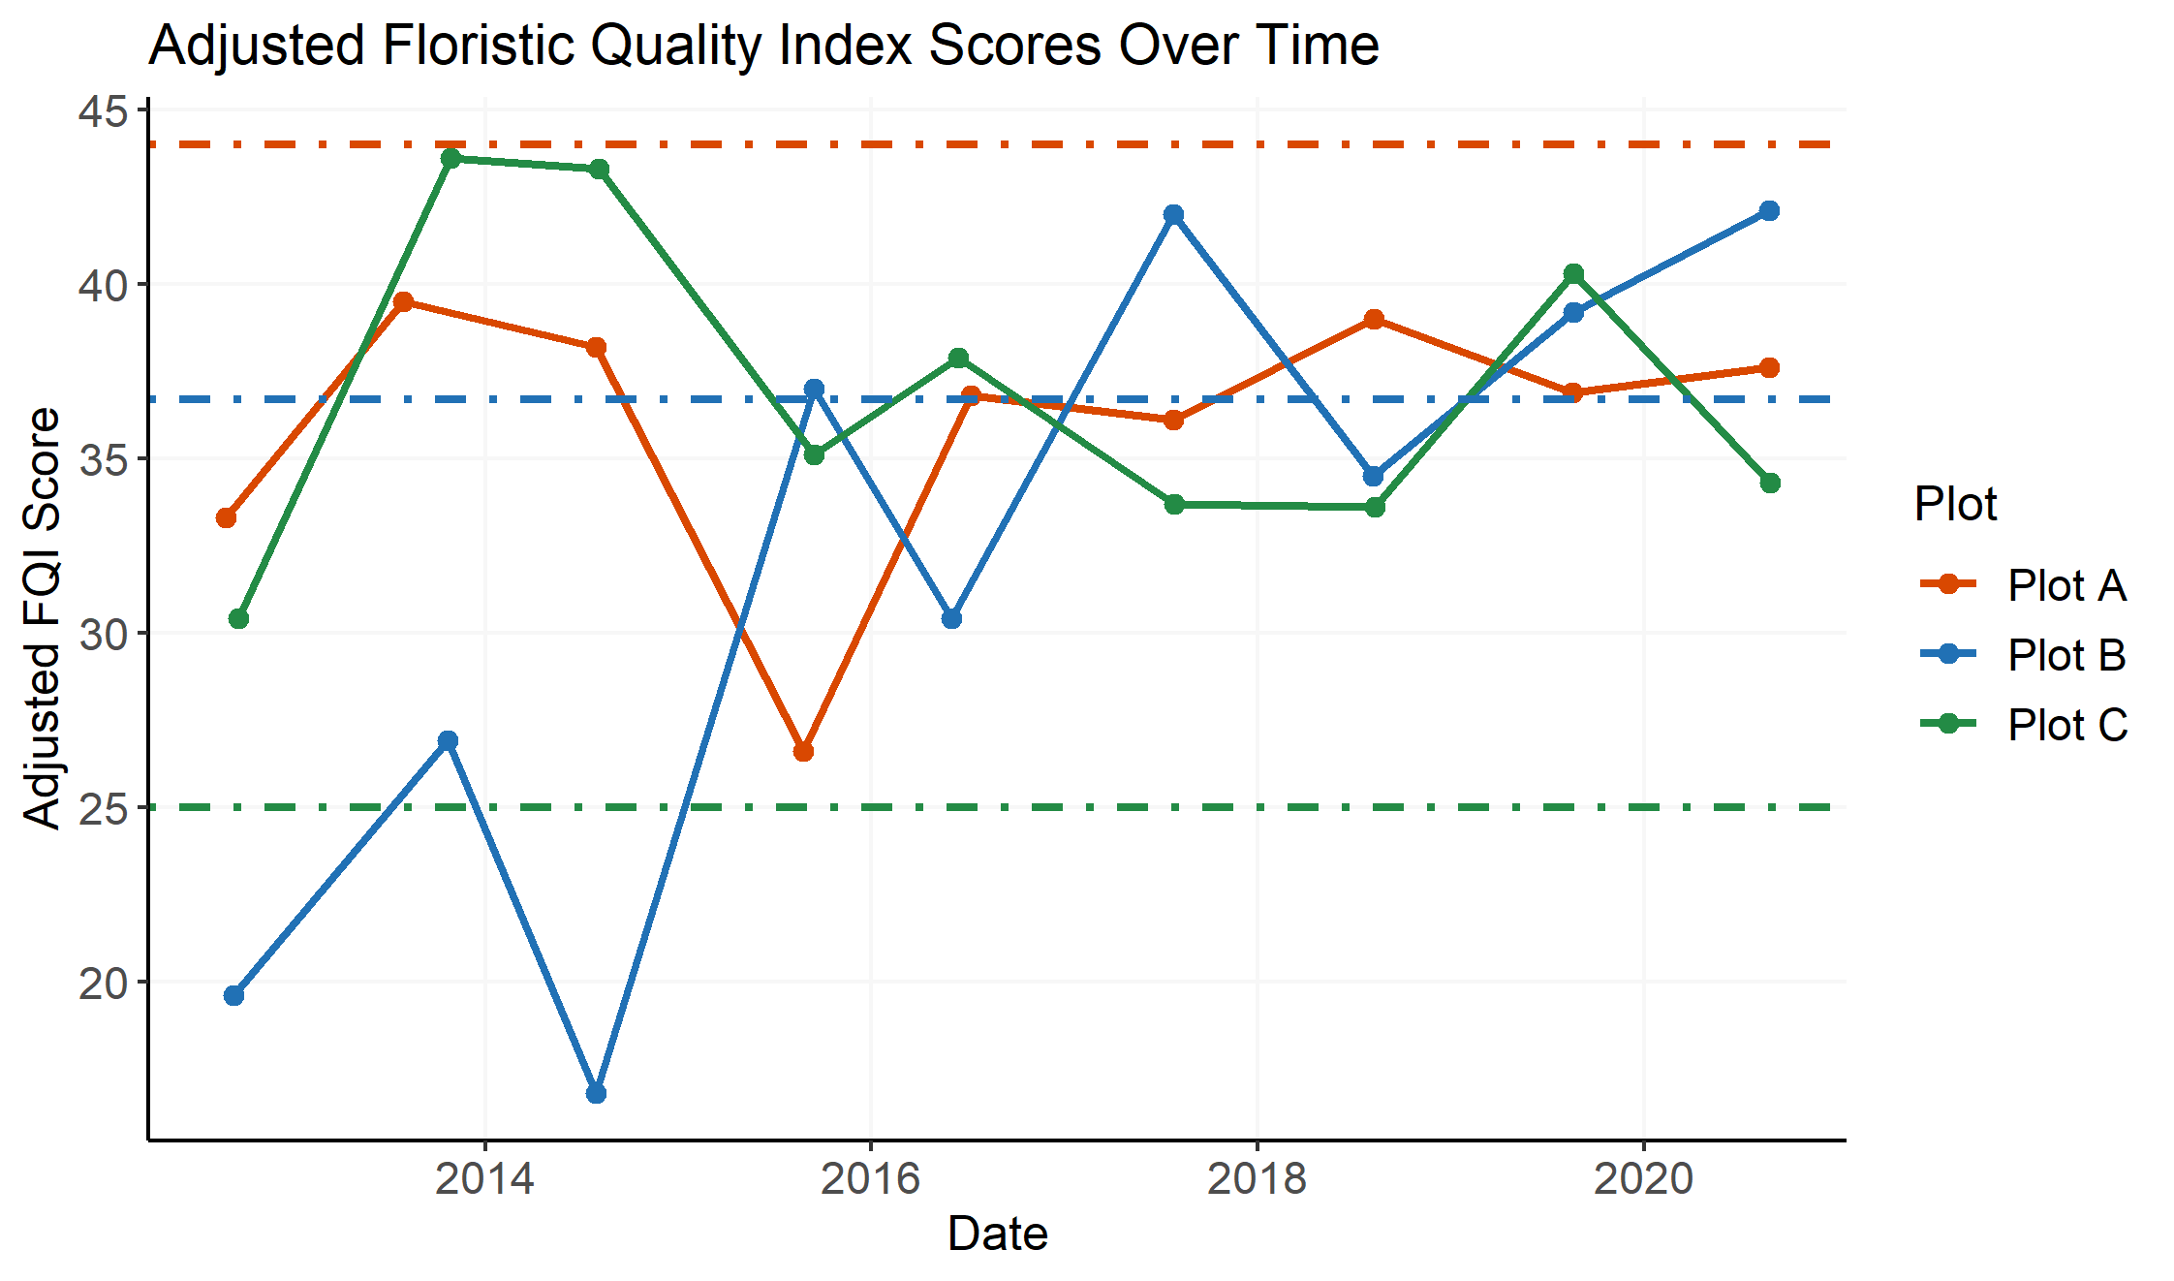
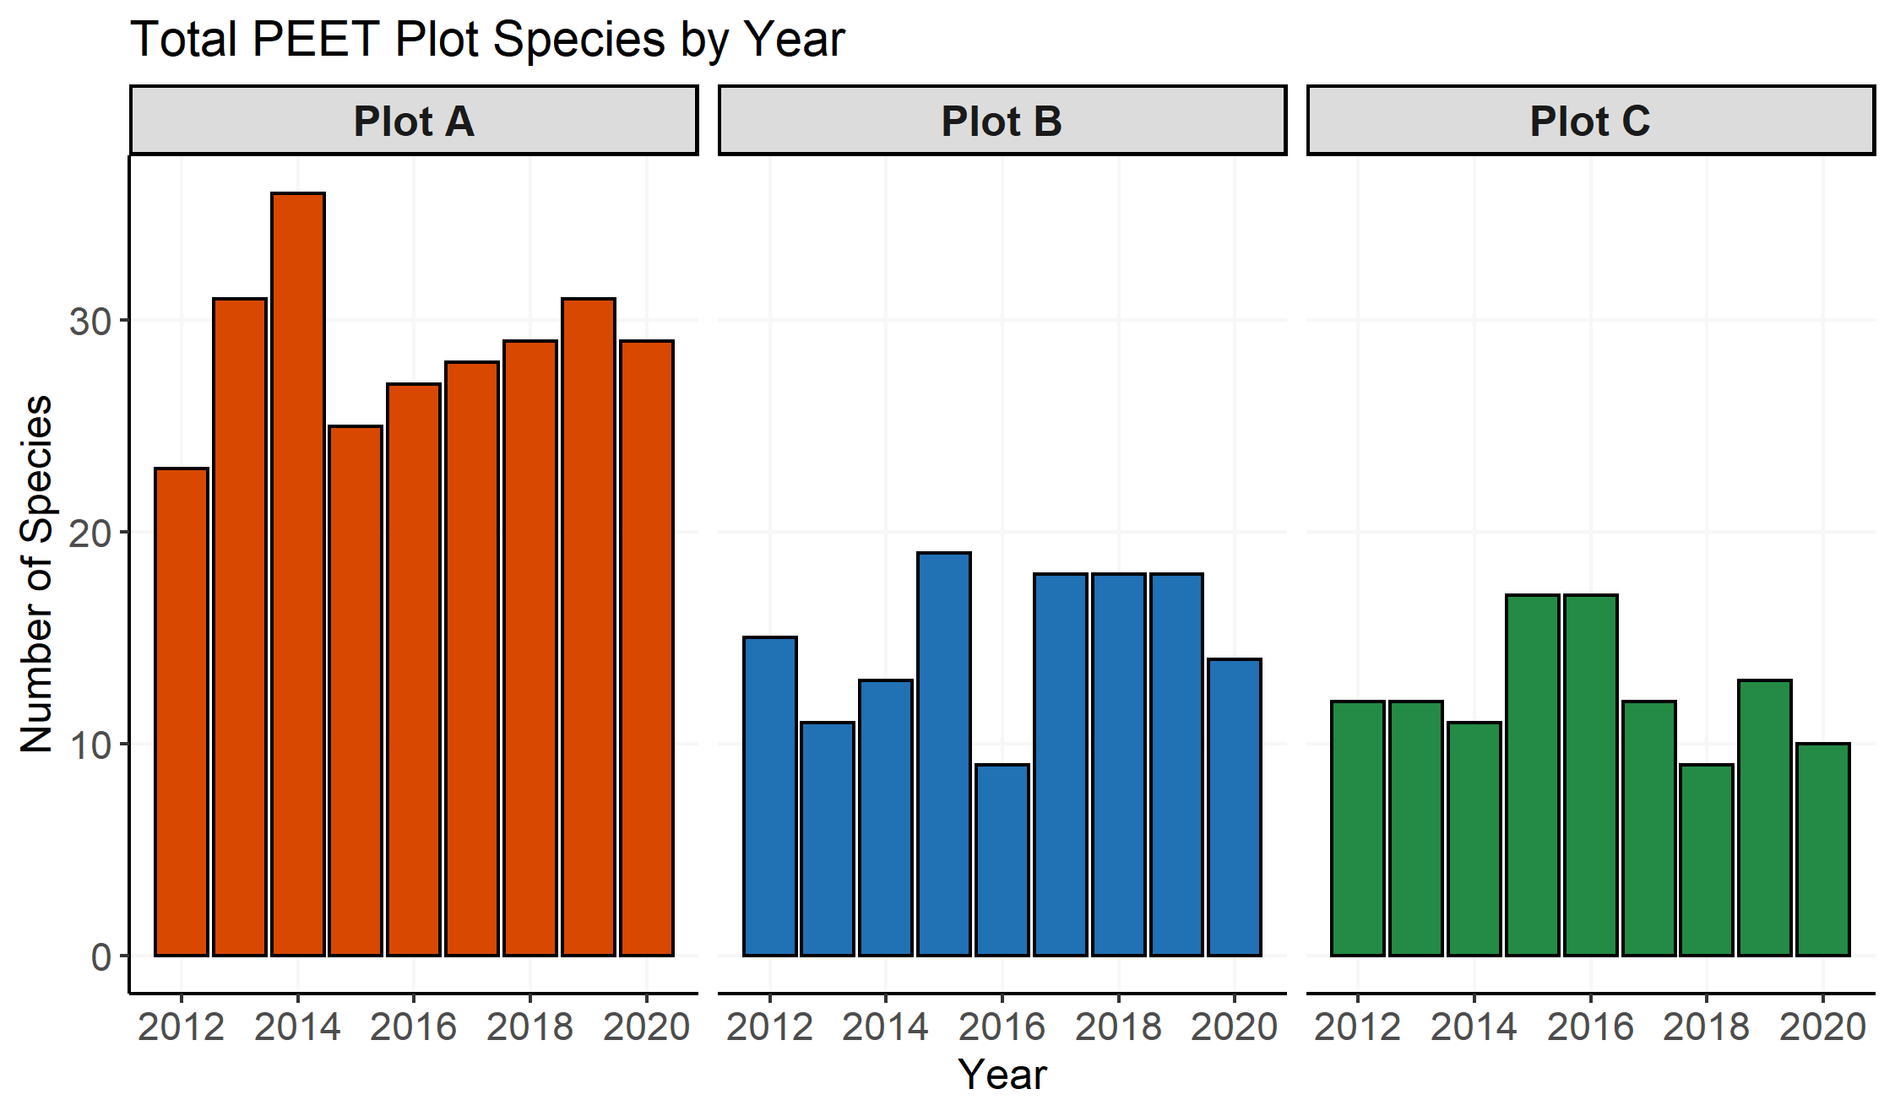

Slide 29
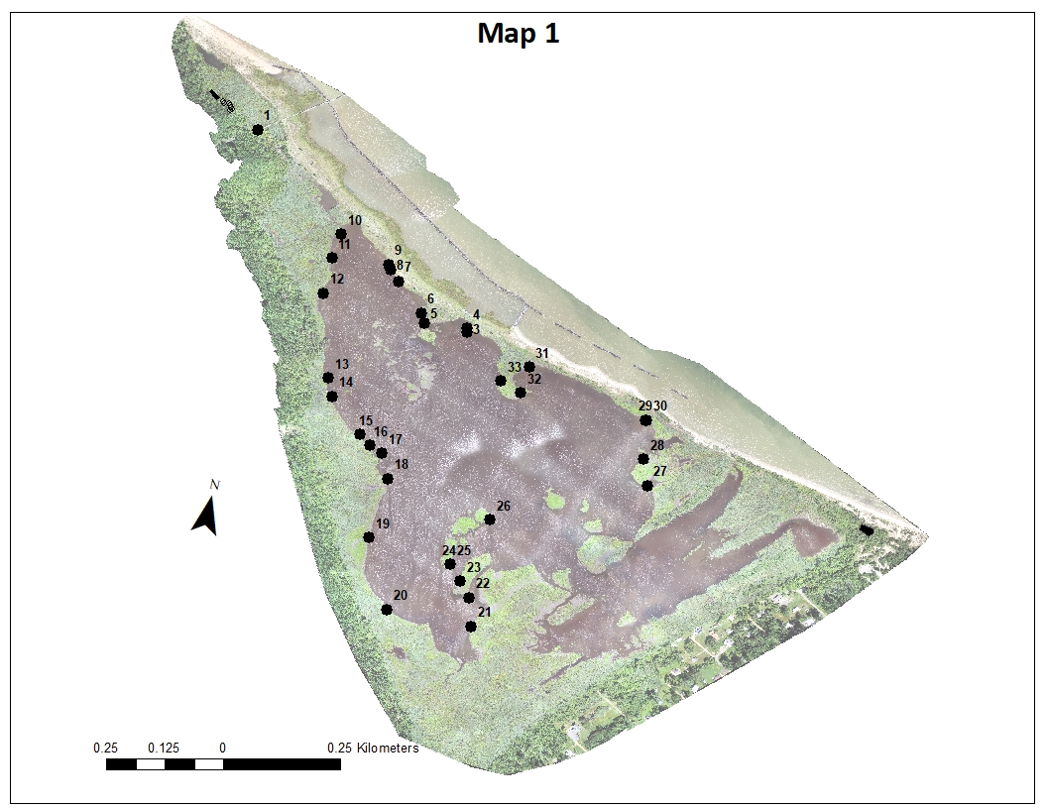
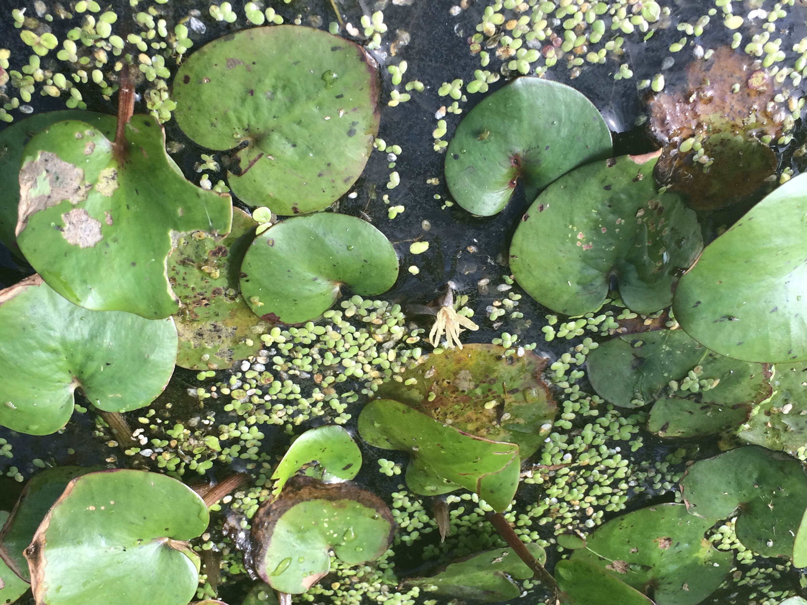
2021 RTE Plant Map

Slide 30
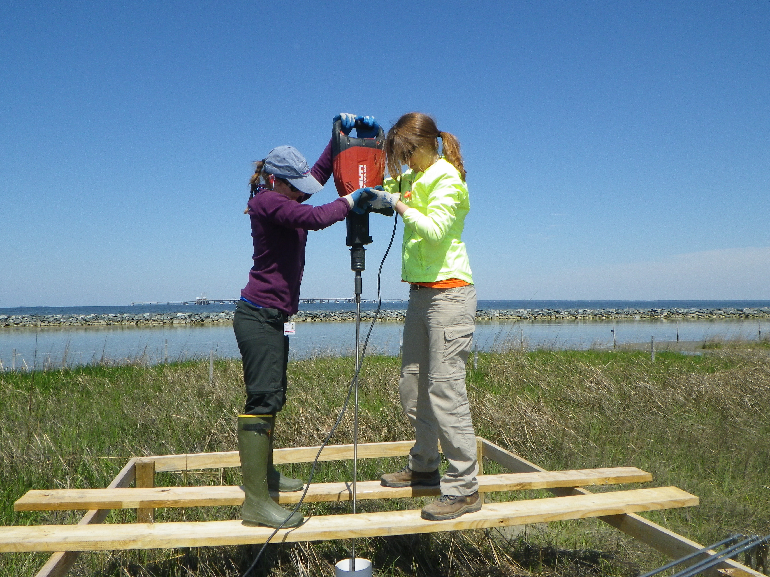
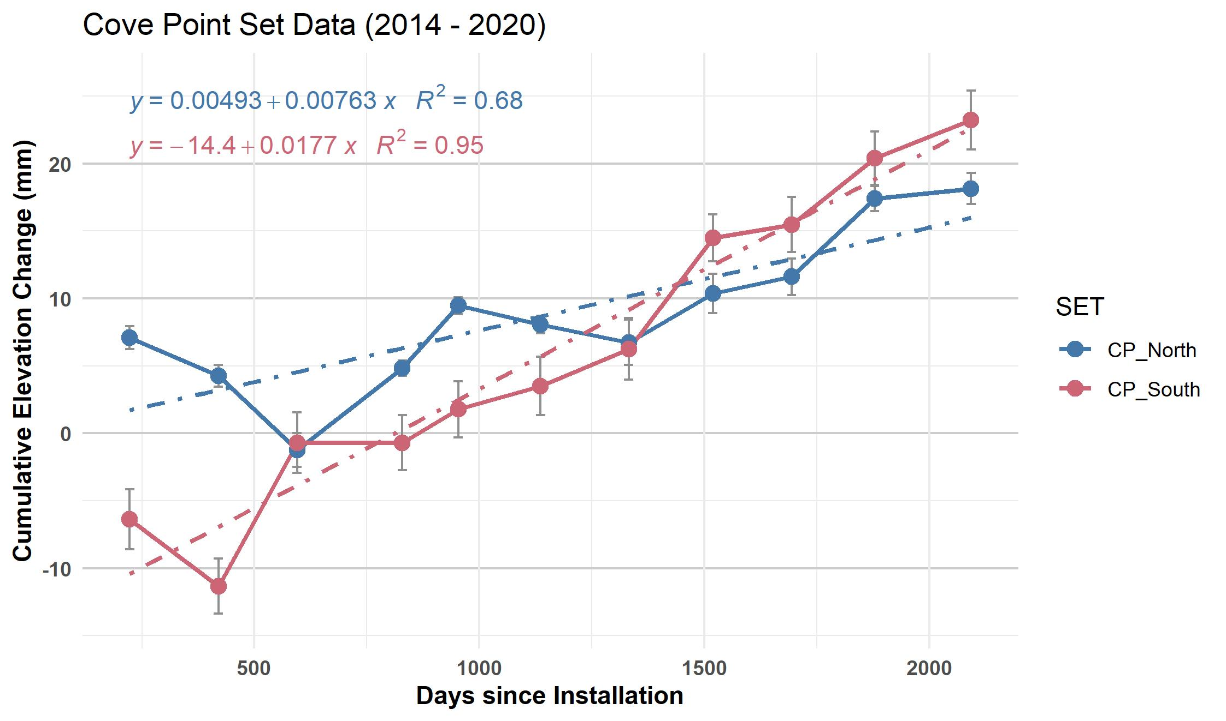

Slide 31
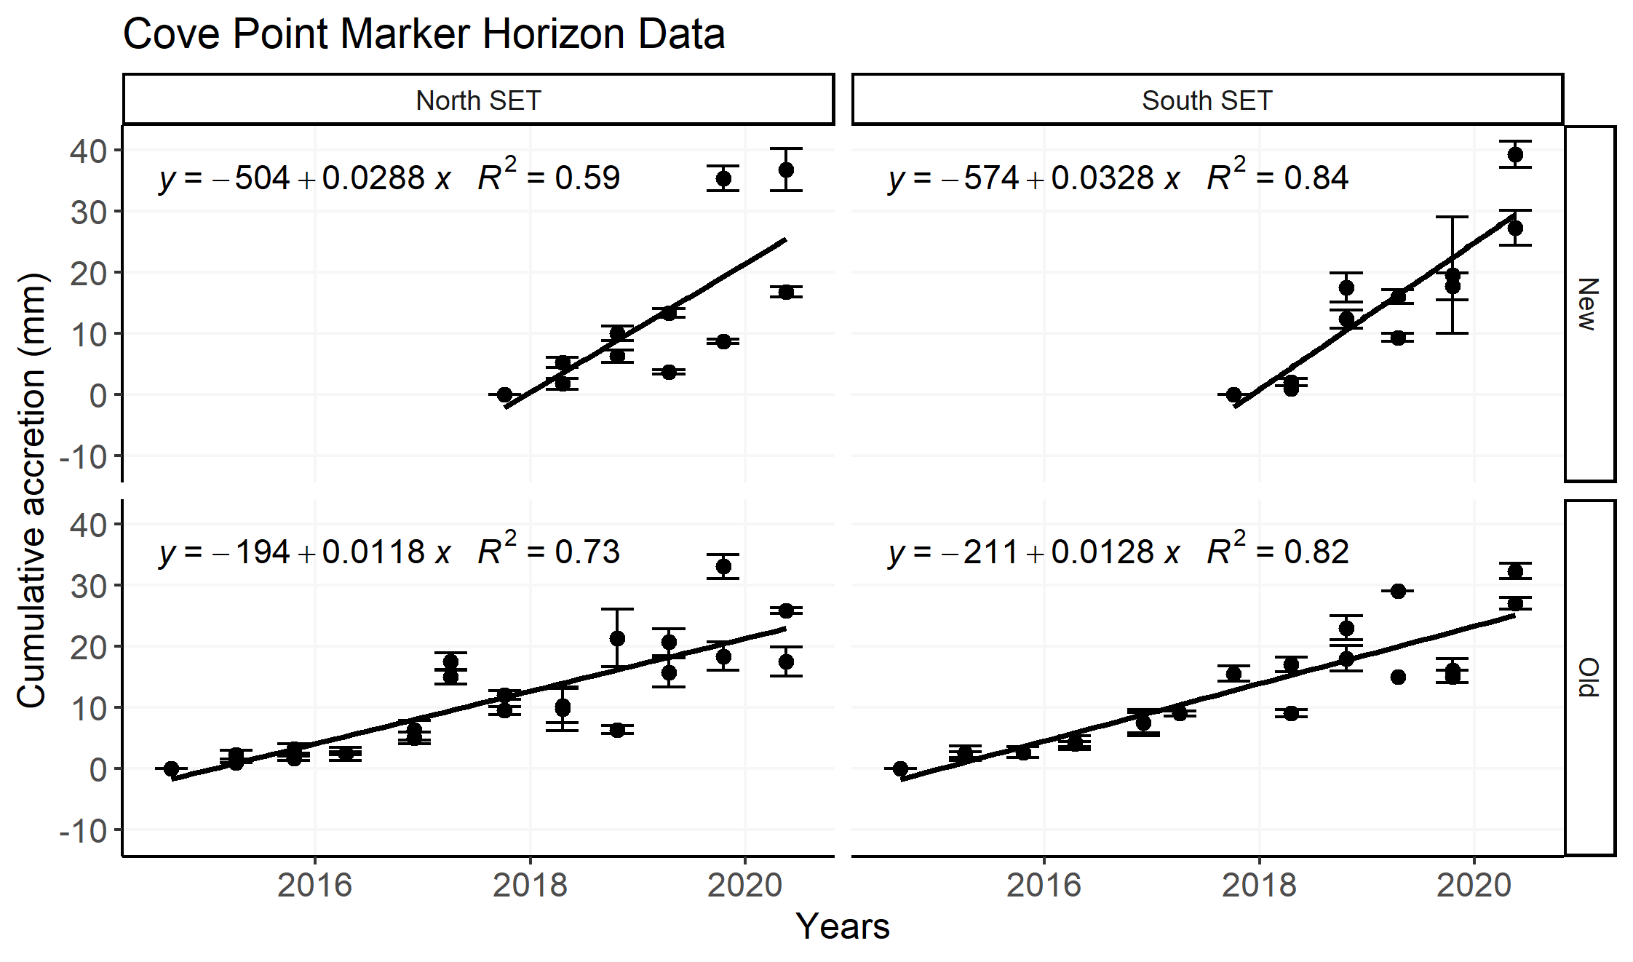

Slide 32
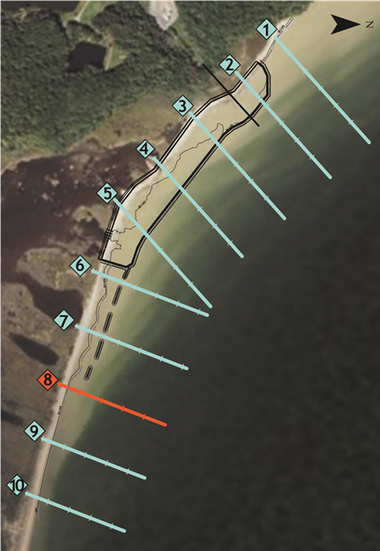
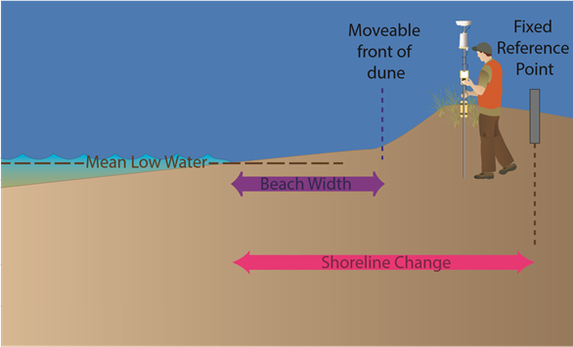
Beach Erosion Data
The shoreline is eroding at a consistent rate, specifically where the breakwaters end (line 8).
Left: 2020 Beach Profile Lines
Below: Data Collection Graphic

Slide 33
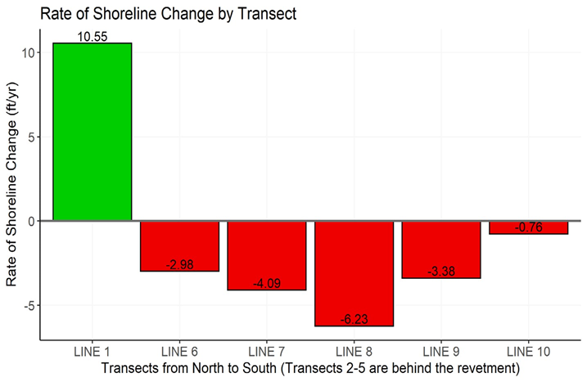

Slide 34
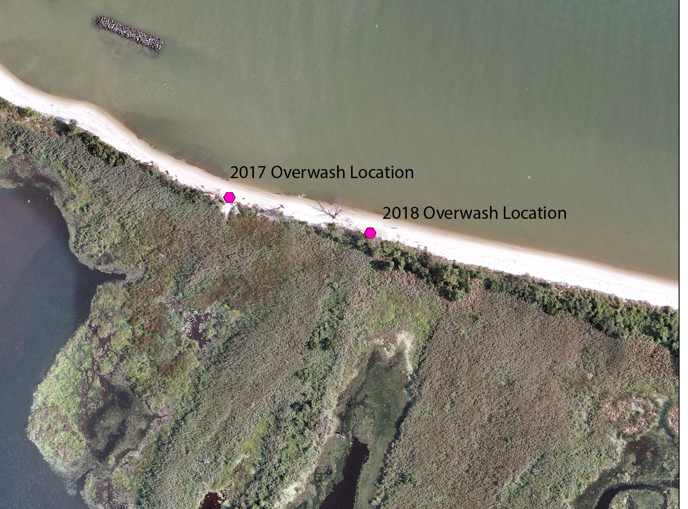
Line 8
Historic overwash locations. Imagery from 2018.

Slide 35
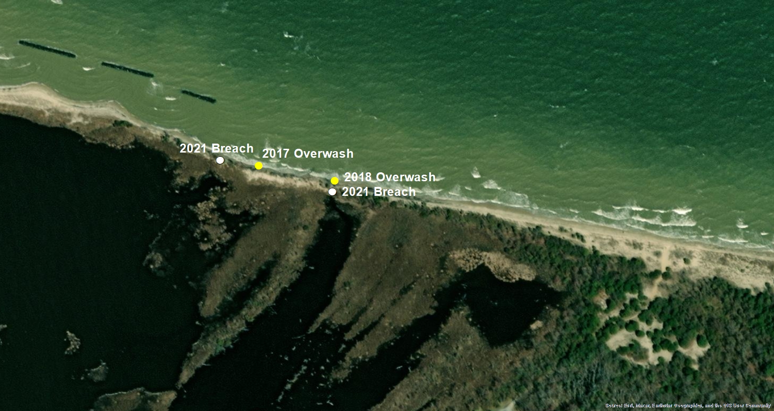
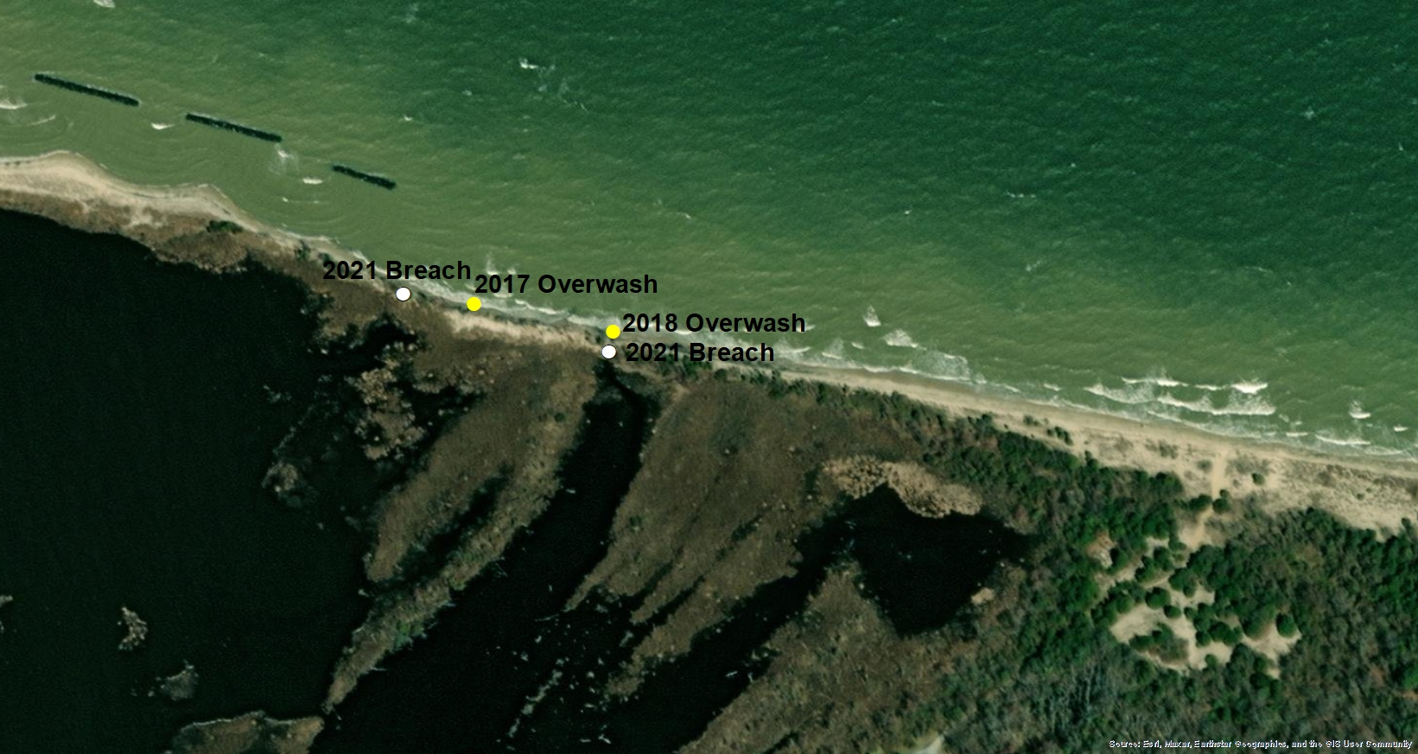
Line 8

Slide 36
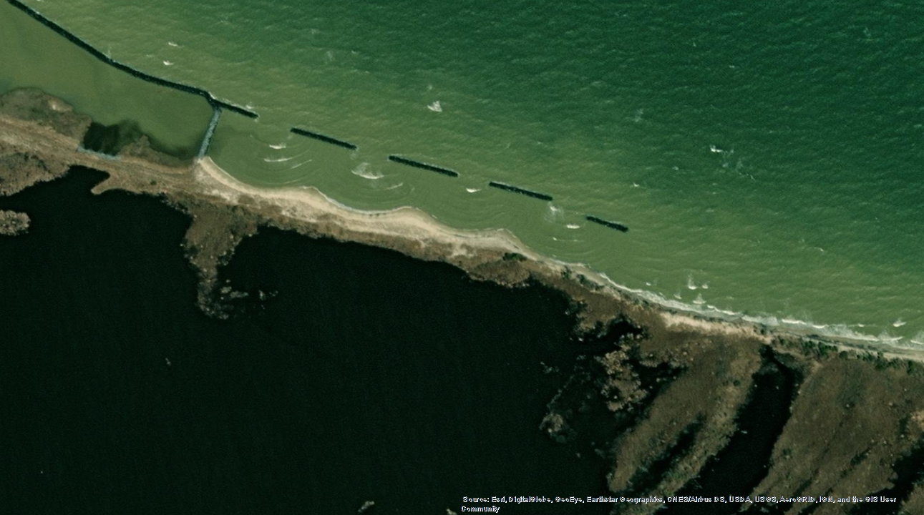
Shoreline erosion occurring between breakwaters; wave energy is channeled and directed off of the end of the breakwaters and towards the shore

Slide 37
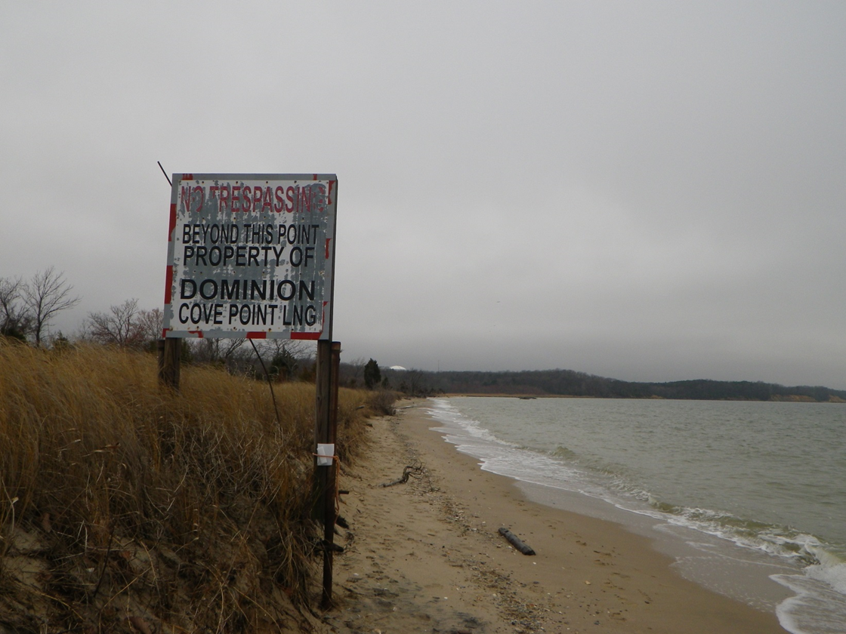
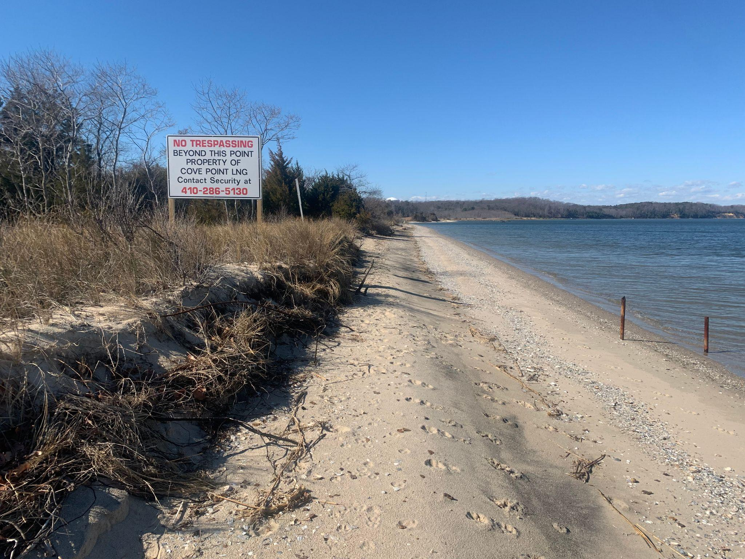
Shoreline Erosion Over Time
April 2015
February 2022

Slide 38
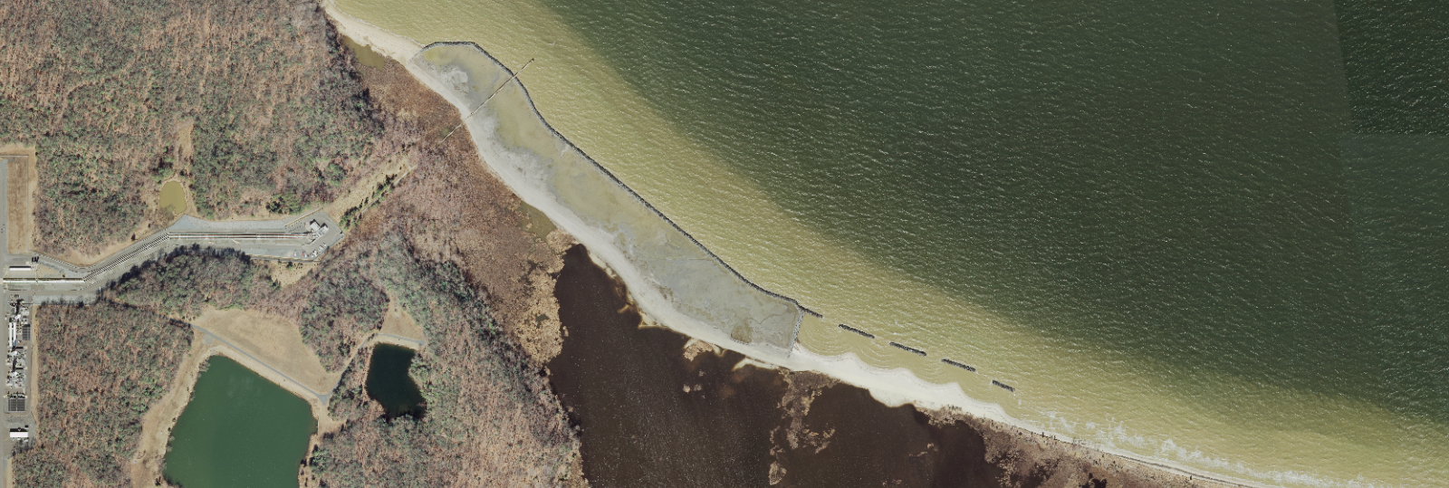
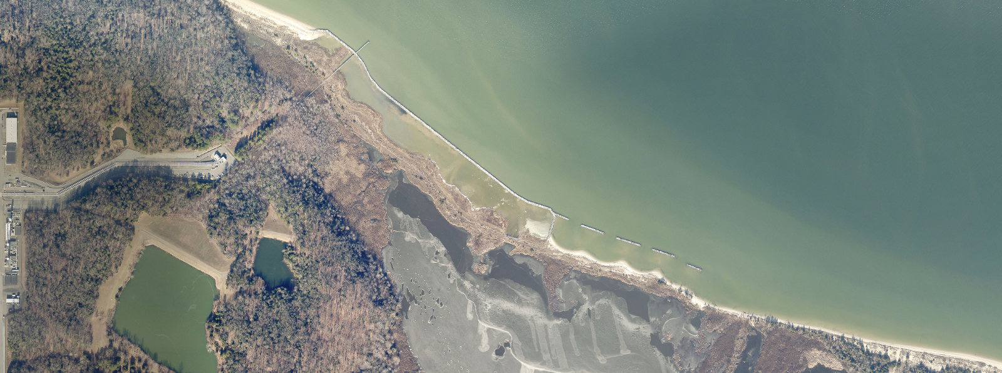
Above Left: 2011 Shoreline Imagery of Cove Point
Bottom Left: 2022 Shoreline Imagery of Cove Point

Slide 39
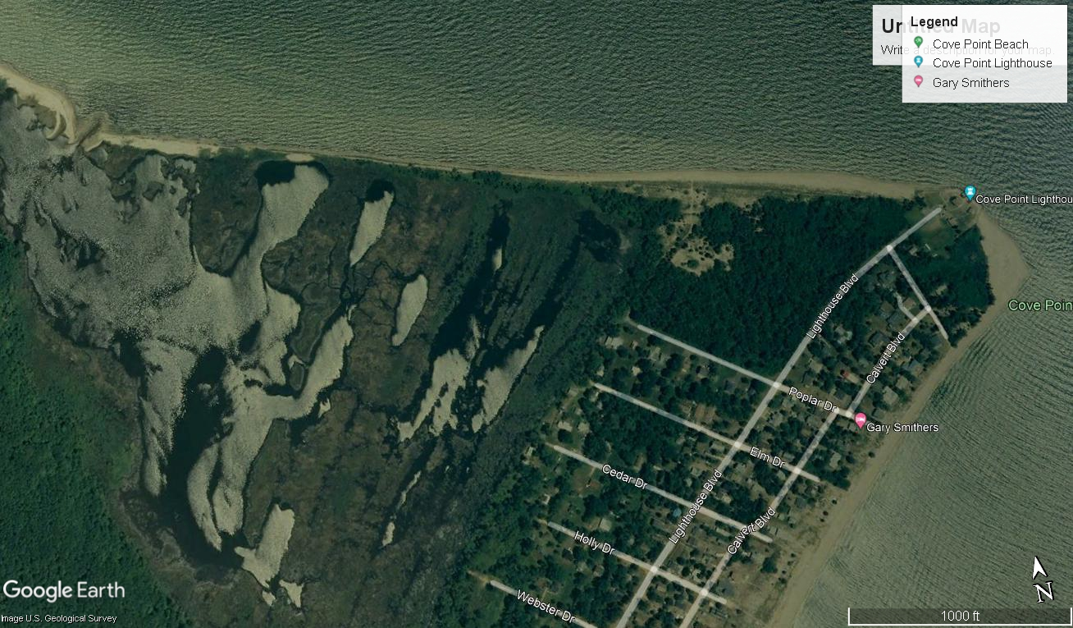
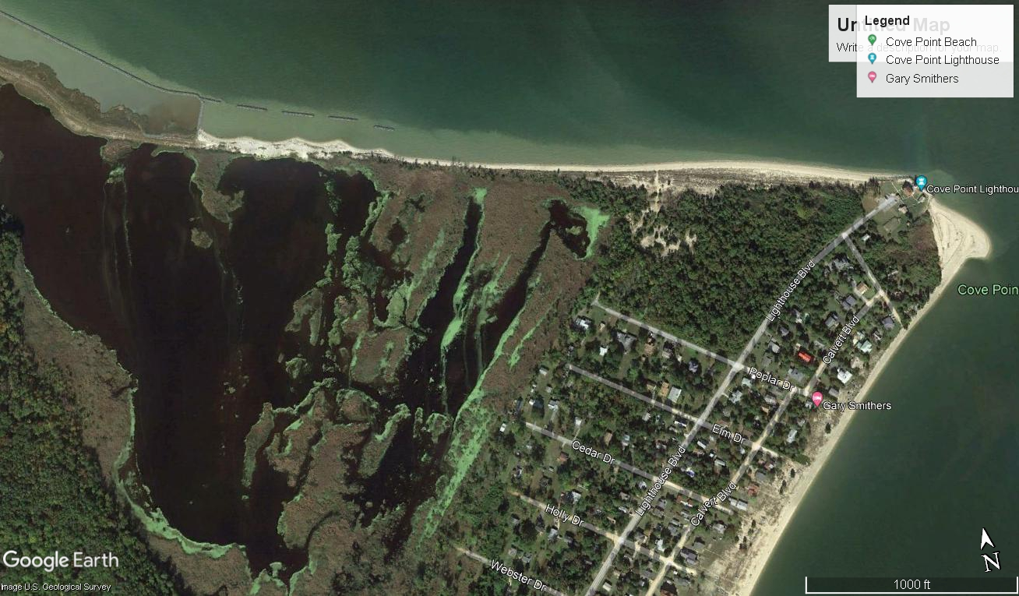
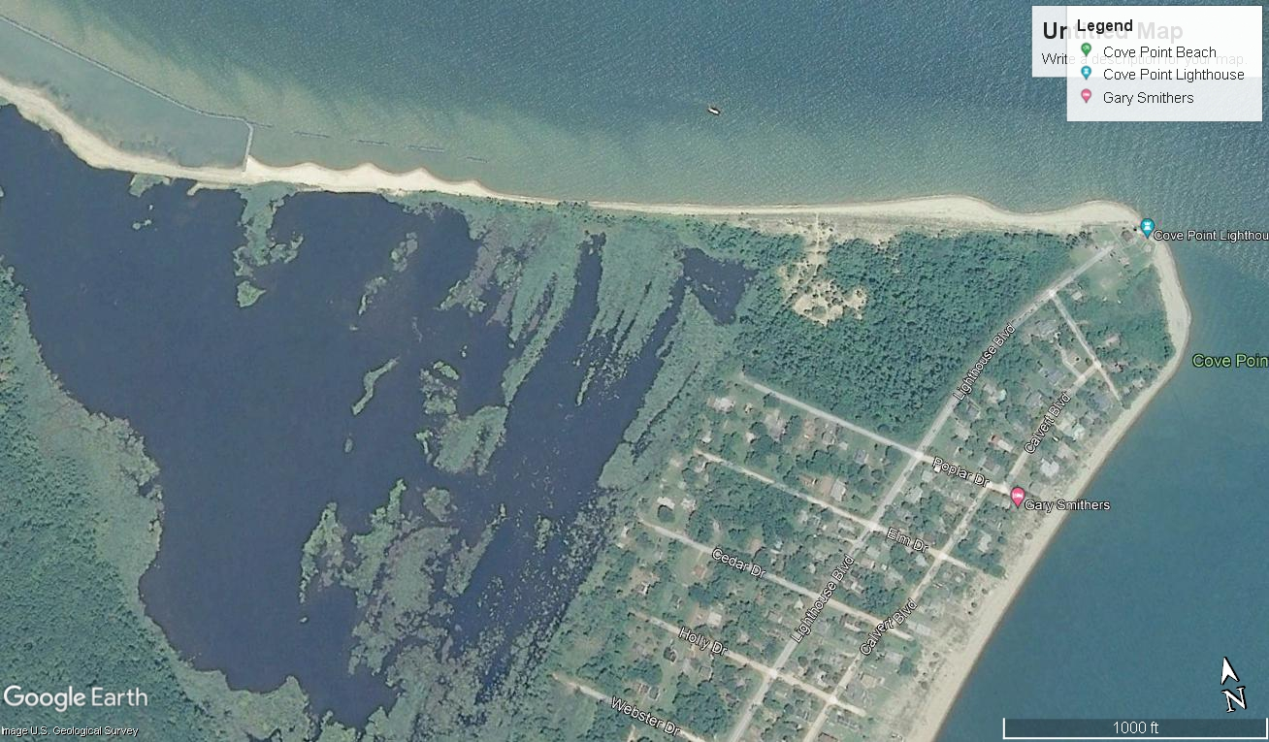
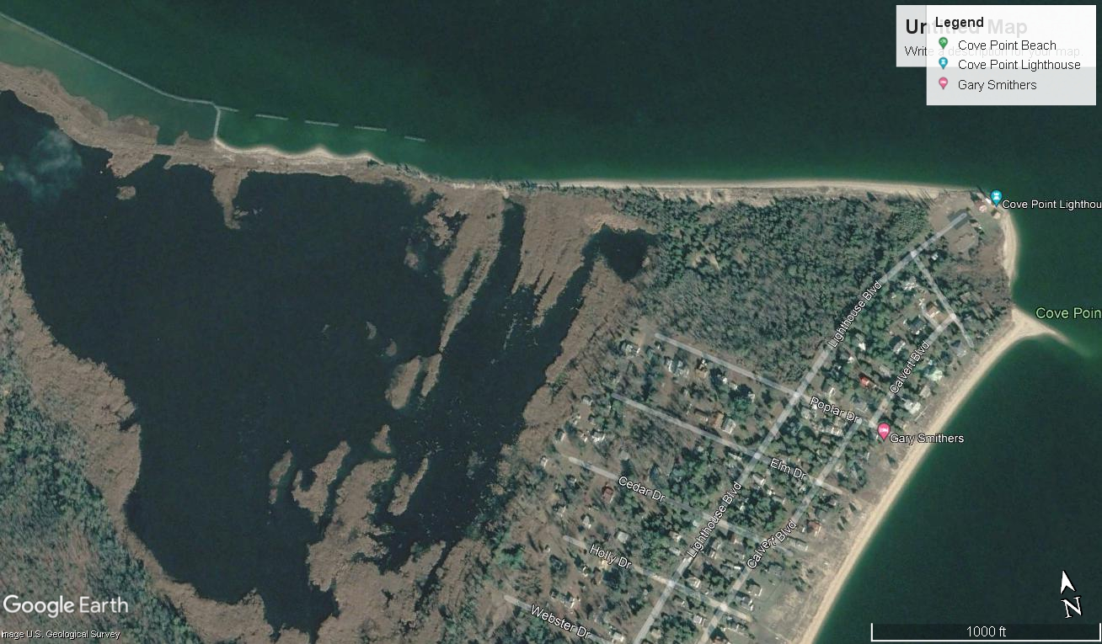
Pre-Construction: 2009
Post-Construction: 2013
Post-Construction: 2011
Post-Construction: 2020

Slide 40
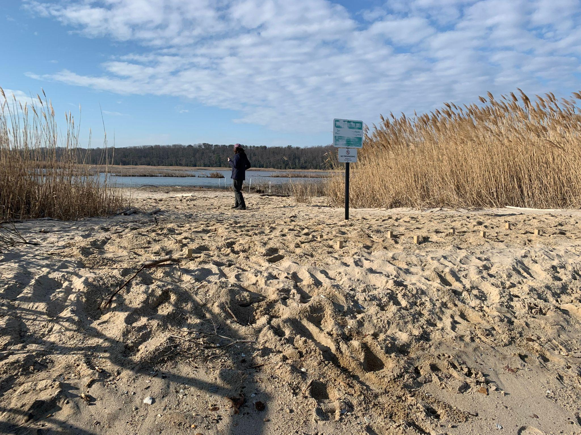
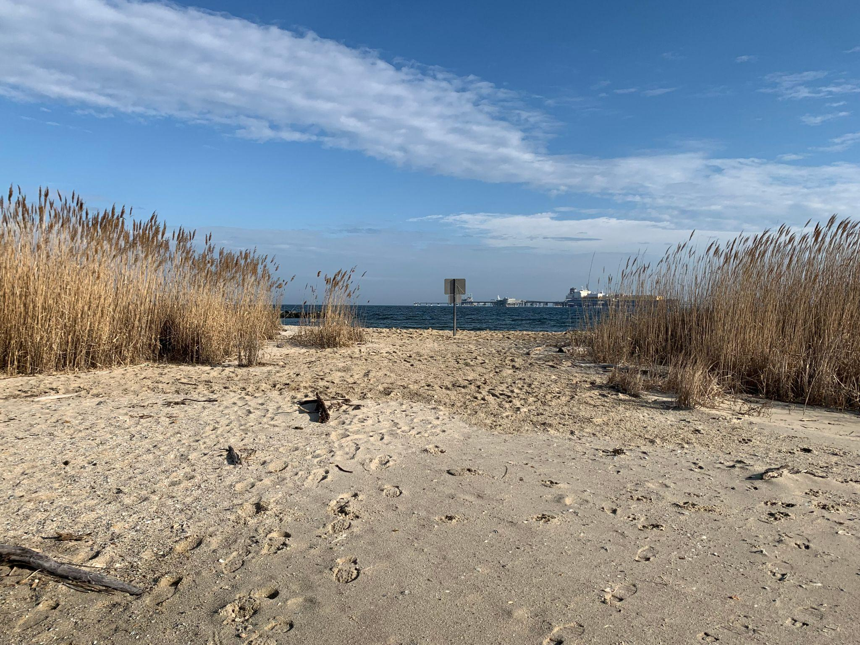
CURRENT Solutions
Coir logs were installed and buried underneath sand.
Elevation of shoreline at the breach raised to prevent overwash.

Slide 41
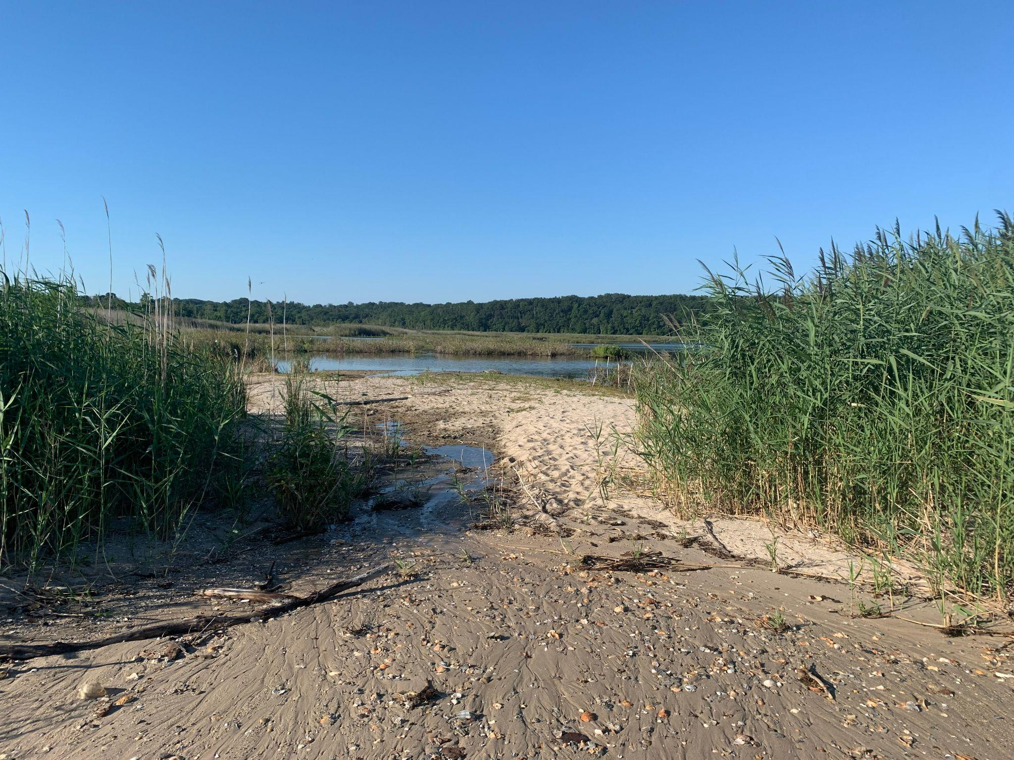
CURRENT Solutions
8/18/2022
2/23/2023

Slide 42
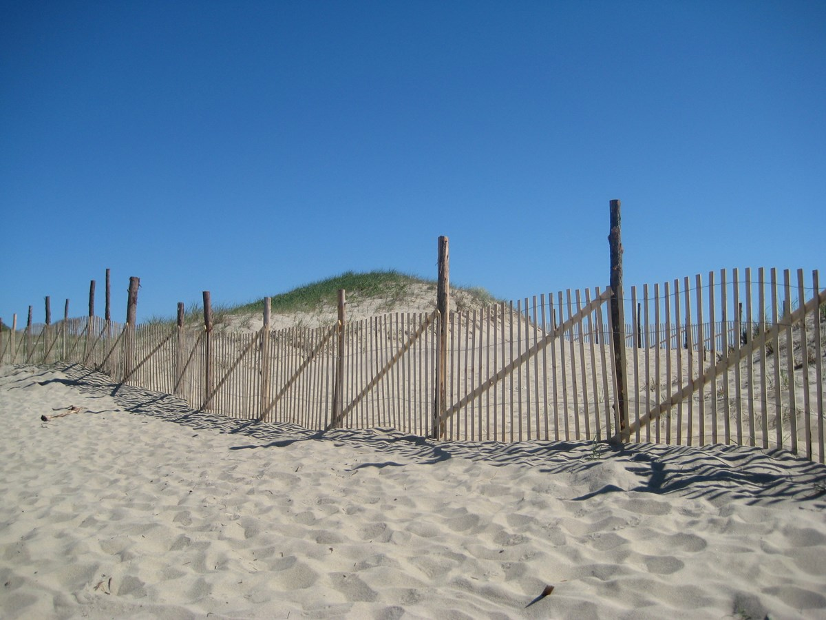
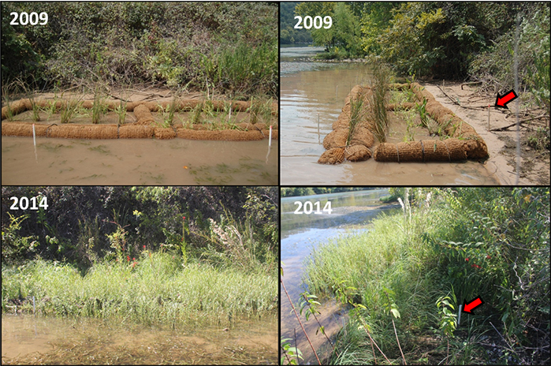
Short-term Solutions
Discussion and Questions
Photo by National Park Service
Photo by Austin, Texas Government
Dune fencing help trap sand that may be eroding or blown from the dunes.
Coir logs help trap sediments and promote plant growth.

Slide 43
Works Cited
Maryland Department of Natural Resources, Maryland Department of Agriculture, Maryland Department of the Environment, Maryland Department of Health, National Oceanic and Atmospheric Administration. Maryland Climate Adaptation and Resilience Framework Recommendations (2021 - 2030).
Retrieved from: https://mde.maryland.gov/programs/air/ClimateChange/MCCC/Documents/2022%20Annual%20Report%20-%20Final%20%284%29.pdf
Maryland Commission on Climate Change (2022). 2022 Annual Report.
Retrieved from: https://mde.maryland.gov/programs/air/ClimateChange/MCCC/Documents/2022%20Annual%20Report%20-%20Final%20%284%29.pdf
Global Energy Network Institute (2016). Glaciers, Thermal Expansion, and Ice Sheets.
Retrieved from: http://www.geni.org/globalenergy/library/technical-articles/generation/climate-change/bbc-news/major-sea-level-rise-likely-as-antarctic-ice-melts/index.shtml
University of Maryland Extension (2022). Sea Level Rise.
Retrieved from: https://extension.umd.edu/programs/environment-natural-resources/program-areas/coastal-climate-program/sea-level-rise

